Slide 1
Chapter 5
Numerical Integration

Slide 2
Introduction
Numerical integration is a primary tool used by engineers and scientists to obtain approximate answers for definite integrals that cannot be solved analytically.
For example, since there is no analytic expression for , numerical integration must be used to obtain approximate values. The value Φ(5) is the area under the curve y=f(t)=t³/(e^{t}-1) for 0≤t≤5 as follow.
The purpose of this chapter is to develop the basic principles of numerical integration.

Slide 3
Some Simple Quadrature Formulas
Left/Middle/Right Rectangle Rule
Trapezoidal Rule

Slide 4
Left Rectangle Rule
Right Rectangle Rule
Middle Rectangle Rule
Trapezoidal Rule

Slide 5
Introduction to Quadrature
The goal is to approximation the definite integral of f(x) over the interval [a, b] by evaluating f(x) at a finite number of sample points.
Def. 5.1. Suppose that a=x₀<x₁<…<x_{M}=b. A formula of the form
with the property that
is called a numerical integration or quadrature formula. The term E[ f ] is called the truncation error for integration. The values are called the quadrature nodes, and are called the Weights .

Slide 6
Quadrature Formulas Based on Polynomial Interpolation
There exists a unique polynomial P_{M}(x) of degree ≤M passing through the M+1 equally spaced points . When this polynomial is used to approximate f (x) over [a,b], and then the integral of f (x) is approximated by the integral of P_{M}(x), the resulting formula is called a Newton-Cotes quadrature formula. When the sample points x₀=a and x_{M}=b are used, it is called a closed Newton-Cotes formula.

Slide 7
Closed Newton-Cotes Formulas
Thm. 5.1. Assume that x_{k}=x₀+kh are equally spaced nodes and f_{k}=f(x_{k}). The first four closed Newton-Cotes quadrature formulas are
(trapezoidal rule)
(Simpson’s rule)
(Simpson’s 3/8 rule)
(Boole’s rule)

Slide 8
Integral Results from the N-C Formulas
Example 5.1. Consider the function f(x)=1+e^{-x}sin(4x), the equally spaced quadrature nodes x₀=0.0, x₁=0.5,x₂=1.0,x₃=1.5, and x₄=2.0, and the corresponding function values f₀=1.00000, f₁=1.55152, f₂=0.72159, f₃=0.93765, and f₄=1.13390. The step size is h=0.5.

Slide 9
The trapezoidal rule integrates y=P₁(x) over [x₀, x₁]=[0, 0.5].
Simpson’s rule integrates y=P₂(x) over [x₀, x₂]=[0, 1].
Simpson’s 3/8 rule integrates y=P₃(x) over [x₀, x₃]=[0, 1.5].
Boole’s rule integrates y=P₄(x) over [x₀, x₄]=[0, 2].

Slide 10
The Degree of Precision of A Quadrature Formula
Def. 5.2. The degree of precision of a quadrature formula is the positive integer n such that E[P_{i}]=0 for all polynomials P_{i}(x) of degree i≤n, but for which E[P_{n+1}] ≠0 for some polynomial P_{n+1}(x) of degree n+1.
The form of E[P_{i}] can be anticipated by studying what happens when f (x) is a polynomial. Consider the arbitrary polynomial P_{i}(x)=a_{i}x^{i}+a_{i-1}x^{i-1}+…+a₁x+a₀ of degree i. If i≤n, then P_{i}^{(n+1)}(x)≡0 for all x, and for all x.
Thus the general form for the truncation error is E[ f ]=K f ^{(n+1)}(c), where K is a suitably chosen constant and n is the degree of precision.
Note: The definition of the degree of precision of a quadrature formula doesn’t specify the integral interval.

Slide 11
Determine the degree of precision of the quadrature formulas
No integral interval is specified in the definition of the quadrature formulas.
All the polynomials of degree i≤n can be given by the linear combination of the set of functions {1, x, x², x³,…, x^{n}}.
The degree of precision of the quadrature formulas can be determined by computing the integral of the power function x^{i} where i≤n over a suitable interval.

Slide 12
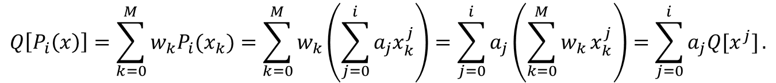
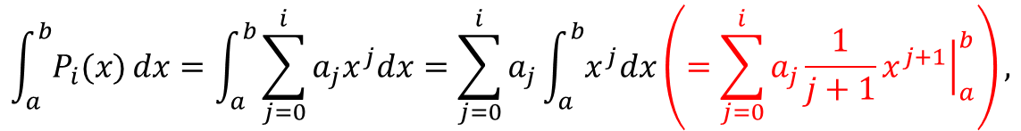

$$\int_{a}^{b}{P_{i}(x)}dx=\int_{a}^{b}{\sum_{j=0}^{i}{a_{j}x^{j}dx}}=\sum_{j=0}^{i}{a_{j}\int_{a}^{b}{x^{j}dx}}\left(=\sum_{j=0}^{i}{a_{j}\frac{1}{j+1}{\left.x^{j+1}\right|}_{a}^{b}}\right),$$
Since
and
$$Q\left[P_{i}\left(x\right)\right]=\sum_{k=0}^{M}{w_{k}P_{i}(x_{k})}=\sum_{k=0}^{M}{w_{k}\left(\sum_{j=0}^{i}{a_{j}x_{k}^{j}}\right)}=\sum_{j=0}^{i}{a_{j}\left(\sum_{k=0}^{M}{w_{k}}x_{k}^{j}\right)}=\sum_{j=0}^{i}{a_{j}Q[x^{j}]}.$$
We want to prove that $Q\left[P_{i}\left(x\right)\right]=\int_{a}^{b}{P_{i}(x)}dx,$
it’s just to prove that $Q\left[x^{j}\right]=\int_{a}^{b}{x^{j}dx}$ , for j = 0,1, …, i.
That means we can prove the precision of Q[ f ] is n by proving that Q[ f ] is exact for all x ^{j}, j=0, 1, …, n.

Slide 13
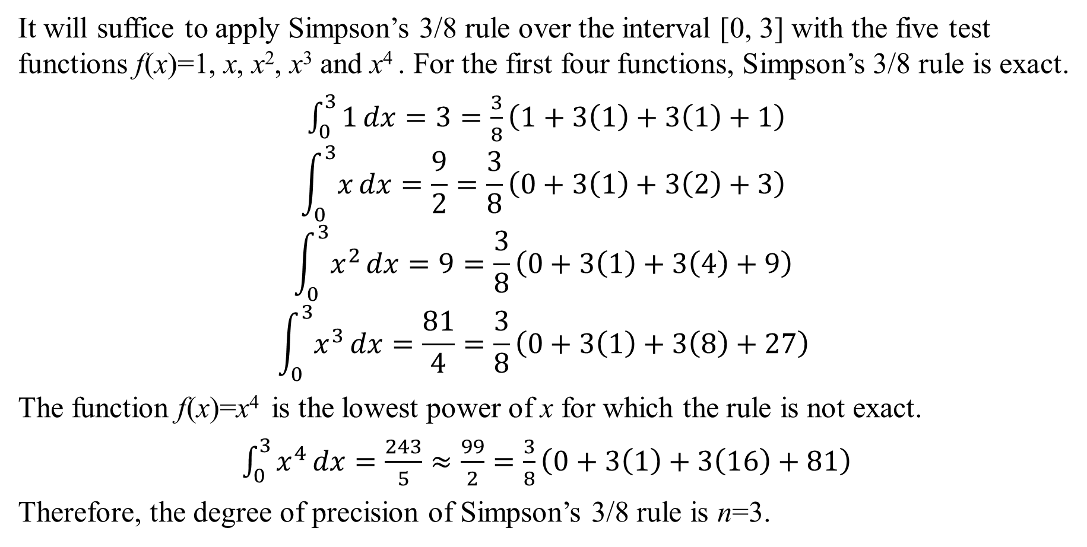
Example 5.4. Determine the degree of precision of Simpson’s 3/8 rule.
It will suffice to apply Simpson’s 3/8 rule over the interval [0, 3] with the five test functions f(x)=1, x, x², x³ and x⁴ . For the first four functions, Simpson’s 3/8 rule is exact.
$\int_{0}^{3}{1}dx=3=\frac{3}{8}\left(1+3\left(1\right)+3\left(1\right)+1\right)$
$$\int_{0}^{3}{x}dx=\frac{9}{2}=\frac{3}{8}\left(0+3\left(1\right)+3\left(2\right)+3\right)$$
$$\int_{0}^{3}{x^{2}}dx=9=\frac{3}{8}\left(0+3\left(1\right)+3\left(4\right)+9\right)$$
$$\int_{0}^{3}{x^{3}}dx=\frac{81}{4}=\frac{3}{8}\left(0+3\left(1\right)+3\left(8\right)+27\right)$$
The function f(x)=x⁴ is the lowest power of x for which the rule is not exact.
$\int_{0}^{3}{x^{4}}dx=\frac{243}{5}≈\frac{99}{2}=\frac{3}{8}\left(0+3\left(1\right)+3\left(16\right)+81\right)$
Therefore, the degree of precision of Simpson’s 3/8 rule is n=3.

Slide 14
Newton-Cotes Precision
Corollary 5.1. Assume that f(x) is sufficiently differentiable; then E[f] for Newton-Cotes quadrature involves an appropriate higher derivative.
The trapezoidal rule has degree of precision n=1. If f∈C²[a,b], then
Simpson’s rule has degree of precision n=3. If f∈C⁴[a,b], then
Simpson’s 3/8 rule has degree of precision n=3. If f∈C⁴[a,b], then
Boole’s rule has degree of precision n=5. If f∈C⁶[a,b], then

Slide 15
The Step Sizes
In Example 5.1 we applied the quadrature rules with h=0.5. If the endpoints of the interval [a, b] are held fixed, the step size must be adjusted for each rule. The step sizes are h=b-a, h=(b-a)/2, h=(b-a)/3, and h=(b-a)/4 for the trapezoidal rule, Simpson’s rule, Simpson’s 3/8 rule, and Boole’s rule, respectively. The next example illustrates this point.
Example 5.2. Consider the integration of the function f(x)=1+e^{-x}sin(4x) over the fixed interval [a, b]=[0, 1]. Apply the first four closed Newton-Cotes quadrature formulas on it.

Slide 16
For the trapezoidal rule, h=1 and
For Simpson’s rule, h=1/2, and we get
For Simpson’s 3/8 rule, h=1/3, and we obtain
For Boole’s rule, h=1/4, and the result is

Slide 17
The true value of the definite integral is
The trapezoidal rule yields the approximation 0.86079
Simpson’s rule yields the approximation 1.32128
Simpson’s 3/8 rule yields the approximation 1.31440
Boole’s rule yields the approximation 1.30859

Slide 18
Comparison of Quadrature Methods
To make a fair comparison of Quadrature methods, we must use the same number of function evaluations in each method.
The final example is concerned with comparing integration over a fixed interval [a, b] using exactly five function evaluations f_{k}=f(x_{k}), for k=0, 1, …, 4 for each method. When the trapezoidal rule is applied on the four subintervals [x₀, x₁], [x₁, x₂], [x₂, x₃], and [x₃, x₄], it is called a composite trapezoidal rule. Simpson’s rule can also be used in this manner. When Simpson’s rule is applied on the two subintervals [x₀, x₂] and [x₂,x₄], it is called a composite Simpson’s rule.

Slide 19
Composite Formulas
Example 5.3. Consider the integration of the function f(x)=1+e^{-x}sin(4x) over [a, b]=[0, 1]. Use exactly five function evaluations and compare the results from the composite trapezoidal rule, composite Simpson’s rule, and Boole’s rule. The uniform step size is h=1/4.
The composite trapezoidal rule is
The composite Simpson’s rule is

Slide 20
The composite trapezoidal rule produces
The composite Simpson’s rule produces
The result of Boole’s rule is
The true value of the integral is
Obviously, the approximation from Boole’s rule is the closest.

Slide 21
The composite trapezoidal rule yields the approximation 1.28358
The composite Simpson’s rule yields the approximation 1.30938

Slide 22
Composite Quadrature Formulas
In theoretical mathematics, the geometric meaning of integration of the function y=f (x) over [a, b] is the area under the curve over the interval.
The idea of integration is subdivision-sum-limitation.
An intuitive method of finding the area under the curve y=f(x) over [a, b] is by approximating that area with a series of trapezoids that lie above the intervals {[x_{k}, x_{k+1}]}.
Essentially, finite is used to approximate infinite.

Slide 23
Composite Trapezoidal Rule
Thm.5.2. Suppose that the interval [a, b] is subdivided into M sub-intervals [x_{k}, x_{k+1}] of width h=(b-a)/M by using the equally spaced nodes x_{k}=a+kh, for k=0,1,…,M. The composite trapezoidal rule for M subintervals can be expressed in any of three equivalent ways:
This is an approximation to the integral of f (x) over [a, b], and we write

Slide 24
Piecewise Linear Interpolation
Composite Trapezoid Rule
f(x)
x₀
h
x₁
h
x₂
h
x₃
h
x₄
x

Slide 25
Composite Trapezoid Rule
The true value is I=5216.926477323024…
Evaluate the integral

Slide 26
Composite Simpson’s Rule
Thm. 5.3. Suppose that [a, b] is subdivided into 2M subintervals [x_{k}, x_{k+1}] of equal width h=(b-a)/(2M) by using x_{k}=a+kh, for k=0,1,…,2M. The composite Simpson’s rule for M subintervals [x_{k}, x_{k+2}] can be expressed in any of three equivalent ways:
This is an approximation to the integral of f (x) over [a, b], and we write

Slide 27
Composite Simpson’s Rule
Piecewise Quadratic Approximations
f(x)
…...
x₀
h
x₁
x
h
x₂
h
x₃
h
x₄
x_{n-2}
x_{n-1}
x_{n}

Slide 28
Composite Simpson’s Rule
Multiple applications of Simpson’s rule

Slide 29
Composite Simpson’s Rule
The true value is I=5216.926477323024…
Evaluate the integral
n = 2, h = 2
n = 4, h = 1

Slide 30
Error Analysis
The significance of the next two results is to understand that the error terms E_{T}( f , h) and E_{S}( f , h) for the composite trapezoidal rule and composite Simpson’s rule are of the order O(h²) and O(h⁴).
The error for Simpson’s rule converges to zero faster than the error for the trapezoidal rule as the step size h decreases to zero.
How to estimate the number of subinterval required to achieve a specified accuracy when the derivatives of f(x) are known?

Slide 31
Trapezoidal Rule: Error Analysis
Corollary 5.2. Suppose that [a, b] is subdivided into M subintervals [x_{k}, x_{k+1}] of width h=(b-a)/M. The composite trapezoidal rule
is an approximation to the integral
Furthermore, if f ∈C²[a,b], there exists a value c with a<c<b so that the error term E_{T}( f , h) has the form

Slide 32
Simpson’s Rule: Error Analysis
Corollary 5.3. Suppose that [a, b] is subdivided into 2M subintervals [x_{k}, x_{k+1}] of width h=(b-a)/(2M). The composite trapezoidal rule
is an approximation to the integral
Furthermore, if f ∈C⁴[a,b], there exists a value c with a<c<b so that the error term E_{S}( f , h) has the form

Slide 33
Example 7.7&7.8
Consider . Investigate the error when the composite trapezoidal rule and Simpson’s rule are used over [1, 6] and the number of subintervals is 10, 20, 40, 80, and 160. The true value is I=8.18347920766273…
M | h | T(f,h) | E_{T}(f,h)=O(h²) | S(f,h) | E_{s}(f,h) =O(h⁴)
10 | 0.5 | 8.19385457 | -0.01037540 | 8.18301549 | 0.00046371
20 | 0.25 | 8.18604926 | -0.00257006 | 8.18344750 | 0.00003171
40 | 0.125 | 8.18412019 | -0.00064098 | 8.18347717 | 0.00000204
80 | 0.0625 | 8.18363936 | -0.00016015 | 8.18347908 | 0.00000013
160 | 0.03125 | 8.18351924 | -0.00004003 | 8.18347920 | 0.00000001
The results in the table shows that when h is reduced by a factor of ½ the successive errors E_{T}(f,h) are diminished by approximately ¼ while E_{s}(f,h) are diminished by approximately 1/16. These confirm that the orders are O(h²) and O(h⁴) respectively.

Slide 34
Determing the Number of Subintervals by Using the Error Order
Example 5.9&5.10 Find the number M and the step size h so that the errors E_{T}( f ,h) for the composite trapezoidal rule and E_{S}( f ,h) for the composite Simpson’s rule are less than 5×10⁻⁹ respectively for the approximation .
For the composite trapezoidal rule: M=22822, h=5/22822=0.000219086846.
For the composite Simpson’s rule:M=113, h=5/113=0.02212389381.
So we see that the composite rule using 227 evaluations of f(x) and the composite trapezoidal rule using 22823 evaluations of f(x) achieve the same accuracy. Simpson’s rule required about 1% the number of function evaluations of the trapezoidal rule.

Slide 35
Recursive Rules and Romberg Integration
How to compute a high order formula with a special linear combination of a low order formula?
The approximation will have greater accuracy if one uses a larger number of subintervals. How many should we choose?
We can try two subintervals, four subintervals, and so on, until the desired accuracy is obtained.
First, a sequence {T(J)} of trapezoidal rule approximations must be generated in the process.

Slide 36
T(0) is the area under 2⁰=1 trapezoid
T(1) is the area under 2¹=2 trapezoids
T(2) is the area under 2²=4 trapezoids
T(3) is the area under 2³=8 trapezoids

Slide 37
Successive Trapezoidal Rules
Thm. 5.4. Suppose that J ≥1 and the points {x_{k}=a+kh} subdivide [a, b] into 2^{J}=2M subintervals of equal width h=(b-a)/2^{J}. The trapezoidal rules T( f ,h) and T( f ,2h) obey the relationship
Sequence of Trapezoidal Rules. Define T(0)=(h/2)(f(a)+f(b)), which is the trapezoidal rule with step size h=b-a. Then for each J≥1 define T(J)=T(f, h), where T(f, h) is the trapezoidal rule with step size h=(b-a)/2^{J}.

Slide 38
Recursive Trapezoidal Rule
Corollary 5.4. Start with T(0)=(h/2)(f(a)+f(b)). Then a sequence of trapezoidal rules {T(J )} is generated by the recursive formula
for J =1, 2, …，where h=(b-a)/2^{J} and {x_{k}=a+kh}.

Slide 39
Example 5.11. Use the sequential trapezoidal rule to compute the approximations T(0), T(1), T(2), and T(3) for the integral
Only evaluations of f (x) at 9 points are needed, and the calculation is gradually increased according to the recursion

Slide 40
Recursive Simpson Rules
Thm. 5.5. Suppose that {T(J)} is the sequence of trapezoidal rules generated by Corollary 5.4. If J ≥1 and S(J) is Simpson’s rule for 2^{J} subintervals of [a, b], then S(J) and the trapezoidal rules T(J-1) and T(J) obey the relationship

Slide 41
Example 5.12. Use the sequential Simpson’s rule to compute the approximations S(1), S(2), and S(3) for the integral
Combining of the results of sequential trapezoidal rule obtains the sequential Simpson’s rule. The error is decreased from O(h²) to O(h⁴).

Slide 42
Recursive Boole’s Rules
When it is applied M times over 4M equally spaced subintervals of [a, b] of step size h=(b-a)/(4M), we call it the composite Boole’s rule：
Thm. 5.6. Suppose that {S(J)} is the sequence of Simpson’s rules generated by Thm. 5.5. If J ≥2 and B(J) is Boole’s rule for 2^{J} subintervals of [a, b], then B(J) and Simpson’s rules S(J-1) and S(J) obey the relationship

Slide 43
Example 5.13. Use the sequential Boole’s rule to compute the approximations B(2) and B(3) for the integral
Combining of the results of sequential Simpson’s rule obtains the sequential Boole’s rule. The error is decreased from O(h⁴) to O(h⁶).
Combining of the results of sequential Boole’s rule obtains the formula of higher order. The error is decreased from O(h⁶) to O(h⁸) and the answer gives an accuracy of five decimal places.

Slide 44
Romberg Integration
The pattern for the remainders aboved is extended in the following sense. Suppose that an approximation rule is used with step sizes h and 2h; then an algebraic manipulation of improvement increases the order of the error term from O(h^{2N}) to O(h^{2N+2}). This process, called Romberg integration, has its strengths and weakness.

Slide 45
Strengths and Weakness
The Newton-Cotes rules are seldom used past Boole’s rule because all the rules past the 9-point rule involve negative weights which could introduce loss of significance error due to round off.
The Romberg method has the advantages that all the weights are positive and the equally spaced abscissas are easy to compute.
A computational weakness of Romberg integration is that twice as many function evaluations are needed to decrease the error from O(h^{2N}) to O(h^{2N+2}).
The use of the sequential rules will help keep the number of computations down.

Slide 46
Richardson’s Improvement for Romberg Integration
Lemma 5.1. Given two approximation R(h,K-1) and R(h/2,K-1) for the quantity Q that satisfy Q=R(h,K-1)+c₁h^{2K}+c₂h^{2K+2}+… and Q=R(h/2,K-1)+c₁h^{2K}/4^{K}+c₂h^{2K+2}/4^{K+1}+…, an improved approximation has the form
Def. 5.4. Define the sequence of quadrature formulas for f(x) over [a,b] as follows:
R(J,0)=T(J) for J ≥0, is the sequential trapezoidal rule.
R(J,1)=S(J) for J ≥1, is the sequential Simpson’s rule.
R(J,2)=B(J) for J ≥2, is the sequential Boole’s rule.

Slide 47
Romberg Integration Tableau
R(J,0)
Trapezoidal rule
R(J,1)
Simpson’s rule
R(J,2)
Boole’s rule
R(J,3)
Third improvement
R(J,4)
Fourth improvement
J
0
R(0,0)
1
R(1,0)
R(1,1)
2
R(2,0)
R(2,1)
R(2,2)
3
R(3,0)
R(3,1)
R(3,2)
R(3,3)
4
R(4,0)
R(4,1)
R(4,2)
R(4,3)
R(4,4)

Slide 48
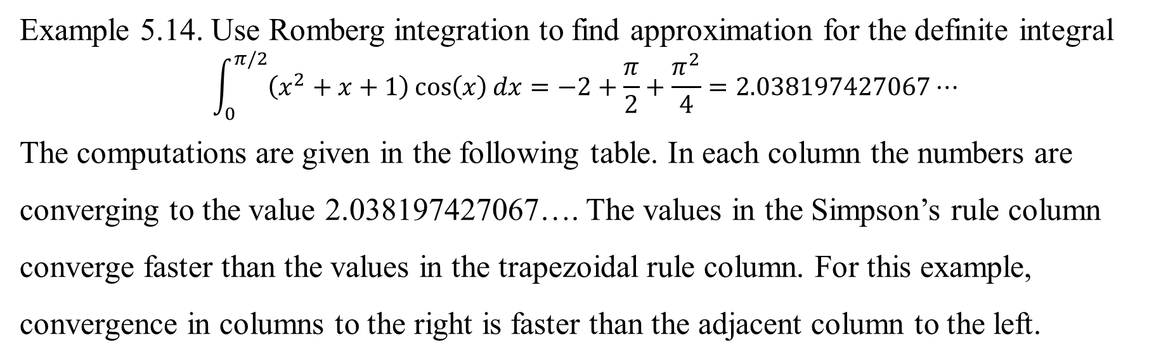
Example 5.14. Use Romberg integration to find approximation for the definite integral
$$\int_{0}^{π/2}{\left(x^{2}+x+1\right)\cos\left(x\right)dx}=−2+\frac{π}{2}+\frac{π^{2}}{4}=2.038197427067⋯$$
The computations are given in the following table. In each column the numbers are converging to the value 2.038197427067…. The values in the Simpson’s rule column converge faster than the values in the trapezoidal rule column. For this example, convergence in columns to the right is faster than the adjacent column to the left.
J | R(J,0)梯形公式 | R(J,1)辛普森公式 | R(J,2)布尔公式 | R(J,3)第3次改进
0 | 0.785398163397
1 | 1.726812656758 | 2.040617487878
2 | 1.960534166564 | 2.038441336499 | 2.038296259740
3 | 2.018793948078 | 2.038213875249 | 2.038198711166 | 2.038197162776
4 | 2.033347341805 | 2.038198473047 | 2.038197446234 | 2.038197426156
5 | 2.036984954990 | 2.038197492719 | 2.038197427363 | 2.038197427064

Slide 49
Romberg Error Tableau for Example 5.14
J | h | E(J,0)=O(h²) | E(J,1)=O(h⁴) | E(J,2)=O(h⁶) | E(J,3)=O(h⁸)
0 | b-a | -1.252799263670
1 | (b-a)/2 | -0.311384770309 | 0.002420060811
2 | (b-a)/4 | -0.077663260503 | 0.000243909432 | 0.000098832673
3 | (b-a)/8 | -0.019403478989 | 0.000016448182 | 0.000001284099 | -0.000000264291
4 | (b-a)/16 | -0.004850085262 | 0.000001045980 | 0.000000019167 | -0.000000000912
5 | (b-a)/32 | -0.001212472077 | 0.000000065651 | 0.000000000296 | -0.000000000003
1/4
1/16
1/64
1/256
The error in column K of the Romberg table diminishes by about a factor of 1/2^{2K+2}=1/4^{K+1}的as one progresses down its rows. Hence, the speed of convergence is R(J,0)<R(J,1)<R(J,2)<R(J,3).

Slide 50
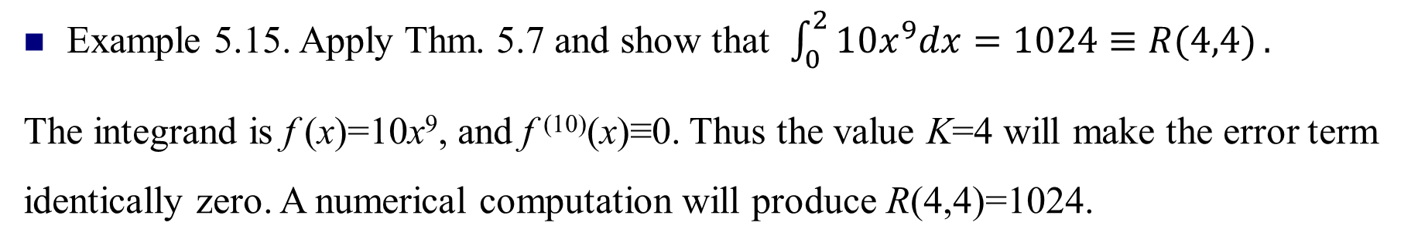
Precision of Romberg Integration
Thm. 5.7. Assume that f∈C^{2K+2}[a,b]. Then the truncation error term for the Romberg approximation is given in the formula
where h=(b-a)/2^{J} is a constant that depends on K and c_{J, K}∈[a, b].
Example 5.15. Apply Thm. 5.7 and show that $\int_{0}^{2}{10x^{9}dx=1024≡R(4,4)}.$
The integrand is f (x)=10x⁹, and f ⁽¹⁰⁾(x)≡0. Thus the value K=4 will make the error term identically zero. A numerical computation will produce R(4,4)=1024.
2020/7/30

