Slide 1
Chapter 4.
Curve Fitting

Slide 2
Curve Fitting
Application of numerical techniques in science and engineering often involve curve fitting of experimental data.
In science and engineering it is often the case that an experiment produces a set of data points (x₁,y₁),…,(x_{N},y_{N}), where the abscissas {x_{k}} are distinct. If all the numerical values {x_{k}}, {y_{k}} are known to several significant digits of accuracy, then polynomial interpolation can be used successfully; otherwise, it cannot.
However, many experiments are done with equipment that is reliable only to three or fewer digits of accuracy. Often, there is an experimental error in the measurements.
How do we find the best approximation that goes near (not always through) the points?

Slide 3
Measures for Errors (Deviations or Residuals)
Denote e_{k}=f(x_{k})-y_{k} for 1≤k≤N
Maximum error:
Average error:
Root-mean-square error:

Slide 4
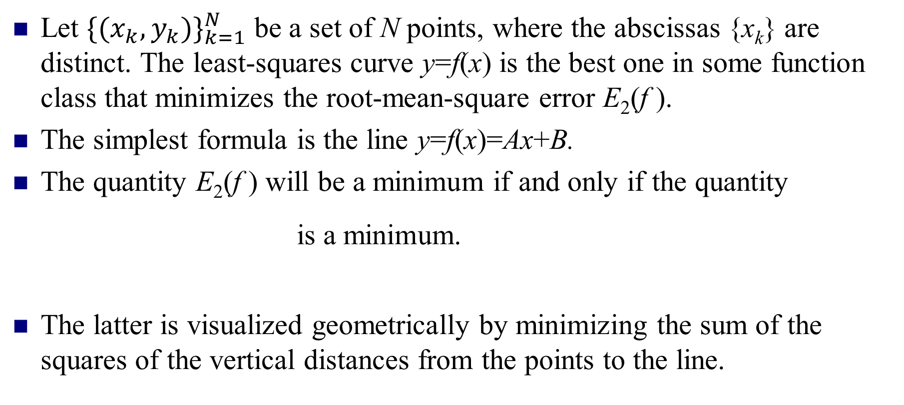
Finding the Least-Squares Curve
Let ${\{(x_{k},y_{k})\}}_{k=1}^{N}$ be a set of N points, where the abscissas {x_{k}} are distinct. The least-squares curve y=f(x) is the best one in some function class that minimizes the root-mean-square error E₂(f ).
The simplest formula is the line y=f(x)=Ax+B.
The quantity E₂(f ) will be a minimum if and only if the quantity
is a minimum.
The latter is visualized geometrically by minimizing the sum of the squares of the vertical distances from the points to the line.

Slide 5
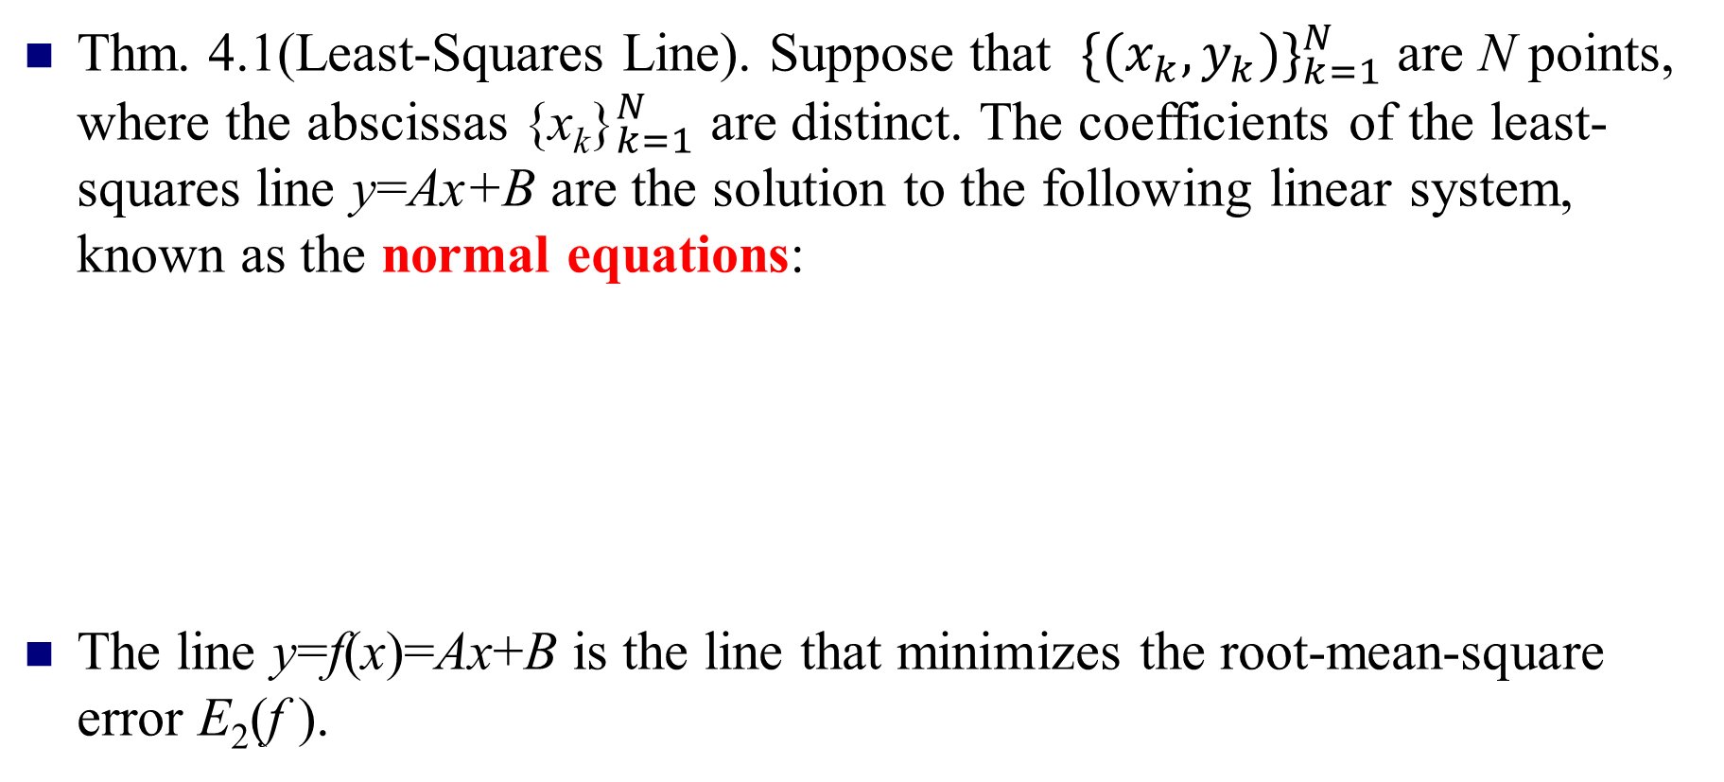
The Least-Squares Line
Thm. 4.1(Least-Squares Line). Suppose that ${\{(x_{k},y_{k})\}}_{k=1}^{N}$ are N points, where the abscissas ${\text{\{}\text{x}\text{k}\text{\}}}_{k=1}^{N}$ are distinct. The coefficients of the least-squares line y=Ax+B are the solution to the following linear system, known as the normal equations:
The line y=f(x)=Ax+B is the line that minimizes the root-mean-square error E₂(f ).

Slide 6
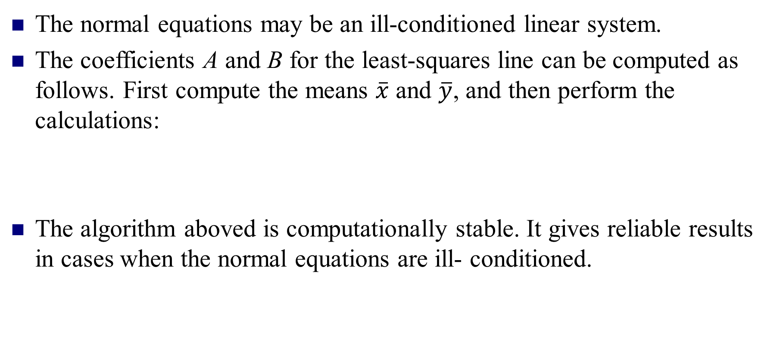
Soluting the Normal Equations
The normal equations may be an ill-conditioned linear system.
The coefficients A and B for the least-squares line can be computed as follows. First compute the means $\overline{x}$ and $\overline{y}$, and then perform the calculations:
The algorithm aboved is computationally stable. It gives reliable results in cases when the normal equations are ill- conditioned.

Slide 7
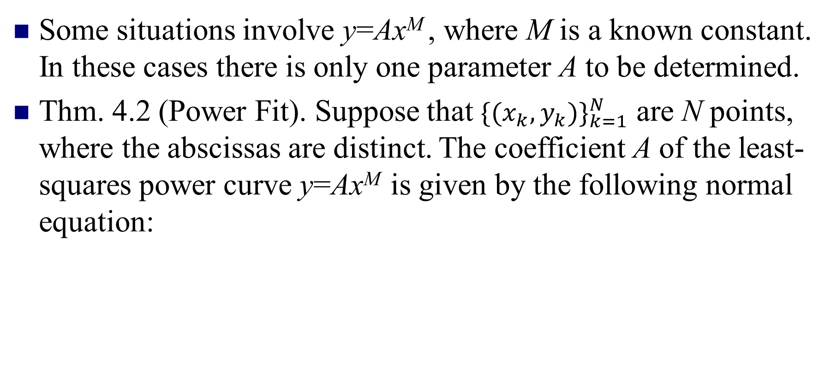
Power Fit y=Ax^{M}
Some situations involve y=Ax^{M} , where M is a known constant. In these cases there is only one parameter A to be determined.
Thm. 4.2 (Power Fit). Suppose that ${\{(x_{k},y_{k})\}}_{k=1}^{N}$ are N points, where the abscissas are distinct. The coefficient A of the least-squares power curve y=Ax^{M} is given by the following normal equation:

Slide 8
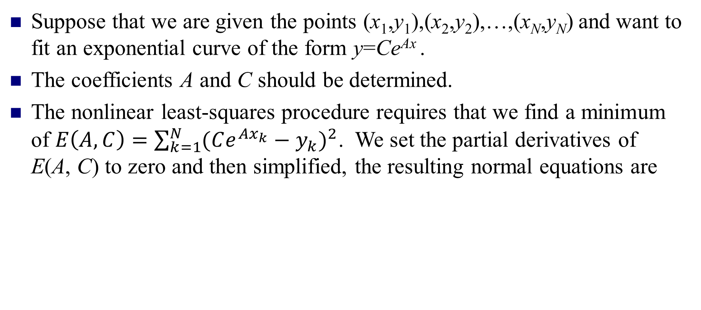
Methods of Curve Fitting
Suppose that we are given the points (x₁,y₁),(x₂,y₂),…,(x_{N},y_{N}) and want to fit an exponential curve of the form y=Ce^{Ax} .
The coefficients A and C should be determined.
The nonlinear least-squares procedure requires that we find a minimum of $E\left(A,C\right)=\sum_{k=1}^{N}{{(Ce^{Ax_{k}}−y_{k})}^{2}}$. We set the partial derivatives of E(A, C) to zero and then simplified, the resulting normal equations are

Slide 9
Data Linearization Method for y=Ce^{Ax} :
Take the logarithm of both sides: ln(y)=Ax+ln(C).
Introduce the change of variables: Y=ln(y), X=x, and B=ln(C).
A linear relation between the new variables X and Y: Y=AX+B.
The original points (x_{k},y_{k}) in the xy-plane are transformed into the points (X_{k},Y_{k})=(x_{k},ln(y_{k})) in the XY-plane. This process is called data linearization. Then the least-squares line is fit to the points {(X_{k}, Y_{k})}. The normal equations for finding A and B are

Slide 10
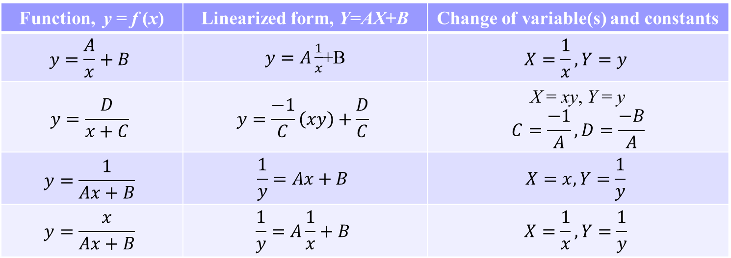
Transformations for Data Linearization
The technique of data linearization has been used to fit curves.
Once the curve has been chosen, a suitable transformation of the variables must be found so that a linear relation is obtained.
Function, y = f (x) | Linearized form, Y=AX+B | Change of variable(s) and constants
$$y=\frac{A}{x}+B$$ | $y=A\frac{1}{x}$+B | $$X=\frac{1}{x},Y=y$$
$$y=\frac{D}{x+C}$$ | $$y=\frac{−1}{C}\left(xy\right)+\frac{D}{C}$$ | X = xy, Y = y $$C=\frac{−1}{A}, D=\frac{−B}{A}$$
$$y=\frac{1}{Ax+B}$$ | $$\frac{1}{y}=Ax+B$$ | $$X=x, Y=\frac{1}{y}$$
$$y=\frac{x}{Ax+B}$$ | $$\frac{1}{y}=A\frac{1}{x}+B$$ | $$X=\frac{1}{x}, Y=\frac{1}{y}$$
(c)

Slide 11
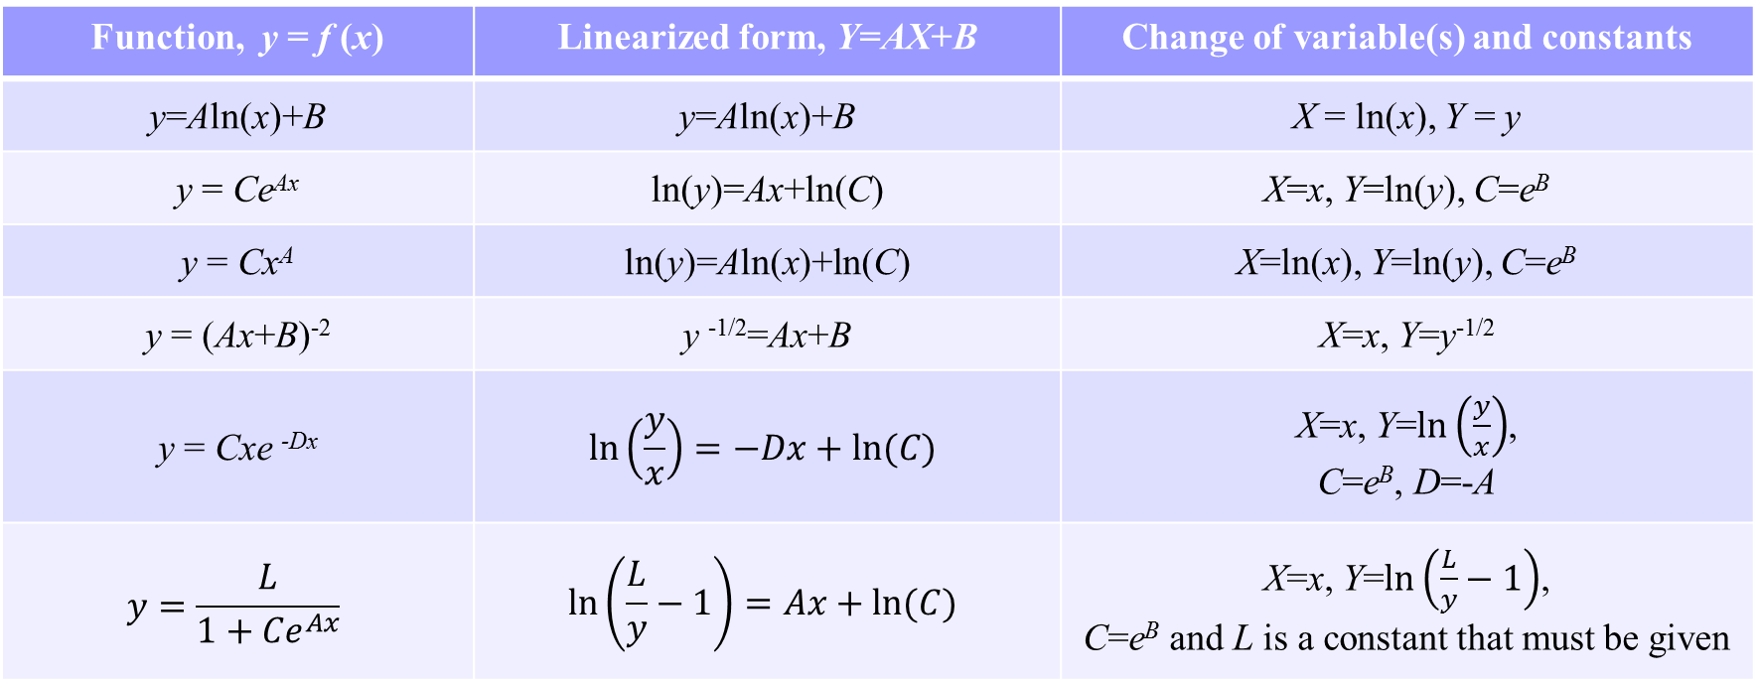
Function, y = f (x) | Linearized form, Y=AX+B | Change of variable(s) and constants
y=Aln(x)+B | y=Aln(x)+B | X = ln(x), Y = y
y = Ce^{Ax} | ln(y)=Ax+ln(C) | X=x, Y=ln(y), C=e^{B}
y = Cx^{A} | ln(y)=Aln(x)+ln(C) | X=ln(x), Y=ln(y), C=e^{B}
y = (Ax+B)⁻² | y ^{-1/2}=Ax+B | X=x, Y=y^{-1/2}
y = Cxe ^{-Dx} | $$\ln\left(\frac{y}{x}\right)=−Dx+ln⁡(C)$$ | X=x, Y=$\ln\left(\frac{y}{x}\right)$, C=e^{B}, D=-A
$$y=\frac{L}{1+{Ce}^{Ax}}$$ | $$\ln\left(\frac{L}{y}−1\right)=Ax+ln⁡(C)$$ | X=x, Y=$\ln\left(\frac{L}{y}−1\right)$, C=e^{B} and L is a constant that must be given
(a)
(b)

Slide 12
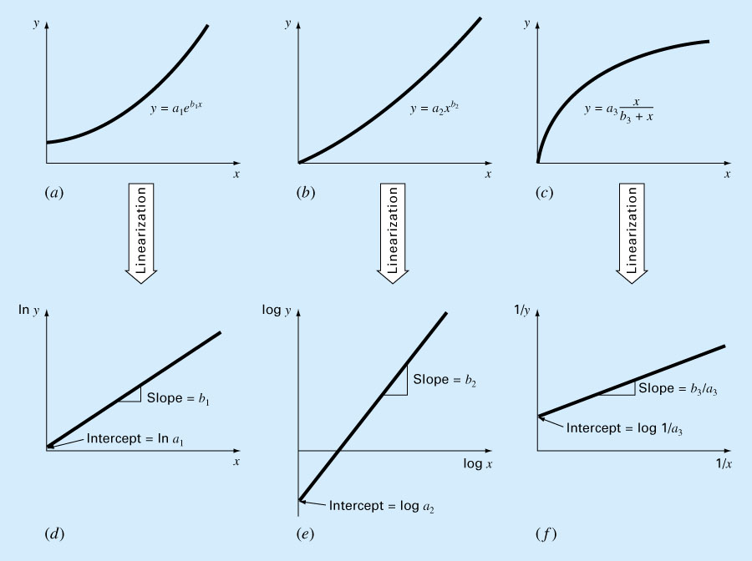
Data Linearization

Slide 13
Linear Least Squares
Suppose that N data points {(x_{k},y_{k})} and a set of M linear independent functions {f_{j}(x)} are given. We want to find M coefficients {c_{j}} so that the function f(x) given by the linear combination
will minimize the sum of the squares of the errors:

Slide 14
For E to be minimized it is necessary that each partial derivative be zero(i.e., ), and this results in the system of equations
Interchanging the order of the summations in the equations aboved will produce an M×M system of linear equations where the unknown are the coefficients {c_{j}}. They are called the normal equations:
for i=1,2,…,M.
for i=1,2,…,M.
(4.40)

Slide 15
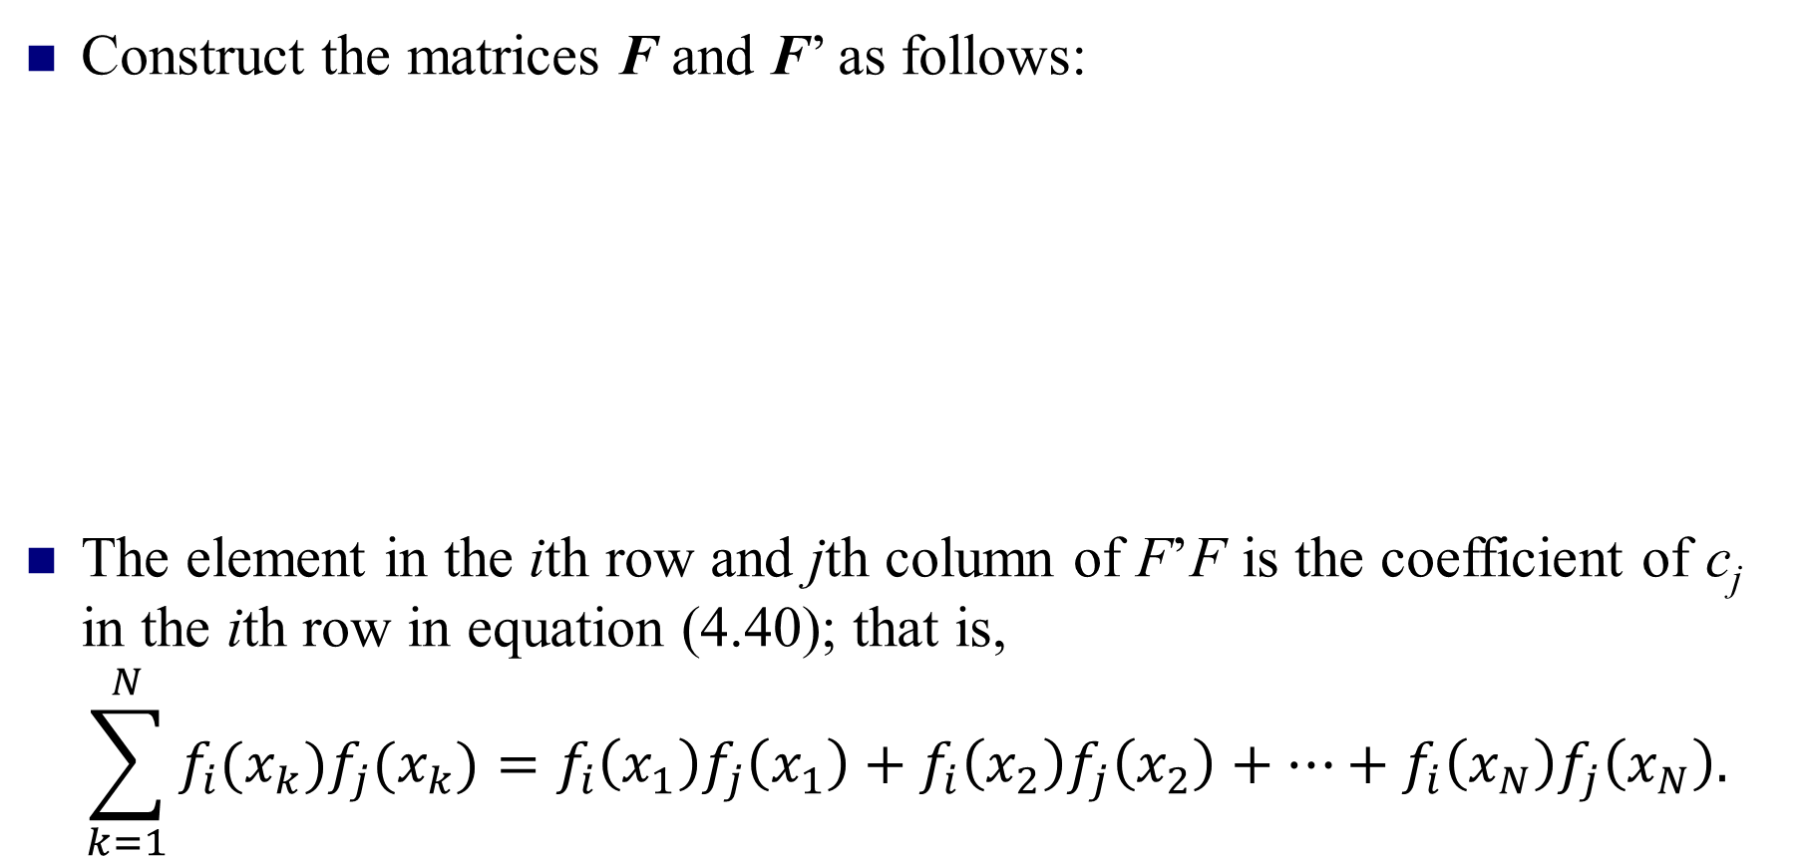
Matrix Formulation
Construct the matrices F and F’ as follows:
The element in the ith row and jth column of F’F is the coefficient of c_{j} in the ith row in equation (4.40); that is,
$$\sum_{k=1}^{N}{f_{i}(x_{k})f_{j}(x_{k})}=f_{i}\left(x_{1}\right)f_{j}\left(x_{1}\right)+f_{i}\left(x_{2}\right)f_{j}\left(x_{2}\right)+…+f_{i}\left(x_{N}\right)f_{j}\left(x_{N}\right).$$

Slide 16
Denote Y=[y₁ y₂ … y_{N}]’，C=[c₁ c₂ … c_{M}]’. Then the problem of solving the normal equation can be expressed as a matrix formula as follows:
F’FC=F’Y,
where F’F is an M×M system of linear equations, C is a vector with M unknowns coefficients, and F’Y is a known vector producted by the matrix F and the vector Y.

Slide 17
Polynomial Fitting
When the foregoing method is adapted to using functions {f_{j}(x)=x^{j-1}}, for j=1,…, M+1, the function f(x) will be a polynomial of degree M: f(x)=c₁+c₂x+c₃x²+…+c_{M+1}x^{M}.
It is tempting to use a least-squares polynomial to fit data that are nonlinear. But if the data do not exhibit a polynomial nature, the resulting curve may exhibit large oscillations. This phenomenon, called polynomial wiggle, becomes more pronounced with higher-degree polynomials. For this reason we seldom use a polynomial of degree 6 or above unless it is known that the true function we are working with is a polynomial.

Slide 18
Using Polynomials to Fit Data
f (x)
P₂(x)
P₃(x)
P₄(x)
P₅(x)

Slide 19
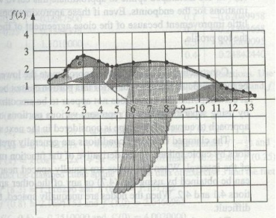
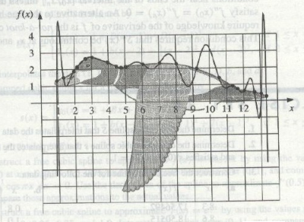
polynomial wiggle
Cubic Splines Interpolation
Lagrange Interpolation

Slide 20
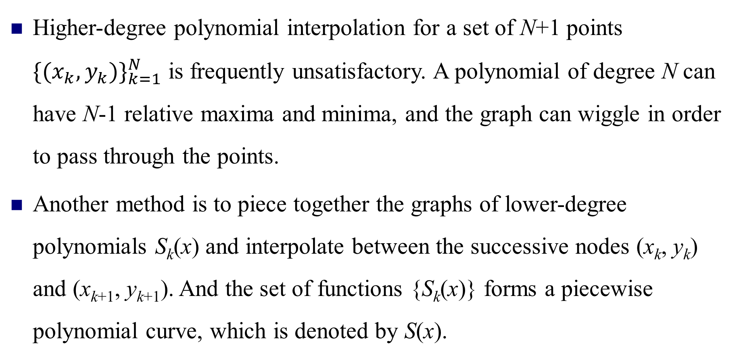
4.3 Interpolation by Spline Functions
Higher-degree polynomial interpolation for a set of N+1 points ${\{(x_{k},y_{k})\}}_{k=1}^{N}$ is frequently unsatisfactory. A polynomial of degree N can have N-1 relative maxima and minima, and the graph can wiggle in order to pass through the points.
Another method is to piece together the graphs of lower-degree polynomials S_{k}(x) and interpolate between the successive nodes (x_{k}, y_{k}) and (x_{k+1}, y_{k+1}). And the set of functions {S_{k}(x)} forms a piecewise polynomial curve, which is denoted by S(x).

Slide 21
Piecewise Linear Interpolation
The simplest polynomial to use, a polynomial of degree 1, produces a polygonal path that consists of line segments that pass through the points.
The Lagrange polynomial is used to represent this piecewise linear curve:
The resulting curve looks like a broken line.
for x_{k}≤x≤x_{k+1}.

Slide 22
Piecewise Linear Interpolation (A Linear Spline)
(x_{k-1}, y_{k-1})
(x_{k+1}, y_{k+1})
(x₂, y₂)
(x_{k}, y_{k})
(x_{N}, y_{N})
(x_{N-1}, y_{N-1})
(x₀, y₀)
(x₁, y₁)
x₀
x₁
x₂
x_{k-1}
x_{k}
x_{k+1}
x_{N-1}
x_{N}

Slide 23
Piecewise Linear Interpolation
An equivalent expression can be obtained if we use the point-slope formula for a line segment. The resulting linear spline function can be written in the form
for x in [x₀, x₁],
for x in [x₁, x₂],
…
for x in [x_{k}, x_{k+1}],
…
for x in [x_{N-1}, x_{N}].
where d_{k}=(y_{k+1}-y_{k})/(x_{k+1}-x_{k}).

Slide 24
Piecewise Cubic Splines
The fitting of a polynomial curve to a set of data points has application in CAD, CAM, and computer graphics systems. An operator wants to draw a smooth curve through data points that are not subject to error.
Mathematically, it is possible to construct cubic functions S_{k}(x) over each interval [x_{k}, x_{k+1}] so that the resulting piecewise curve y=S(x) and its first and second derivatives are all continuous over the larger interval [x₀,x_{N}].
S(x)
f(x)

Slide 25
Physical Background of Interpolation Spline Functions
Splines are some thin wooden strips or metal wires used by draftsmen to draw smooth curves in early aircraft and shipbuilding work. When drawing, in order to connect some known points into a smooth curve, the draftsman uses a weight to fix the spline at these points. Because the spline is elastic, it forms a smooth curve passing through these points, and you can draw the required curve along it. The mathematically imitated function is called the spline function.
From a mechanical point of view, the spline can be regarded as a thin elastic beam, and the weight is a concentrated load acting on the beam. Therefore, the process of drawing the spline curve can be abstracted as finding the bending deformation of the elastic thin beam under the action of the concentrated load.

Slide 26
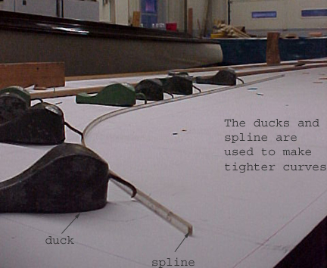

Slide 27
Definition of Spline Function
A kth degree spline S(x) is a piecewise function which is a kth degree polynomial over each subinterval divided by the nodes , and its (k-1)th derivative is continuous over the entire interval [a, b].
The curve formed by such a spline has a continuous slope and curvature at the connection point.
The cubic spline function, which is commonly used, is a third degree polynomial over each subinterval, and its second derivative is continuous over the entire interval.

Slide 28
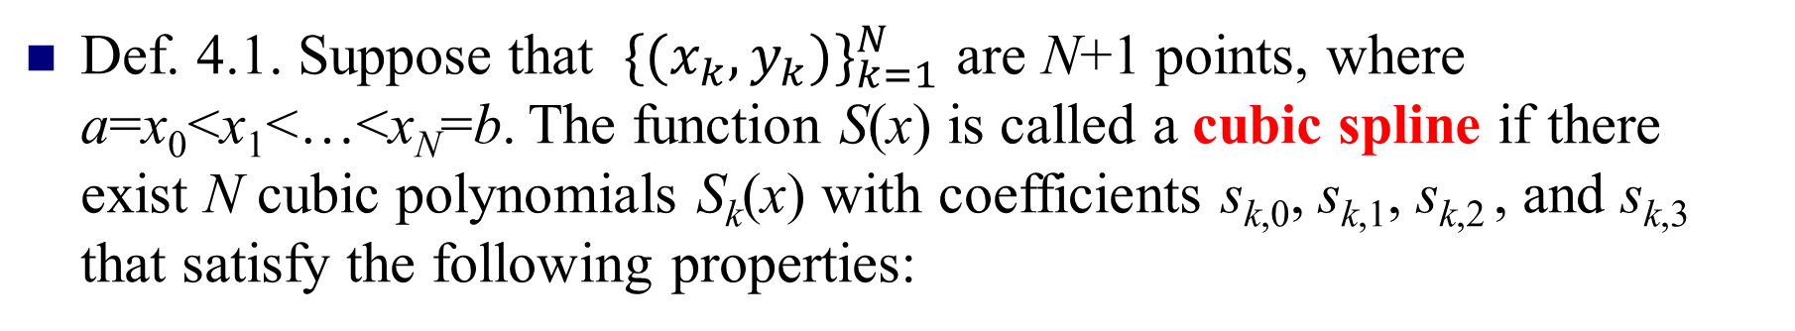
Definition of Cubic Interpolation Splines
Def. 4.1. Suppose that ${\{(x_{k},y_{k})\}}_{k=1}^{N}$ are N+1 points, where a=x₀<x₁<…<x_{N}=b. The function S(x) is called a cubic spline if there exist N cubic polynomials S_{k}(x) with coefficients s_{k,0}, s_{k,1}, s_{k,2} , and s_{k,3} that satisfy the following properties:
S(x)=S_{k}(x)=s_{k,0}+s_{k,1}(x-x_{k})+s_{k,2}(x-x_{k})²+s_{k,3}(x-x_{k})³,
x∈[x_{k} , x_{k+1}], k=0,1,…, N-1
S(x_{k})=y_{k}, k=0,1,…, N
S_{k}(x_{k+1})=S_{k+1}(x_{k+1}), k=0,1,…, N-2
S’_{k}(x_{k+1})=S’_{k+1}(x_{k+1}), k=0,1,…, N-2
S’’_{k}(x_{k+1})=S’’_{k+1}(x_{k+1}), k=0,1,…, N-2

Slide 29
Existence of Cubic Interpolation Splines
Each cubic polynomial S_{k}(x) has four unknown constants(s_{k,0}, s_{k,1}, s_{k,2} and s_{k,3}); hence there are 4N coefficients to be determined. It means that we have 4N degrees of freedom or conditions that must be specified.
The data points supply (N+1) conditions, and properties III, IV and V each supply (N-1) conditions. Hence, N+1+3(N-1)=4N-2 conditions are specified.
This leaves us two additional degrees of freedom. We will call them endpoint constraints: they will involve either S’(x) or S’’(x) at x₀ and x_{N} and will be discussed later.

Slide 30
Construction of Cubic Interpolation Splines
Since S(x) is piecewise cubic, its second derivative S’’(x) is piecewise linear on [x₀, x_{N}]. The linear Lagrange interpolation formula gives the following representation for S’’(x)=S’’_{k}(x):
Use m_{k}=S’’(x_{k}), m_{k+1}=S’’(x_{k+1}), and h_{k}=x_{k+1}-x_{k} in (4.53) to get
(4.53)
(4.54)
for x_{k}≤x≤x_{k+1}, and k=0,1,…, N-1.

Slide 31
Ingegrating (4.54) twice will introduce two constants of integration, and the result can be manipulated so that it has the form
Substituting x_{k} and x_{k+1} into equation (4.55) and using the values y_{k}=S_{k}(x_{k}) and y_{k+1}=S_{k}(x_{k+1}) yields the following equations that involve p_{k} and q_{k} :
Solving these two equations and get p_{k} and q_{k} :
(4.55)

Slide 32
Substituting p_{k} and q_{k} into equation (4.55), the result is the following expression for the cubic function S_{k}(x):
Notice that the representation (4.57) has been reduced to a form that involves only the unknown coefficients {m_{k}}. To find these values, we must use the derivative of (4.57), which is
(4.57)
(4.58)

Slide 33
Evaluating (4.58) at x_{k} and simplifying the result. Similarly, we can replace k by k-1 in (4.58) to get the expression for S’_{k-1}(x) and evaluate it at x_{k} . Then we obtain
Now use property IV and equations (4.59) and (4.60) to obtain an important relation involving m_{k-1}, m_{k}, and m_{k+1}:
(4.59)
where
(4.60)
h_{k-1}m_{k-1}+2(h_{k-1}+h_{k})m_{k}+h_{k}m_{k+1}=u_{k}
(4.61)
where u_{k}=6(d_{k}-d_{k-1}) for k=1,2,…, N-1.

Slide 34
Observe that the unknown in (4.61) are the desired values {m_{k}}, and the other terms are constants obtained by performing simple arithmetic with the data points {(x_{k}, y_{k})}. Therefore, in reality, system (4.61) is an under-determined system of N-1 linear equations involving N+1 unknowns. Hence two additional equations must be supplied.
The two additional conditions can be obtained on the endpoints. They are used to eliminate m₀ from the first equation and m_{N} from the (N-1)st equation in system (4.61). The standard strategies for the endpoint constraints are summarized in Table 4.8. With these strategies, system (4.61) used for k=2, 3, …, N-2 form N-1 linear equation involving the coefficients m₁, m₂, …, m_{N-1}.

Slide 35
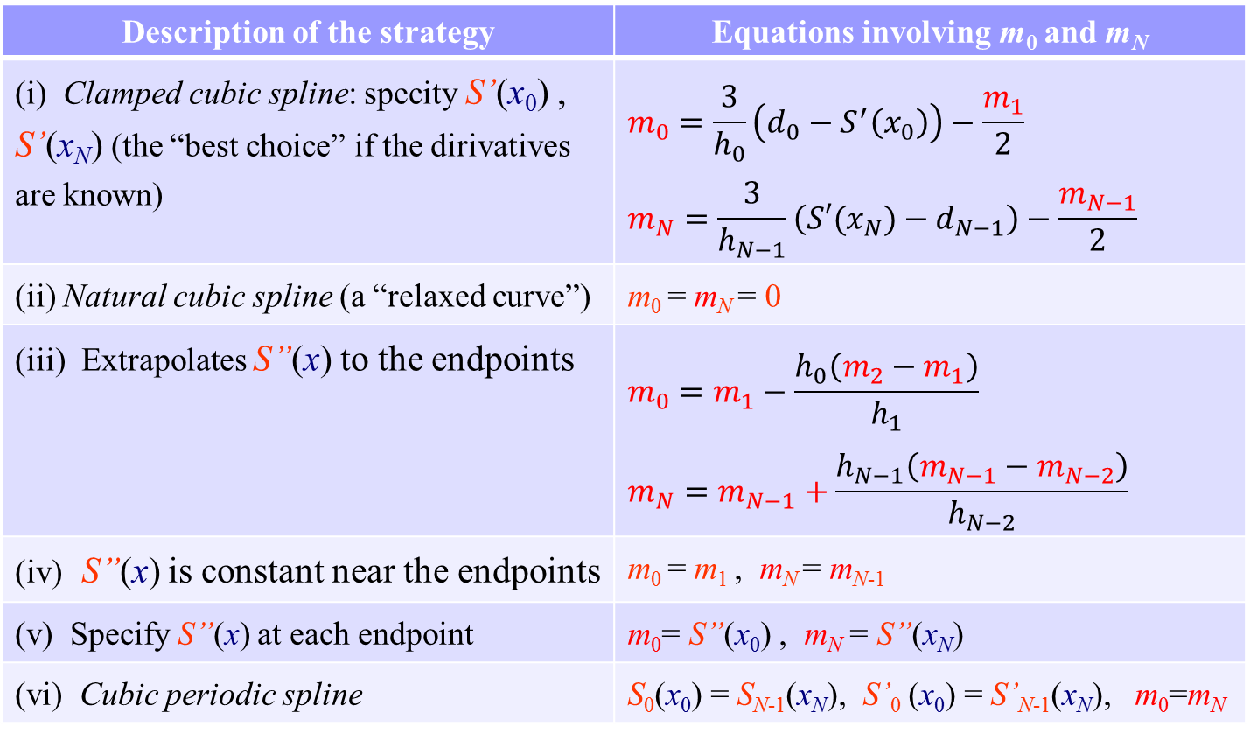
Table 4.8 Endpoint Constraints for Cubic Spline
Description of the strategy | Equations involving m₀ and m_{N}
(i) Clamped cubic spline: specity S’(x₀) , S’(x_{N}) (the “best choice” if the dirivatives are known) | $$m_{0}=\frac{3}{h_{0}}\left(d_{0}−S^{′}\left(x_{0}\right)\right)−\frac{m_{1}}{2}$$ $$m_{N}=\frac{3}{h_{N−1}}\left(S′(x_{N})−d_{N−1}\right)−\frac{m_{N−1}}{2}$$
(ii) Natural cubic spline (a “relaxed curve”) | m₀ = m_{N} = 0
(iii) Extrapolates S’’(x) to the endpoints | $$m_{0}=m_{1}−\frac{h_{0}\left(m_{2}−m_{1}\right)}{h_{1}}$$ $$m_{N}=m_{N−1}+\frac{h_{N−1}\left(m_{N−1}−m_{N−2}\right)}{h_{N−2}}$$
(iv) S’’(x) is constant near the endpoints | m₀ = m₁ , m_{N} = m_{N-1}
(v) Specify S’’(x) at each endpoint | m₀= S”(x₀) , m_{N} = S”(x_{N})
(vi) Cubic periodic spline | S₀(x₀) = S_{N-1}(x_{N}), S’₀ (x₀) = S’_{N-1}(x_{N}), m₀=m_{N}

Slide 36
Lemma 4.1(Clamped Spline). S’(a) = d₀， S’(b) = d_{N}
Substituting S’(a) = d₀ into (4.59) on [a, x₁] we get
Similarly we can use S’(b) = d_{N} on [ x_{N−1}, b ].
Lemma 4.5(Endpoint Curvature-Adjusted Spline). S”(a) = m₀， S”(b) = m_{N}
Substituting the conditions into (4.62).
Especially, m₀ = m_{N} = 0 are so-called free boundary conditions, and the corresponding spline is called Natural Spline(Lemma 4.2).

Slide 37
Lemma 4.3(Extrapolated Spline). Set
Substituting into (4.54), and let the corresponding power terms equal.
Lemma 4.4(Parabolically Terminated Spline). Set
Differentiating (4.54) and set it equal to zero we can get m₀=m₁, m_{N}=m_{N-1}.
Lemma 4.6(Periodic Spline). Set
Finally, write down the expression of the interpolation spline function in the form of piecewise polynomial.

Slide 38
Regardless of the particular strategy chosen in Table 4.8, we can rewrite equations 1 and N-1 in (4.61) and obtain a tridiagonal linear system of the form HM =V, which involves m₁, m₂, …, m_{N-1}:
where b_{j}=2(a_{j-1}+c_{j}), for j=1, …, N-1.
The coefficient matrix of the system aboved is strictly diagonally dominant, so the system which has a unique solution can be solved by the chase method.

Slide 39
Chase Method for Tridiagonal System
Suppose a tridiagonal matrix A can be factorized into the product of a lower-triangular matrix L that has 1’s along the main diagonal and an upper-triangular matrix U with nonzero diagonal elements.
Assuming that the 0 elements outside the three diagonals in A remain 0 in both L and U, the elements outside the three diagonals of the LU product are also 0. Hence, there are 3n-2 elements on the three diagonals in A that can be used to determine the elements in L and U.

Slide 40
Then the total number of undetermined elements in L and U is exactly 3n-2. From A=LU, we can get
v_{i}=c_{i}, i=1, 2, …, n-1.
u₁=b₁, l_{i}=a_{i}/u_{i-1}, u_{i}=b_{i}-l_{i}v_{i-1}, i=2, 3, …, n.
After the triangular factorization of A, L and U can be applied to solve the equation system Ax=d, which is equivalent to solving Ly=d, Ux=y in turn. The algorithm which is called chase method is as follows:
(1) u₁=b₁, v_{i}=c_{i}, i=1, 2, …, n-1. (2) l_{i}=a_{i}/u_{i-1}, u_{i}=b_{i}-l_{i}c_{i-1}, i=2,3,…,n. (3) Solve Ly=d: y₁=d₁, y_{i}=d_{i}-l_{i}y_{i-1}, i=2,3,…,n. | (4) Solve Ux=y： x_{n}=y_{n}/u_{n} x_{i}=(y_{i}-c_{i}x_{i+1})/u_{i} i=n-1, n-2,…, 1.

Slide 41
According to the Gaussian elimination process, the calculation sequence is u₁→l₂→u₂→l₃→…→l_{n}→u_{n} and y₁→y₂→…→y_{n}, then x_{n}→x_{n-1}→…→x₁. A total of (5n-4) multiplication and division operations and 3 (n-1) addition and subtraction operations are required.
To ensure that the triangular system has a unique solution, all u_{i}≠0 in the U matrix are required, which can be guaranteed when A is positive definite or strictly diagonally dominant.
Compare with the calculation amount of general equations Ax=b solved by triangulation factorization.

Slide 42
Example: Using chase method to solve the following system
(1-2):
u₁=b₁=2 | l₂=a₂/u₁=-1/2
u₂=b₂-l₂c₁=5/2 | l₃=a₃/u₂=-4/5
u₃=b₃-l₃c₂=12/5 | l₄=a₄/u₃=-5/4
u₄=b₄-l₄c₃=5/4
y₁=d₁=6 | y₂=d₂-l₂y₁=4
y₃=d₃-l₃y₂=6/5 | y₄=d₄-l₄y₃=5/2
x₄=y₄/u₄=2 | x₃=(y₃-c₃x₄)/u₃=3
x₂=(y₂-c₂x₃)/u₂=4 | x₁=(y₁-c₁x₂)/u₁=5
(3-4):
The solution is x=(5,4,3,2)^{T}.

Slide 43
After the coefficients {m_{k}} are determined, the spline coefficients {s_{k,j}} for S_{k}(x) are computed using the following formulas:
Each cubic polynomial S_{k}(x) can be written in nested multiplication form for efficient computation:
S_{k}(x) = ((s_{k,3}(x-x_{k})+s_{k,2})(x-x_{k})+s_{k,1})(x-x_{k})+y_{k},
and S_{k}(x) is used on the interval x_{k}≤ x ≤x_{k+1}.
(4.65)

Slide 44
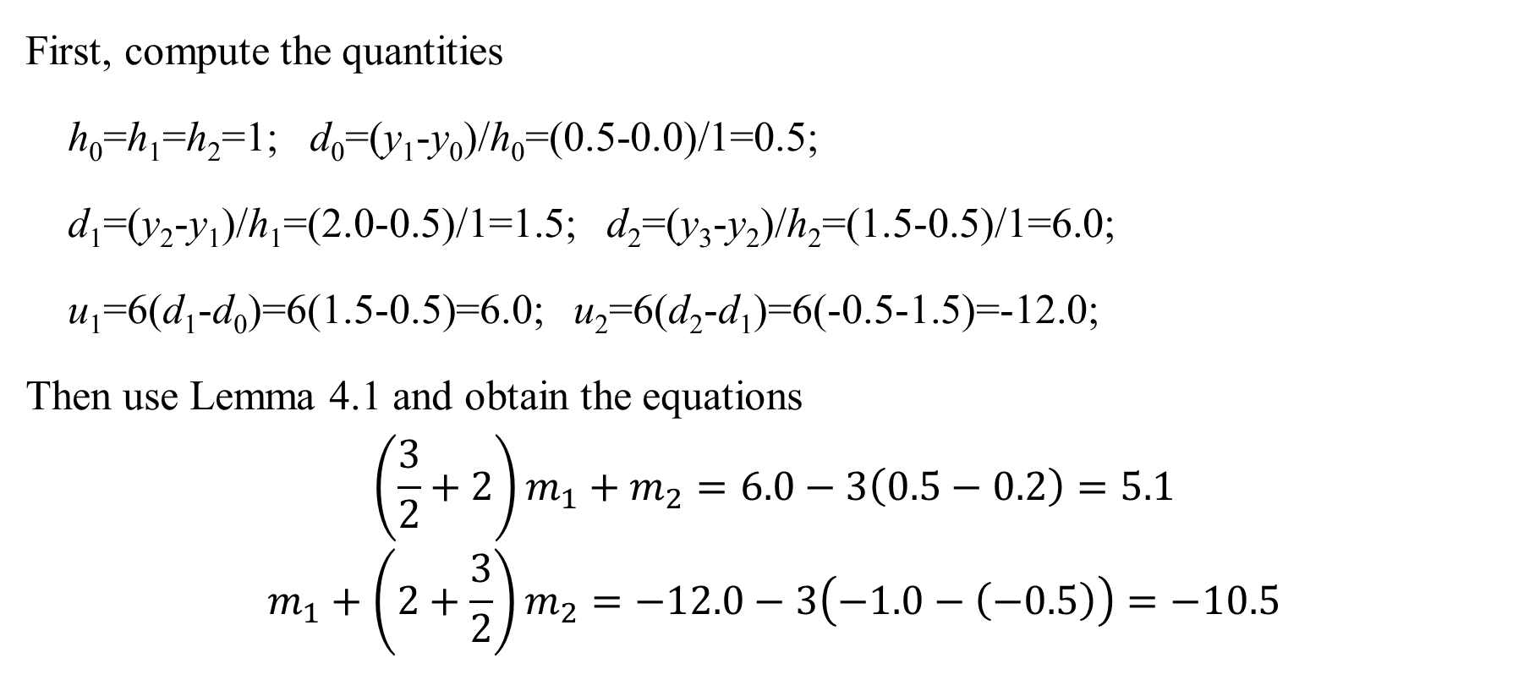
Example 4.7. Find the clamped cubic spline that passes through (0,0), (1,0.5), (2,2.0) and (3,1.5) with the first derivative boundary conditions S’(0)=0.2 and S’(3)=-1.
First, compute the quantities
h₀=h₁=h₂=1; d₀=(y₁-y₀)/h₀=(0.5-0.0)/1=0.5;
d₁=(y₂-y₁)/h₁=(2.0-0.5)/1=1.5; d₂=(y₃-y₂)/h₂=(1.5-0.5)/1=6.0;
u₁=6(d₁-d₀)=6(1.5-0.5)=6.0; u₂=6(d₂-d₁)=6(-0.5-1.5)=-12.0;
Then use Lemma 4.1 and obtain the equations
$$\left(\frac{3}{2}+2\right)m_{1}+m_{2}=6.0−3\left(0.5−0.2\right)=5.1$$
$$m_{1}+\left(2+\frac{3}{2}\right)m_{2}=−12.0−3\left(−1.0−\left(−0.5\right)\right)=−10.5$$

Slide 45
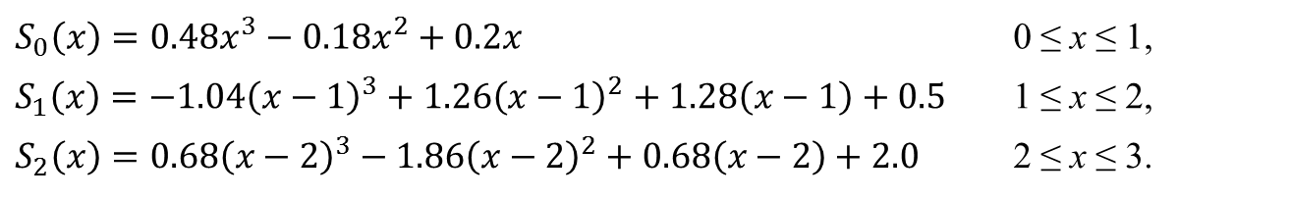
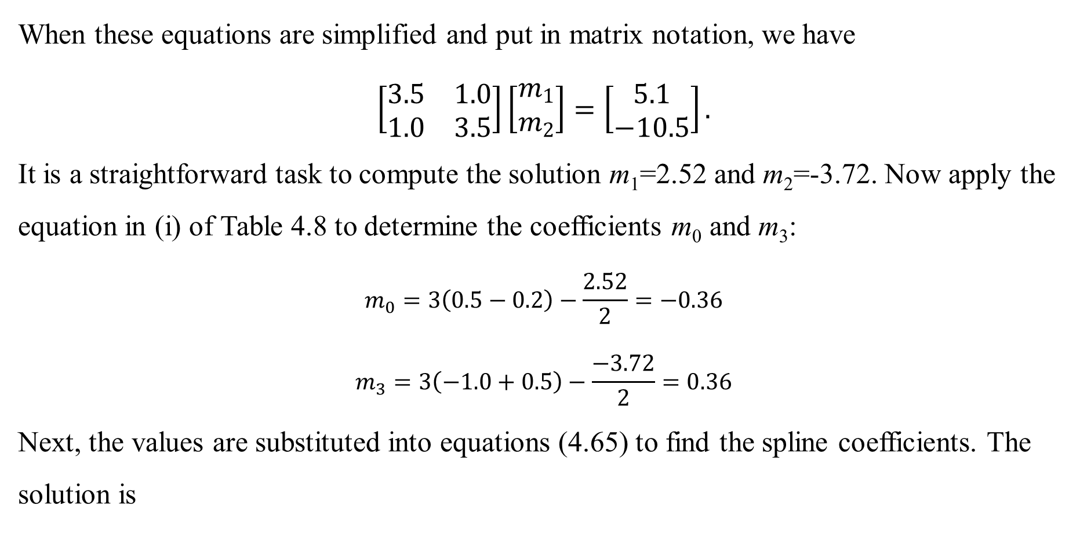
When these equations are simplified and put in matrix notation, we have
$$\left[\begin{matrix}3.5 & 1.0 \\ 1.0 & 3.5\end{matrix}\right]\left[\begin{matrix}m_{1} \\ m_{2}\end{matrix}\right]=\left[\begin{matrix}5.1 \\ −10.5\end{matrix}\right].$$
It is a straightforward task to compute the solution m₁=2.52 and m₂=-3.72. Now apply the equation in (i) of Table 4.8 to determine the coefficients m₀ and m₃:
$$m_{0}=3\left(0.5−0.2\right)−\frac{2.52}{2}=−0.36$$
$$m_{3}=3\left(−1.0+0.5\right)−\frac{−3.72}{2}=0.36$$
Next, the values are substituted into equations (4.65) to find the spline coefficients. The solution is
$$S_{0}\left(x\right)=0.48x^{3}−0.18x^{2}+0.2x$$ | 0 ≤ x ≤ 1,
$$S_{1}\left(x\right)=−1.04{\left(x−1\right)}^{3}+1.26{\left(x−1\right)}^{2}+1.28\left(x−1\right)+0.5$$ | 1 ≤ x ≤ 2,
$$S_{2}\left(x\right)=0.68{\left(x−2\right)}^{3}−1.86{\left(x−2\right)}^{2}+0.68\left(x−2\right)+2.0$$ | 2 ≤ x ≤ 3.

Slide 47
Periodic Cubic Spline

Slide 48
Example: Find the periodic cubic spline that passes through nine points determined by the curve y=f(x)=x⁴-3x³+2x²-tanx(x-2) over [0,2] with the abscissas x_{j}=j/4, for j=0…8.

Slide 49
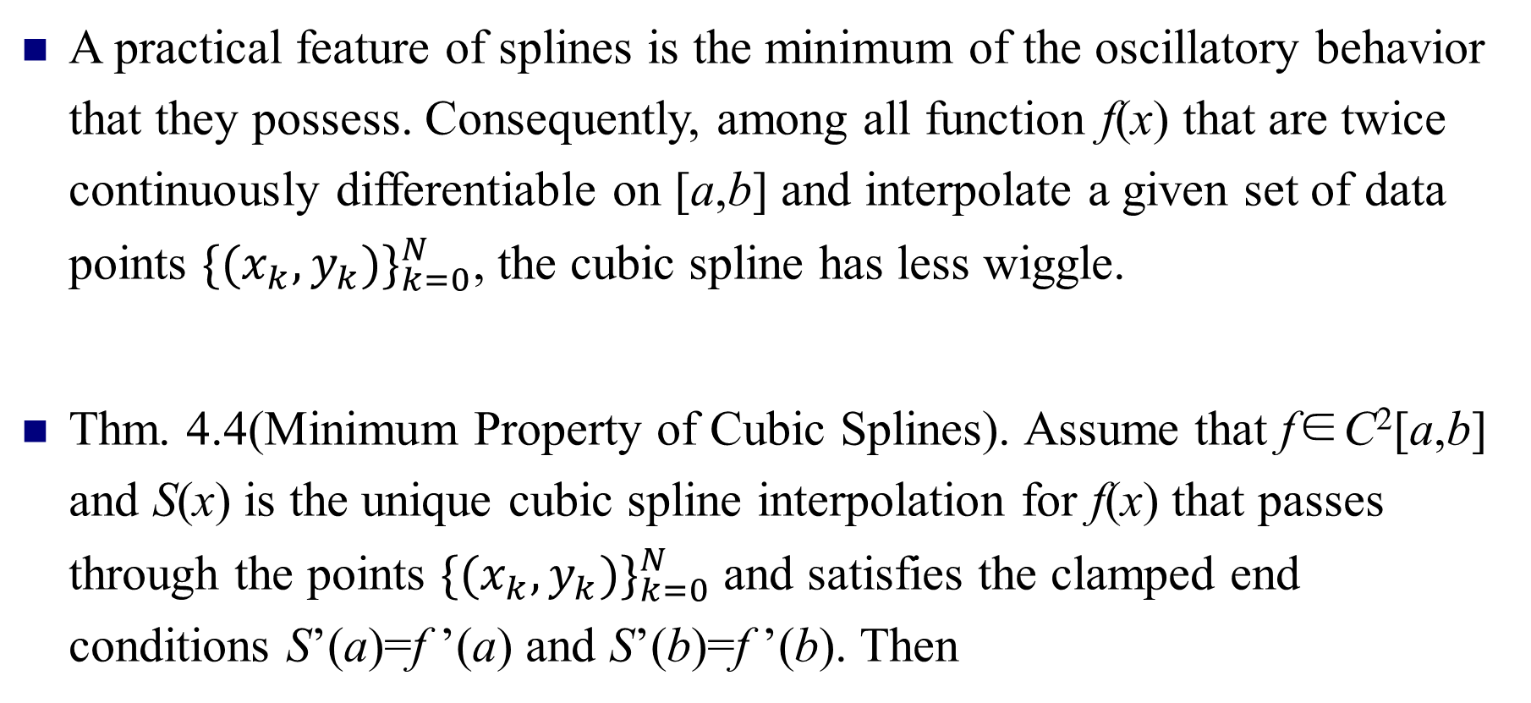
Suitability of Cubic Splines
A practical feature of splines is the minimum of the oscillatory behavior that they possess. Consequently, among all function f(x) that are twice continuously differentiable on [a,b] and interpolate a given set of data points ${\{(x_{k},y_{k})\}}_{k=0}^{N}$, the cubic spline has less wiggle.
Thm. 4.4(Minimum Property of Cubic Splines). Assume that f∈C²[a,b] and S(x) is the unique cubic spline interpolation for f(x) that passes through the points ${\{(x_{k},y_{k})\}}_{k=0}^{N}$ and satisfies the clamped end conditions S’(a)=f ’(a) and S’(b)=f ’(b). Then

Slide 50
Bézier Curves
Bézier curves which are a class of parametrically polynomials, continue to be the primary method of representing curves and surfaces in computer graphics (CAD/CAM). They are usually used in the design of free curves and surfaces.
Bézier curves were defined implicitly by a recursive algorithm originally, and the development of the properties of Bézier curves will be facilitated by defining them explicitly in terms of Bernstein polynomials.

Slide 51
Bernstein Polynomials
Def. 4.2. Bernstein polynomials of degree N are defined by
In general, there are N+1 Bernstein polynomials of degree N.

Slide 52
Properties of Bernstein Polynomials
Recurrence Relation. Set B_{0,0}(t)=1 and B_{i,N}(t)=0 for i<0 or i>N, then B_{i,N}(t)=(1-t)B_{i,N-1}(t)+tB_{i-1,N-1}(t), for i=1, 2, 3, …, N-1.
Nonnegative on [0, 1]. B_{i,N}(t) ≥0, for i=0, 1, 2, …, N.
Partition of Unity.
Derivatives.
Basis. The Bernstein polynomials of order N(B_{i,N}(t) for i=0,1,…, N) form a basis of the space of all polynomials of degree less than or equal to N.

Slide 53
Definition of Bézier Curves
Given a set of control points, , a Bézier Curves of degree N is now defined as a weighted sum of the Bernstein polynomials of degree N.
Def. 4.3. Given a set of control points , where P_{i}=(x_{i}, y_{i}), a Bézier curves of degree N is
where B_{i,N}(t), for i=0, 1, …, N, are the Bernstein polynomials of degree N, and
t∈[0,1].
In the formula aboved the control points are ordered pairs representing x- and y-coordinates in the plane. Without ambiguity the control points can be treated as vectors and the corresponding Bernstein polynomials as scalars. Thus P(t) can be represented parametrically as P(t)=(x(t), y(t)).

Slide 54
Example 1. Find the Bézier curve which has the control points (2,2), (1,1.5), (3.5,0) and (4,1).
Substituting the x- and y-coordinates of the control points and N=3 into the definition yields
x(t)=2B_{0,3}(t)+1B_{1,3}(t)+3.5B_{2,3}(t)+4B_{3,3}(t)
=2-3t+10.5t²-5.5t³,
y(t)=2B_{0,3}(t)+1.5B_{1,3}(t)+0B_{2,3}(t)+1B_{3,3}(t)
=2-1.5t-3t²+3.5t³.

Slide 55
Properties of Bézier Curves
Property 1. The points P₀ and P₁ are on the curve P(t).
Property 2. P(t) is continuous and has derivatives of all orders on the interval [0, 1].
Property 3. P’(0)=N(P₁-P₀) and P’(1)=N(P_{N}-P_{N-1}). The tangent lines to a Bézier Curve at the endpoints are parallel to the lines through the endpoints and the adjacent control points.
Property 4. The Bézier Curve lies in the convex hull of its set of control points.

Slide 56
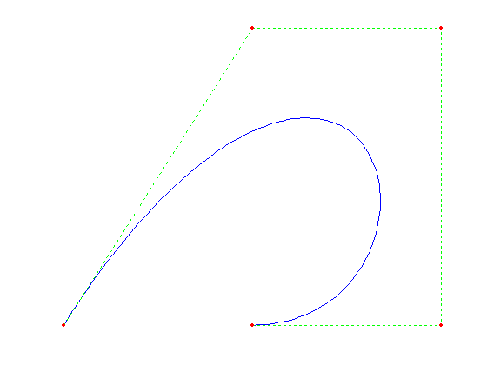
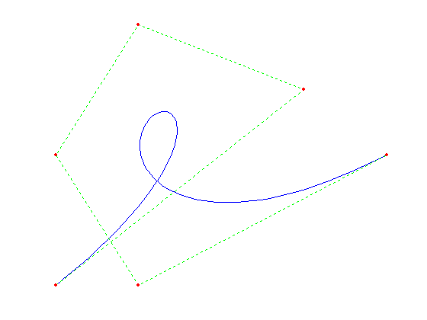
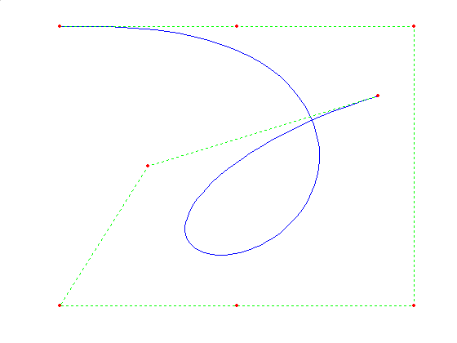
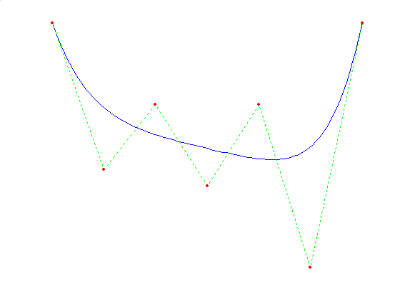
Bézier Curves and polygonal paths

Slide 57
Example 1. Find the Bézier curve which has the control points (2,2), (0,1), (3,-1) and (4,1).
Substituting the x- and y-coordinates of the control points and N=3 into the definition yields
x(t)=2B_{0,3}(t)+0B_{1,3}(t)+3B_{2,3}(t)+4B_{3,3}(t)
=2-6t+15t²-7t³,
y(t)=2B_{0,3}(t)+1B_{1,3}(t)-1B_{2,3}(t)+1B_{3,3}(t)
=2-3t-3t²+5t³.

Slide 58
Composite Bézier Curves
In practice, curves are produced using a sequence of Bézier Curves sharing common endpoints. Property 4 shows that the oscillatory behavior of high-degree polynomials is not a problem with Bézier curves. Since changing one control point changes the shape of a Bézier curve, it is simpler to break the process into a series of Bézier curves and minimize the number of changes in the control points.
Example 3. Find the composite Bézier curve for the four sets of control points {(-9,0),(-8,1), (-8,2.5),(-4,2.5)}, {(-4,2.5),(-3,3.5),(-1,4),(0,4)}, {(0,4),(2,4), (3,4),(5,2)}, {(5,2),(6,2),(20,3),(18,0)}.
Substituting the x- and y-coordinates of each sets of control points and N=3 into the definition yields

Slide 59
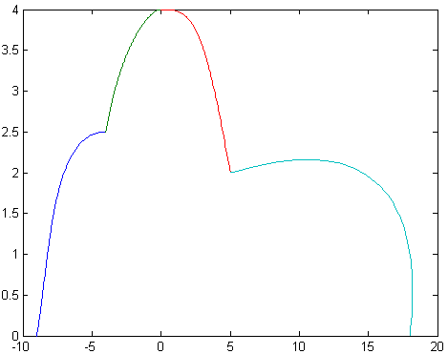
P₁(t)=(-9+3t-3t²+5t³, 3t+1.5t²-2t³)
P₂(t)=(-4+3t+3t²-2t³, 2.5+3t-1.5t²)
P₃(t)=(6t-3t²+2t³, 4-2t³)
P₄(t)=(5+3t+39t²-29t³, 2+3t²-5t³)
The graph of the composite Bézier curves is shown as follows.

Slide 60
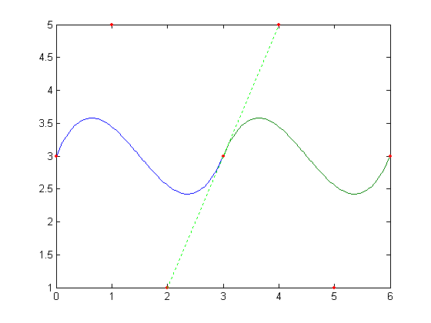
Smooth Composite Bézier Curves
The composite Bézier curves usually do not meet smoothly at the common endpoints. To have two Bézier curves P(t) and Q(t) meet smoothly would require that P_{N}=Q₀ and P’(P_{N})=Q’(Q₀). Property 3 indicates that it is sufficient to require that the control points P_{N-1}, P_{N}=Q₀, and Q₁ be collinear and satisfy 2P_{N}=P_{N -1}+ Q₁.
Example：The Bézier curves P(t) and Q(t) of degree 3 with the control point sets {(0,3),(1,5),(2,1),(3,3)} and {(3,3),(4,5),(5,1),(6,3)} respectively. Clearly the control points (2,1), (3,3) and (4,5) are collinear while P₃ is the midpoint of P₂Q₁.
P(t)=(3t, 3+6t-18t²+12t³), Q(t)=(3+3t, 3+6t-18t²+12t³).
Q₁
P₃=Q₀
P(t)
Q(t)
P₂

