Slide 1
Chapter 3. Interpolation and Polynomial Approximation

Slide 2
What is Interpolation ?
Given (x₀,y₀), (x₁,y₁), …… (x_{n},y_{n}), find the value of ‘y’ at a value of ‘x’ that is not given.
The theory of polynomial approximation is suitable for a first course in numerical analysis although the state-of-the-art methods use rational functions.
Polynomials are the most common choice of interpolants because they are easy to: evaluate, differentiate, and integrate.
华南师范大学数学科学学院 谢骊玲

Slide 3
Introduction to Interpolation
If there is a significant amount of error in the tabulated values, then the methods of curve fitting should be considered. On the other hand, if the points (x_{k}, y_{k}) are known to a high degree of accuracy, then the polynomial curve y=P(x) that passes through them can be considered.
When x₀<x<x_{N}, the approximation P(x) is called an interpolated value. If either x<x₀ or x_{N}<x, then P(x) is called an extrapolated value.

Slide 4
Taylor Series and Calculation of Functions
Thm. 3.1(Taylor Polynomial Approximation). Assume that f∈C^{N+1}[a, b] and x₀∈[a, b] is a fixed value. If x∈[a, b], then f(x)=P_{N}(x)+E_{N}(x), where P_{N}(x) is a polynomial that can be used to approximate f(x):
The error term E_{N}(x) has the form
for some value c=c(x) that lies between x and x₀.
A finite sum can be used to obtain a good approximation to an infinite sum.
It is used to determine a bound for the accuracy of the approximation

Slide 5
Taylor Series Expansions for Some Common Functions
for all x
for all x
for all x
-1≤x≤1
-1≤x≤1
for |x|<1

Slide 6
Taylor polynomial
The graphs of the approximation P_{N}(x) and the function f(x) both pass through the center x₀ and they have the same slopes (N=1) and curvature (N=2) at it.
The approximation is good near the center x₀ and that the distance between the curves grows as x moves away from x₀.
The accuracy of a Taylor polynomial is increased when we choose N large.
Cor. 3.1. If P_{N}(x) is the Taylor polynomial of degree N given in Theorem 3.1, then
for k=0,1,…,N.

Slide 7
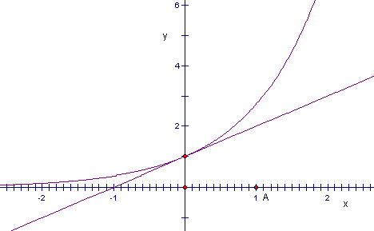
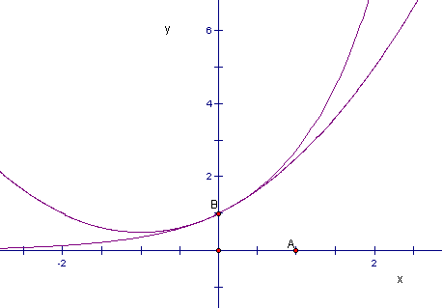
y=e^{x}
Example for Taylor Approximation (1)
y=P₁(x)=1+x
y=P₂(x)
=1+x+x²/2
y=e^{x}

Slide 8
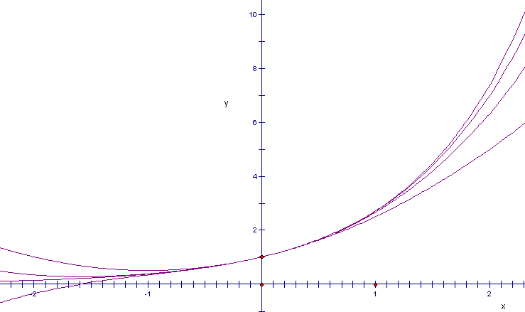
Example for Taylor Approximation (2)
y=P₄(x)
y=e^{x}
y=P₃(x)
y=P₂(x)
Example 3.2 & 3.3

Slide 9
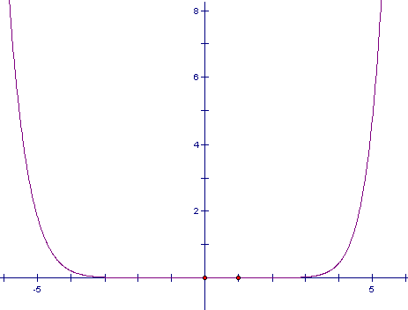
The graph of the error y=E₉(x)=e^{x}-P₉(x)
Example 3.3
y=E₉(x)

Slide 10
Methods for Evaluating a Polynomial
Nested Multiplication:
(i) Algorithm to Evaluate P(x) | (ii) Algorithm to Evaluate P’(x) | (iii) Algorithm to Evaluate I(x)
B(N):=A(N) FOR K=N-1 DOWNTO 0 DO B(K):=A(K)+B(K+1)*X PRINT “The value P(x) is”, B(0) | D(N-1):=N*A(N) FOR K=N-1 DOWNTO 1 DO D(K-1):=K*A(K)+D(K)*X PRINT “The value P’(x) is”, D(0) | I(N+1):=A(N) /(N+1) FOR K=N DOWNTO 1 DO I(K):=A(K-1)/K+I(K+1)*X I(0):=C+I(1)*X PRINT “The value I(x) is”, I(0)

Slide 11
Introduction to Interpolation
A shortcoming of Taylor polynomial is that the higher-order derivatives must be known, and often they are either not available or they are lard to compute.
Suppose that the function y=f (x) is known at the N+1 points (x₀,y₀), (x₁,y₁),…,(x_{N},y_{N}), where the values x_{k} are spread out over the interval [a,b] and satisfy
a≤x₀<x₁<…<x_{N}≤b, and y_{k}=f(x_{k}).
A polynomial P(x) of degree N will be constructed that passes through these N+1 points.
In the construction, only the numerical values x_{k} and y_{k} are needed. Hence the higher-order derivatives are not necessary.

Slide 12
Introduction to Interpolation-Cont.
Use the known N+1 points’ coordinates (x₀,y₀), (x₁,y₁),…,(x_{N},y_{N}) to establish a linear system of the coefficients a_{k} (k=0,…,N) of the polynomial P_{N}(x), and solve the system to obtain the polynomial P_{N}(x) which interpolates the known points.
This method for finding the coefficients is mathematically sound, but sometimes the matrix is difficult to solve accurately.
Interpolation means to estimate a missing function value by taking a weighted average of known function values at neighboring points.

Slide 13
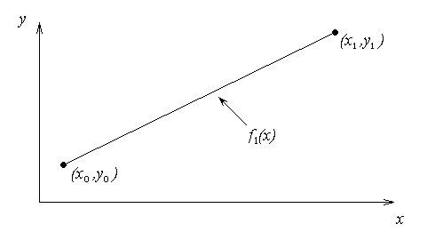
Linear Interpolation
A linear interpolant passes through two given points and
with the form
where
f₁(x) can be written as a slightly different form as follow:
Lagrange linear interpolating polynomial
华南师范大学数学科学学院 谢骊玲

Slide 14
Example
The path of a rapid laser is given by these specifications.
If the laser is traversing from x = 2 to x = 4.25 in a linear path, find the value of y at x = 4 using the above method.
华南师范大学数学科学学院 谢骊玲

Slide 15
Linear Interpolation

Slide 16
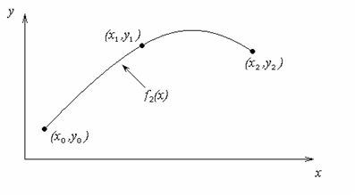
Quadratic Interpolation

Slide 17
Example
The path of a rapid laser is given by these specifications.
If the laser is traversing from x = 2 to x = 4.25 to x=5.25 using a quadratic path, find the value of y at x = 4 using the Newton’s Divided difference polynomial method.
华南师范大学数学科学学院 谢骊玲

Slide 18
Quadratic Interpolation (cont.)

Slide 20
3.3 Lagrange Approximation
A polynomial P_{N}(x) of degree at most N that passes through the N+1 points (x₀,y₀), (x₁,y₁),…,(x_{N}, y_{N}) on [a, b] and has the form
where L_{N,k}(x) is the Lagrange coefficient polynomial based on these nodes:

Slide 21
Properties of Lagrange Interpolation Polynomial P_{N}(x)
For each fixed k, the Lagrange coefficient polynomial L_{N,k}(x) has the property
L_{N,k}(x_{j})=1 when j=k and L_{N,k}(x_{j})=0 when j≠k.
The polynomial curve y=P_{N}(x) goes through (x_{j},y_{j}):
P_{N}(x_{j})=y₀L_{N,0}(x_{j})+…+y_{j}L_{N,j}(x_{j})+…+y_{N}L_{N,N}(x_{j})
=y₀(0)+…y_{j}(1)+…+y_{N}(0)=y_{j}, j=0,1,…,N.
The polynomial P_{N}(x) of degree ≤N which interpolates the given N+1 points is unique.

Slide 22
Error Terms
Thm. 3.3(Lagrange Polynomial Approximation). Assume that f∈C^{N+1}[a,b] and x₀, x₁, …, x_{N}∈[a,b] are N+1 nodes. If x∈[a,b], then f(x)=P_{N}(x)+E_{N}(x), where P_{N}(x) is a polynomial that can be used to approximate f(x):
The error term E_{N}(x) has the form
for some value ξ= ξ(x) that lies in the interval [a, b].

Slide 23
Error Bounds for Lagrange Interpolation,
Equally Spaced Nodes
Thm. 3.4. Assume that f(x) is defined on [a,b], which contains equally spaced nodes x_{k}=x₀+hk . Additionally, assume that f(x) and the derivatives of f(x), up to the order N+1, are continuous and bounded on the special subintervals [x₀,x₁], [x₀,x₂] and [x₀,x₃], respectively; that is,
|f^{(N+1)}(x)|≤M_{N+1} for x₀≤x≤x_{N},
for N=1,2,3. The error terms E_{N}(x)corresponding to the cases N=1,2, and 3 have the following useful bounds on their magnitude:
valid for x∈[x₀,x₁],
valid for x∈[x₀,x₂],
valid for x∈[x₀,x₃].

Slide 24
Error Bounds for Lagrange Interpolation,
Equally Spaced Nodes
Thm. 3.5. Assume that f(x) is defined on [a, b], which contains equally spaced nodes x_{k}=x₀+hk. Additionally, assume that f(x) and the derivatives of f(x), up to the order N+1, are continuous and bounded on [x₀, x_{N}]
|f^{(N+1)}(x)|≤M_{N+1} for x₀≤x≤x_{N}
then

Slide 25
Comparison of Accuracy and O(h^{N+1})
Example 3.8
The bound for the error term |E_{N}(x)| depends on h and is approximately a multiple of h^{N+1}.
If the derivatives of f(x) are uniformly bounded on the interval [a, b] and |h|<1, then choosing N large will make h^{N+1} small, and the higher-degree approximating polynomial will have less error.

Slide 26
3.4 Newton Polynomials
If the Lagrange polynomials are used, there is no constructive relationship between P_{N-1}(x) and P_{N}(x). Each polynomial has to be constructed individually, and the work required to compute the higher-degree polynomials involves many computations.
Newton polynomials have the recursive pattern
The coefficients a_{j} can be computed using divided differences: a_{k}=f [x₀, x₁, …, x_{k}].

Slide 27
Definition of the Divided Differences
Def. 3.1. The divided differences for a function f(x) are defined as follows:

Slide 28
Divided-Difference Table

Slide 29
General Form
where
Rewriting

Slide 30
General Form

Slide 31
Example
The path of a rapid laser is given by these specifications. Find the path traversed by the laser using the Newton’s Divided Difference Polynomial method.
华南师范大学数学科学学院 谢骊玲

Slide 32
Example

Slide 33
Example

Slide 34
Example-Cont.

Slide 35
Newton Polynomial
Thm. 3.6. Suppose that x₀,x₁,…,x_{N} are N+1 distinct numbers in [a, b]. There exists a unique polynomial P_{N}(x) of degree at most N with the property that
f (x_{j})=P_{N}(x_{j}) for j=0,1,…,N.
The Newton form of this polynomial is
P_{N}(x)=a₀+a₁(x-x₀)+…+a_{N}(x-x₀)(x-x₁)…(x-x_{N-1})
where a_{k}=f [x₀, x₁, …, x_{k}], for k=0,1,…, N.

Slide 36
Truncation Error of Newton Polynomial
Cor. 3.2(Newton Approximation). Assume that P_{N}(x) is the Newton polynomial given in Thm. 3.6 and is used to approximation the function f (x), that is,
f (x)=P_{N}(x)+E_{N}(x).
If f∈C^{N+1}[a,b], then for each x∈[a, b] there corresponds a number c=c(x) in (a, b), so that the error term has the form

Slide 37
Discussion of Interpolating Polynomials
Consider Lagrange interpolating to f(x) over [-1,1] based on the equally spaced nodes. Does the error E_{N}(x)=f(x)-P_{N}(x) tend to zero as N increases?
For functions like sin(x) or e^{x}, where all the derivatives are bounded by the same constant M, the answer is yes.
In general, the answer to this question is no, and it is easy to find functions for which the sequence {P_{N}(x)} does not converge.
The interpolating polynomials of high degree(more than seven or eight degree) are seldom used in practical applications. Although the interpolating function P_{N}(x) passes through more given points, P_{N}(x) may not be a good approximation of f(x) between two given nodes, even the differences are quite large sometimes.

Slide 38
Runge Phenomenon
A function with any order derivatives constructed by Runge is as follows:
Take N+1 equally spaced nodes x_{k}=-1+2×k/N in the interval [-1,1] to form a Lagrange interpolating polynomial
The maximum of the error term E_{N}(x)=f (x)-L_{N,k}(x) grows fast when N→∞.

Slide 39
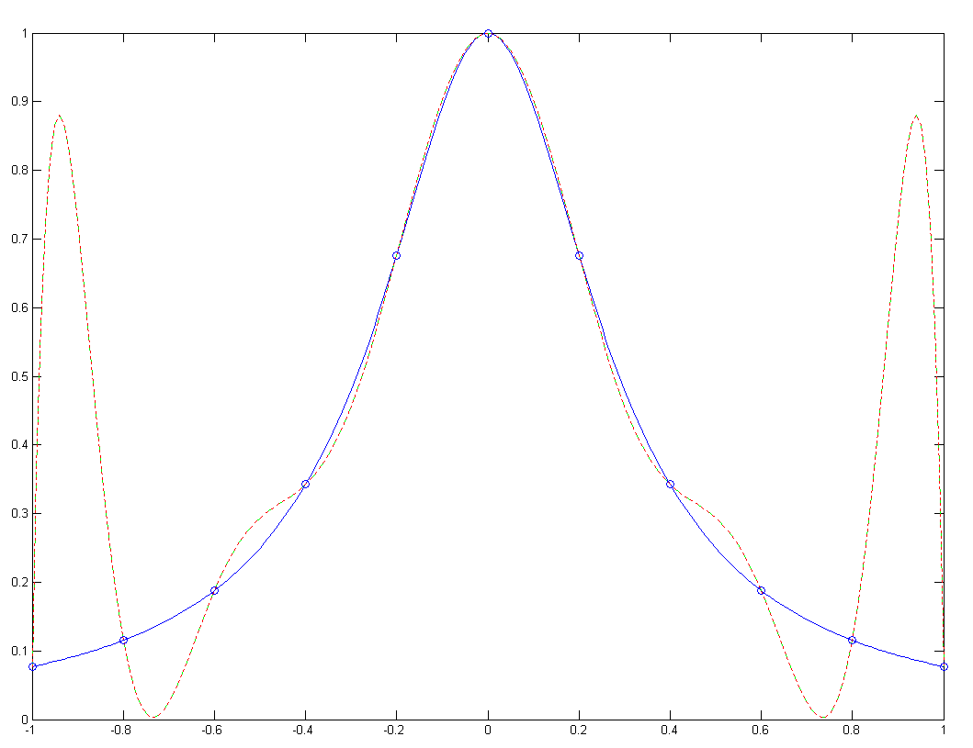
The polynomial approximation to f(x)=1/(1+12x²) based on 11 equally spaced nodes over [-1, 1].
f(x)
L－插值
N－插值

Slide 40
Minimax
Consider the polynomial interpolation for f(x) over [-1,1] based on the nodes -1≤x₀<x₁<…<x_{N}≤1. Both the Lagrange and Newton polynomials satisfy f(x)=P_{N}(x)+E_{N}(x),
where
and Q(x) is the polynomial of degree N+1: Q(x)=(x-x₀)(x-x₁)…(x-x_{N})
Using the relationship
our task is to follow Chebyshev’s derivation on how to select the set of nodes that minimizes max_{-1≤x≤1}{|Q(x)|}.

Slide 41
Minimax-Cont.
One upper bound can be formed by taking the product of the maximum value of |Q(x)| over all x in [-1,1] and the maximum value |f ^{(N+1)}(x)/(N+1)!| over all x in [-1,1]. That is
To minimize the factor max{|Q(x)|}, Chebyshev discovered that x₀,x₁,…, x_{N} should be chosen so that
that is,

Slide 42
Minimax-Cont.
Thm.3.7. Assume that N is fixed. Among all possible choices for Q(x)=(x-x₀)(x-x₁)…(x-x_{N}), and thus among all possible choices for the distinct nodes in [-1,1], the polynomial T(x)=T_{N+1}(x)/2^{N} is the unique choice that has the property
Moreover,
For Lagrange interpolation f(x)=P_{N}(x)+E_{N}(x) on [-1,1], the minimum value of the error bound is
It is achieved when the nodes {x_{k}} are the Chebyshev abscissas of T_{N+1}(x).

Slide 43
Properties of Chebyshev Polynomials
Recurrence Relation: T₀(x)=1, T₁(x)=x, T_{k}(x)=2xT_{k-1}(x)-T_{k-2}(x), for k=2,3,...
Leading Coefficient: The coefficient of x^{N} in T_{N}(x) is 2^{N-1} when N≥1.
Symmetry:T_{2M}(x) is an even function while T_{2M+1}(x) is an odd one.
Trigonometric Representation on [-1,1]: T_{N}(x)=cos(Narccos(x)),
for -1≤x≤1.

Slide 44
Properties of Chebyshev Polynomials-Cont.
Distinct Zeros in [-1, 1]: T_{N}(x) has N distinct zeros x_{k} that lie in the interval [-1,1].
These values are called the Chebyshev abscissas(nodes).
Extreme Values: |T_{N}(x)|≤1 for -1≤x≤1.
Orthogonality:
when i≠j,
when i=j≠0,

Slide 45
Chebyshev Approximation Polynomial
Thm. 3.9. The Chebyshev approximation polynomial P_{N}(x) of degree ≤ N for f(x) over [-1,1] can be written as a sum of {T_{j}(x)}:
The coefficients {c_{j}} are computed with the formulas
and
for j=1,2,…,N.

Slide 46
Interpolation using Chebyshev Nodes
Example 3.14. Compare the Lagrange polynomials of degree N=3 for f(x)=e^{x} that are obtained by using the equally spaced nodes x₀=-1, x₁=-1/3, x₂=1/3, x₃=1, and the Chebyshev nodes
x₀=cos(7π/8), x₁=cos(5π/8), x₂=cos(3π /8), x₃=cos(π/8).
The interpolation using Chebyshev nodes can minimize the maximum error in the interpolation interval [-1, 1].
In general, if f(x) and f ’(x) are continuous on [-1,1], then it can be proved that Chebyshev interpolation will produce a sequence of polynomial {P_{N}(x)} that converges uniformly to f(x) over [-1, 1].

Slide 47
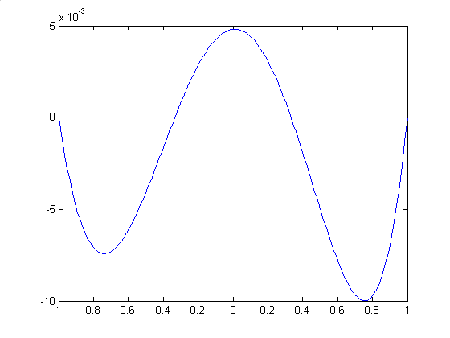
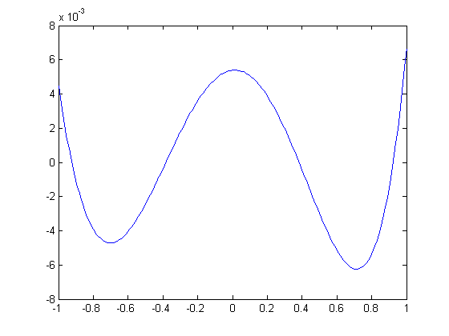
Interpolation using Chebyshev Nodes-Cont.
y=e^{x}-P(x) , -1≤x≤1
y=e^{x}-V(x) , -1≤x≤1
Maximum Error: |e^{x}-P(x)|≤0.00998481
Maximum Error: |e^{x}-V(x)|≤0.00665687
The maximum error in V(x) is about two-thirds the maximum error in P(x). Also, the error is spread out more evenly over the interval.

Slide 48
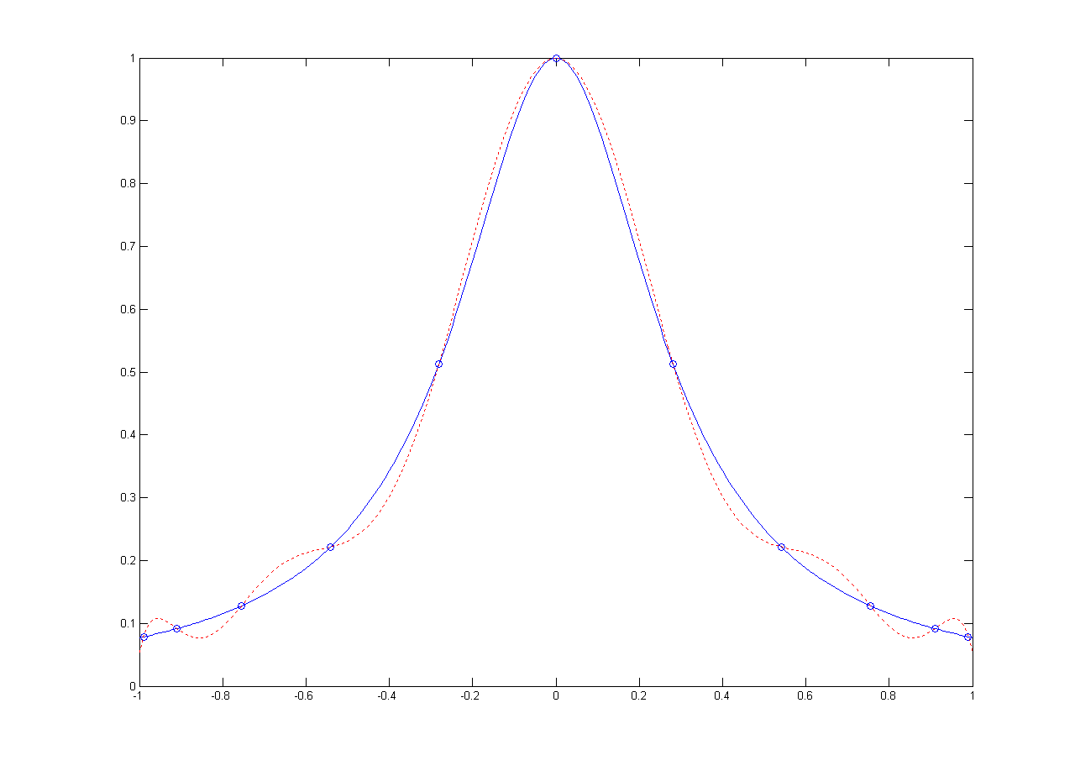
The Chebyshev nodes are used to construct an interpolating polynomial of degree 10 to , the error is much smaller, and under the condition that Chebyshev nodes be used, the error E_{N}(x) will go to zero as N→∞.
f(x)
f(x)
P(x)
T(x)
The maximum error is |f(x)-T(x)|≤0.0410295
The maximum error is |f(x)-P(x)|≤0.794349

Slide 49
Transforming the Interval
If the approximation P_{N}(x) to f(x) is to be obtained on the interval [a,b], then we change the variable so that the problem is reformulated on [-1,1]:
or
where a≤x≤b and -1≤t≤1. The required Chebyshev nodes of T_{N+1}(t) on [-1, 1] are
for k=0,1,…, N
and the interpolating nodes on [a, b] are obtained:
for k=0,1,…, N.

Slide 50
3.6 Padé Approximation
Rational approximations for functions：When the function is unbounded near a point (with poles), the approximation by polynomials is very poor, while approximation by rational functions can get better results.
A rational approximation to f(x) on [a,b] is the quotient of two polynomials P_{n}(x) and Q_{m}(x) of degree n and m, respectively. We use the notation R_{n,m}(x) to denote this quotient:
for a≤x≤b and q₀=1.

Slide 51
The critical step is to find the coefficients p_{k} and q_{k} when we use the rational function R_{n,m} (x) to approximate the original function f (x).
The Taylor series expansions of f (x) can be used to get the rational approximation. Expand f (x) in a Taylor polynomial of degree N using the fixed value x₀=0 and involving the powers (x-0)^{k}=x^{k}. The first N derivatives are used to write
The partial sum is denoted as
, for .
Obviously, P^{(k)}(0)=f ^{(k)}(0), k=0,1,…, N.

Slide 52
Def. Suppose
The rational function is
where P_{n}(x) and Q_{m}(x) have no common factor, and satisfies
R_{n,m}(x) is the Padé approximation of (n,m) order to f (x) at x=0.

Slide 53
Thm. Let . The condition
is equivalent to
It means that
Since according to Newton-Leibniz Formula,

Slide 54
where obtained from
.
Thm. Let .
Denote c_{j}=f ^{(j)}(0)/j!. Set p_{j}=0 when j >n and q_{j}=0 when j >m. The Padé approximation is equal to the following system of N+M+1 linear equations:
and

Slide 55
Cross out k! from ,
according to q₀=1, q_{j}=0(when j > m), the systems can be obtained:
(1)
and (2)
Note that q_{j}=0 when j>m, formula (2) can be rewritten as

Slide 56
(1)
where c_{j}=0 when j < 0.
Denote
(2)

Slide 57
We can get the matrix form of the systems
Thm.
Suppose
the rational function
is the (n, m)-order of Padé approximation for f (x) if and only if
and , the coefficients of the polynomials P_{n}(x) and Q_{m}(x)
satisfy the systems (1) and (2).

Slide 58
According to the above theorem, the system (1) can be solved for q₀, q₁, …, q_{m}, the coefficients of Q_{m}(x), then the system (2) is solved for p₀, p₁, …, p_{n} which are the coefficients of P_{n}(x). The Padé approximation of
f (x) can be listed in a table, which is called Padé table (see table below)

Slide 59
Example. A comparison of the approximation effects between the Padé approximation R_{4,4}(x) and the Taylor polynomial P₆(x) for the function f(x)=cos(x) over [-5, 5].
R44

Slide 60
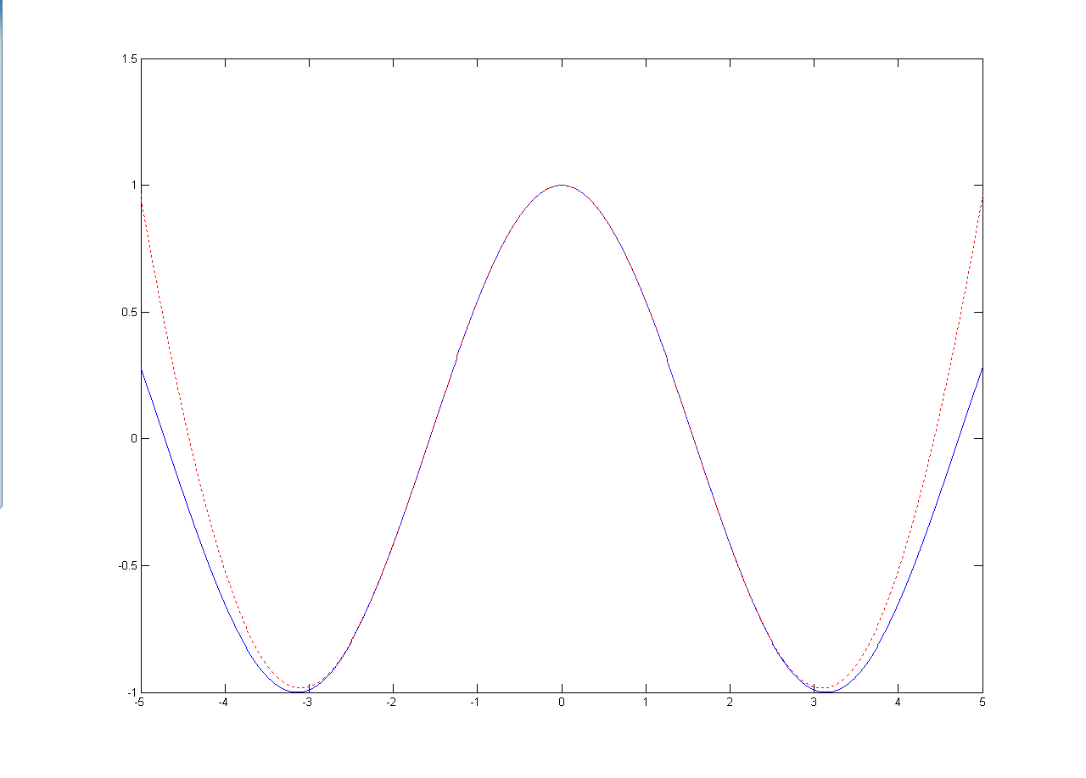
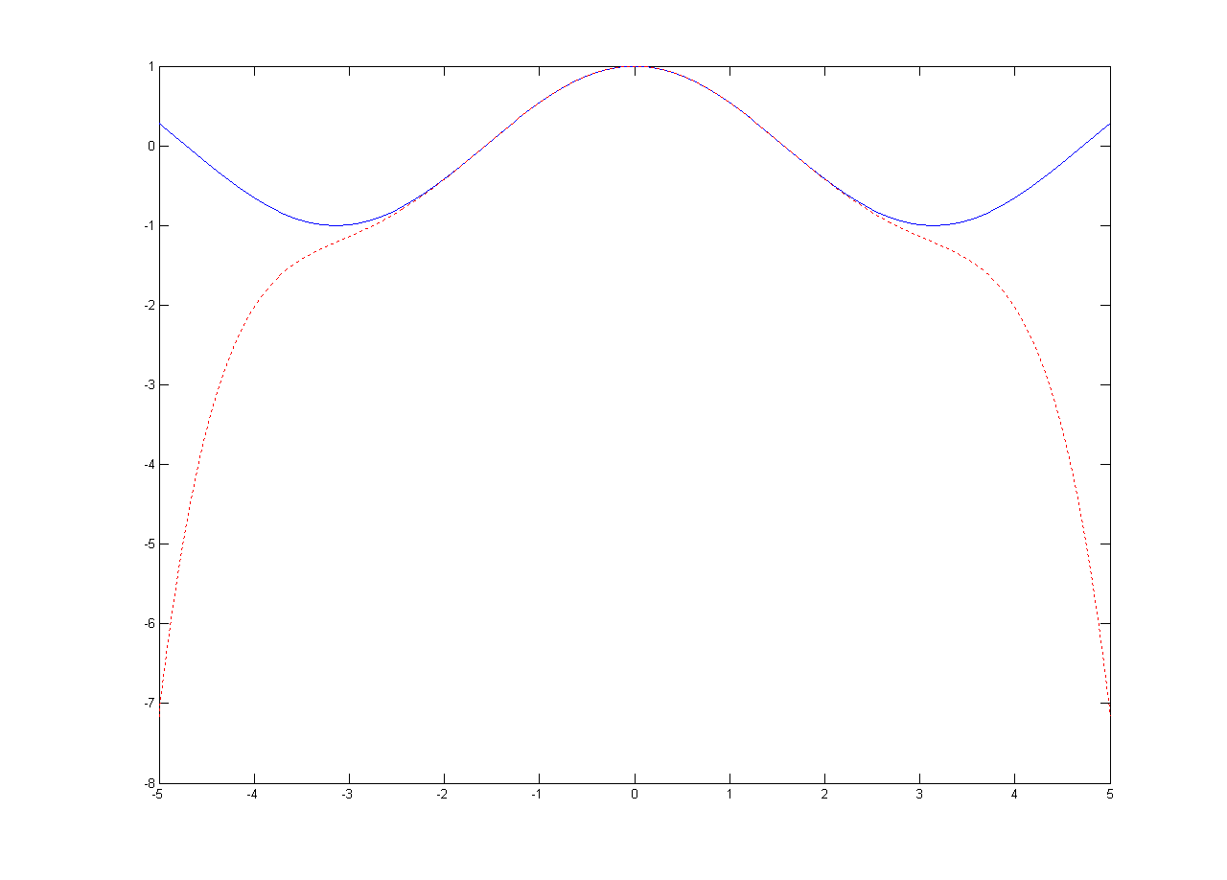
A comparison of the approximation effects between the Padé approximation R_{4,4}(x) and the Taylor polynomial P₆(x) for the function f(x)=cos(x) over [-5, 5].
f(x)
Obviously, the Padé approximation R_{4,4}(x) is much better than that of the Taylor polynomial P₆(x).
R_{4,4}(x) or P₆(x)
R_{4,4}(x)
P₆(x)

Slide 61
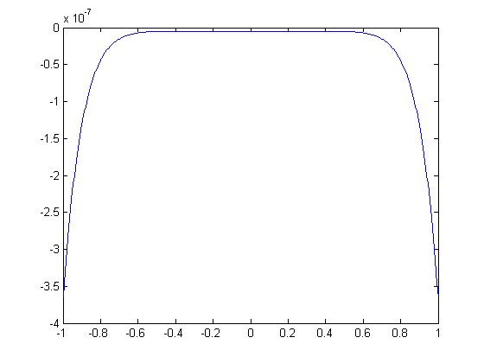
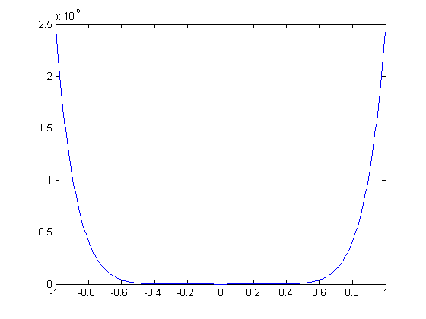
A comparison of the approximation effects between the Padé approximation R_{4,4}(x) and the Taylor polynomial P₆(x) for the function f(x)=cos(x) over [-1, 1].
The maximum errors both appear at the end points which are E_{R}(1)=-0.0000003599 and E_{P}(1)=-0.0000245281. The maximum error of R_{4,4}(x) is about 1.467% of that of P₆(x). The smaller the interval, the better the Padé approximation is than the Taylor approximation. The maximum error of R_{4,4}(x) is about 0.384 % of that of P₆(x) over [-0.1,0.1] while E_{R}(0.1)=-0.0000000004 and E_{P}(0.1)=0.0000000966.
The error function E_{R}(x) for R_{4,4}(x)
The error function E_{P}(x) for P₆(x)

Slide 62
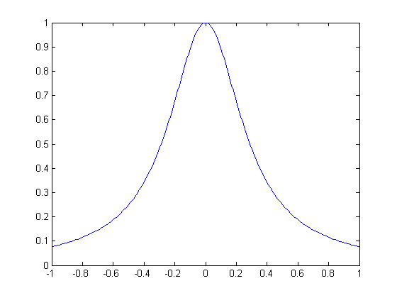
The result of Runge function approximated by Padé
In fact the Padé approximation R_{2,2} (x) is just the Runge function f (x)

