Slide 1
Chapter 2. Solution of Linear Systems AX=B

Slide 2
Example – Material Selection
Manufacturing a product containing
  Manganese, silicon, and copper
  Required amounts [15; 22; 39] lbs/ton manufactured
  3 supplies exist with different concentrations of each ingredient
Problem: How much to buy from each supplier?
Notes:
锰，硅，铜

Slide 3
Example - Continued
X_{j} = amount to buy from supplier j
C_{i} = amount of ingredient i required per ton of product manufactured
a_{ij} = amount of ingredient i in each ton from supplier j
 | Supplier 1 (lb/ton) | Supplier 2 (lb/ton) | Supplier 3 (lb/ton)
Manganese | 1 | 3 | 2
Silicon | 2 | 4 | 3
Copper | 3 | 4 | 7

Slide 4
Example – Cont.
Relation among composition from suppliers, the amount needed from each supplier, and the composition of the final product

Slide 5
Example - Truss
Truss – structure consisting of rigid members interconnected by joints
Example
B
f₁
g₁
f₃
f₄
f₇
f₁
f₃
f₈
f₆
θ
C
φ
f₄
A
D
f₂
f₂
f₅
f₅
g₂
Notes:
桁架

Slide 6
Example – Cont.
Given values of the load forces, g₁ and g₂, find the values of the forces in the beams, f₁, …, f₈

Slide 7
Systems of Linear Equations
Consider the linear system Ax = b
where A is an (n × n) matrix, x is the vector of (n) unknown solution values, and b is a column vector of constants

Slide 8
Solution of a Linear System
A formal way to obtain a solution using matrix algebra is to multiply each side of the equation by the inverse of A to yield

Slide 9
Example
2 unknowns in 2 equations

Slide 10
Upper-Triangular Linear Systems
Def. 2.1. An N×N matrix A=[a_{ij}] is called upper triangular provided that the elements satisfy a_{ij}=0 whenever i>j. A is called lower triangular provided that a_{ij}=0 whenever i<j.
Thm. 2.1(Back Substitution). Suppose that AX=B is an upper-triangular system with the form as below. If a_{kk}≠0 for k=1,2,…,N, then there exists a unique solution for the system.

Slide 11
Back Substitution to solve the linear system
First,
,…
Algorithm:
Finally,

Slide 12
Upper-Triangular Linear Systems
The condition that a_{kk}≠0 is essential because the back-substitu- tion algorithm involves division by a_{kk}. If this requirement is not fulfilled, either no solution exists or infinitely many solution exist.
Thm. 2.2. If the N×N matrix A=[a_{ij}] is either upper or lower triangular, then

Slide 13
Gaussian Elimination
Two linear systems of dimension N×N are said to be equivalent provided that their solution sets are the same.
When elementary transformations are applied to a given system, the solution sets do not change.
A scheme for solving a general system AX=B of N equations and N unknowns is to construct an equivalent upper-triangular system UX=Y that can be solved by the back-substitution algorithm.

Slide 14
Gaussian Elimination
A simple example:
The variable x₁ is eliminated from the second equation by substracting from it 4/3 times the first equation. We arrive at the equivalent system:
The back-substitution algorithm is now used to find the unknowns
and

Slide 15
Gaussian Elimination
It is efficient to store all the coefficients of the linear system AX=B in an array of dimension N×(N+1). The coefficients of B are stored in column N+1 of the array(i.e., a_{k,N+1}=b_{k}). Each row contains all the coefficients necessary to represent an equation in the linear system. The augmented matrix is denoted [A|B] and the linear system is represented as follows:
The system can be solved by performing row operations on the augmented matrix [A|B]. The variables xk are placeholders for the coefficients and can be omitted until the end of the calculation.

Slide 16
Gaussian Elimination
Thm. 2.4(Elementary Row Operations). The following operations applied to the augmented matrix yield an equivalent linear system.
  Interchanges: The order of two rows can be changed.
  Scaling: Multiplying a row by a nonzero constant.
  Replacement: The row can be replaced by the sum of that row and a nonzero multiple of any other row; that is : row_{r}=row_{r}-m_{rp}×row_{p}.
It is common to use the last operation by replacing a row with the difference of that row and a multiple of another row.

Slide 17
Gauss Elimination
Forward Elimination - multiple of one equation is subtracted from another to eliminate unknowns
Back Substitution – last equation yields unknown, substituting back into the other equations yields the rest

Slide 18
Gaussian Elimination Process

Slide 19
Gaussian Elimination Process-Cont.

Slide 20
Gaussian Elimination Process-Cont.

Slide 21
Gaussian Elimination Process-Cont.
Finally, back-substitution can be used to solve the upper-triangular systems above.

Slide 22
Example
Forward Elimination
Back Substitution

Slide 23
Gauss Elimination

Slide 24
Gauss Elimination

Slide 25
Gauss Elimination

Slide 26
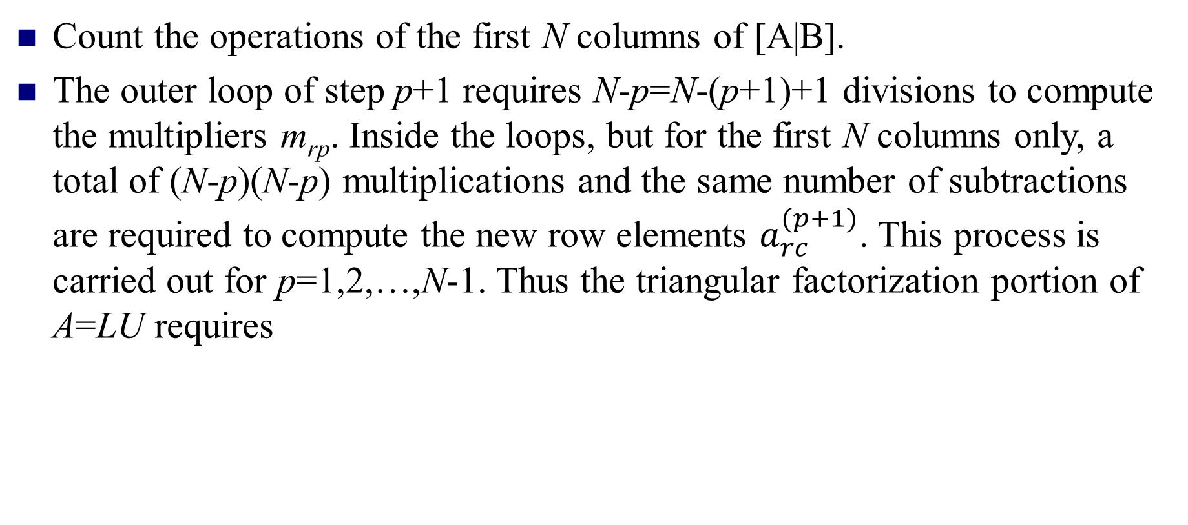
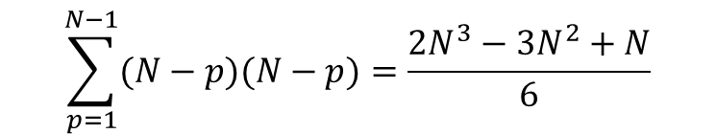
Computational Complexity
Count the operations of the first N columns of [A|B].
The outer loop of step p+1 requires N-p=N-(p+1)+1 divisions to compute the multipliers m_{rp}. Inside the loops, but for the first N columns only, a total of (N-p)(N-p) multiplications and the same number of subtractions are required to compute the new row elements $a_{rc}^{(p+1)}$. This process is carried out for p=1,2,…,N-1. Thus the triangular factorization portion of A=LU requires
multiplications and divisions
and
$$\sum_{p=1}^{N−1}{(N−p)(N−p)}=\frac{2N^{3}−3N^{2}+N}{6}$$
subtractions.

Slide 27
Example
Division by zero: May occur in the forward elimination steps. Consider the set of equations below. Use five significant figures with chopping
At the end of Forward Elimination

Slide 28
Example-Cont.
Back Substitution

Slide 29
Example-Cont.
Compare the calculated values with the exact solution
Improvements:
Increase the number of significant digits
Decreases round off error
Does not avoid division by zero
Gaussian Elimination with Pivoting
Avoids division by zero
Reduces round off error

Slide 30
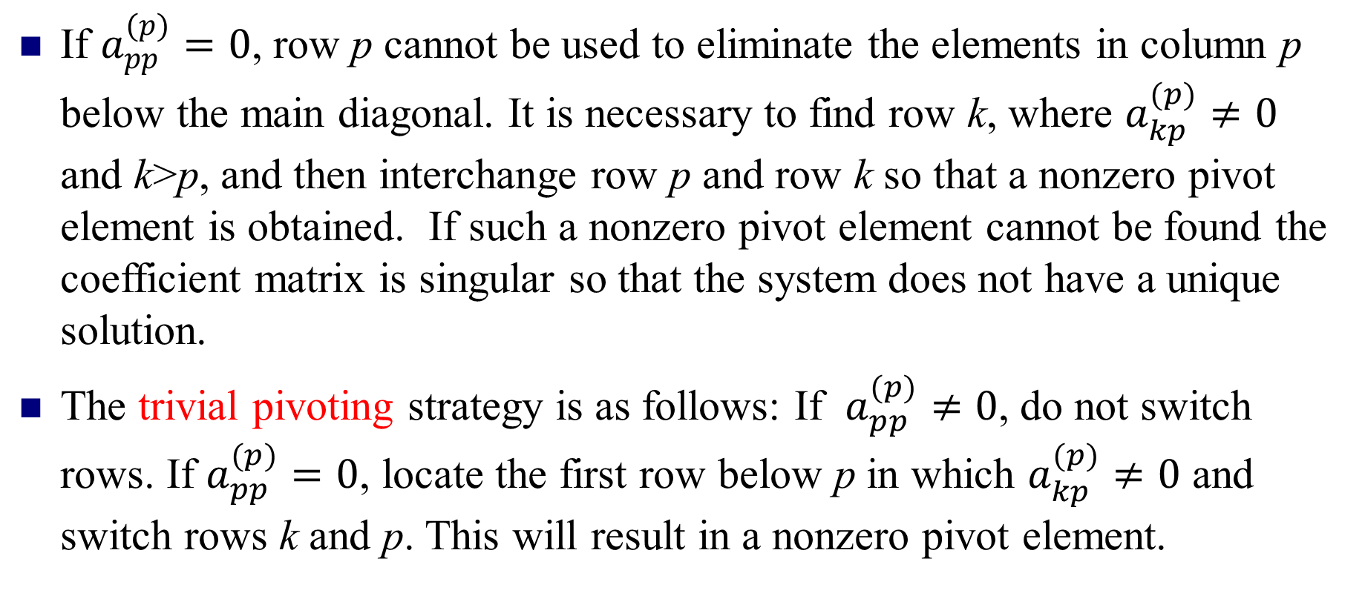
Pivoting Strategy
If $a_{pp}^{(p)}=0$, row p cannot be used to eliminate the elements in column pbelow the main diagonal. It is necessary to find row k, where $a_{kp}^{(p)}≠0$and k>p, and then interchange row p and row k so that a nonzero pivot element is obtained. If such a nonzero pivot element cannot be found the coefficient matrix is singular so that the system does not have a unique solution.
The trivial pivoting strategy is as follows: If $a_{pp}^{(p)}≠0$, do not switch rows. If $a_{pp}^{(p)}=0$, locate the first row below p in which $a_{kp}^{(p)}≠0$and switch rows k and p. This will result in a nonzero pivot element.

Slide 31
Pitfalls
Two Potential Pitfalls
Division by zero: May occur in the forward elimination steps. Consider the set of equations:
- Round-off error: Prone to round-off errors.

Slide 32
Pitfalls: Example
Consider the system of equations:
Use five significant figures with chopping
=
At the end of Forward Elimination
=

Slide 33
Pitfalls: Example
Back Substitution

Slide 34
Pitfalls: Example
Compare the calculated values with the exact solution

Slide 35
Improvements
Increase the number of significant digits
Decreases round off error
Does not avoid division by zero
Gaussian Elimination with Partial Pivoting
Avoids division by zero
Reduces round off error

Slide 36
Partial Pivoting
Gaussian Elimination with partial pivoting applies row switching to normal Gaussian Elimination.
How?
At the beginning of the k^{th} step of forward elimination, find the maximum of
If the maximum of the values is |a_{pk}| In the p^{th} row,
then switch rows p and k.

Slide 37
Partial Pivoting
What does it Mean?
Gaussian Elimination with Partial Pivoting ensures that each step of Forward Elimination is performed with the pivoting element |a_{kk}| having the largest absolute value.

Slide 38
Partial Pivoting: Example
Consider the system of equations
In matrix form
=
Solve using Gaussian Elimination with Partial Pivoting using five significant digits with chopping

Slide 39
Partial Pivoting: Example
Forward Elimination: Step 1
Examining the values of the first column
|10|, |-3|, and |5| or 10, 3, and 5
The largest absolute value is 10, which means, to follow the rules of Partial Pivoting, we switch row1 with row1.
Performing Forward Elimination

Slide 40
Partial Pivoting: Example
Forward Elimination: Step 2
Examining the values of the first column
|-0.001| and |2.5| or 0.0001 and 2.5
The largest absolute value is 2.5, so row 2 is switched with row 3
Performing the row swap

Slide 41
Partial Pivoting: Example
Forward Elimination: Step 2
Performing the Forward Elimination results in:

Slide 42
Partial Pivoting: Example
Back Substitution
Solving the equations through back substitution

Slide 43
Partial Pivoting: Example
Compare the calculated and exact solution
The fact that they are equal is coincidence, but it does illustrate the advantage of Partial Pivoting

Slide 44
Triangular Factorization
It is easy to solve a problem of the form Lx=b or Ux=b using forward/back elimination.
Suppose we are given a matrix A and we are able to find a lower triangular matrix L that has 1’s along the main diagonal and an upper-triangular matrix U with nonzero diagonal elements such that:
A = LU
Then to solve Ax=b we can solve two simple problems:
  Ly = b
  Ux = y
  (sanity check LUx = L(Ux) = Ly =b)

Slide 45
Triangular Factorization
Def. 2.3. The nonsingular matrix A has triangular factorization if it can be expressed as the product of a lower-triangular matrix L and an upper-triangular matrix U: A=LU.
In matrix form, this is written as
The condition that A is nonsingular implies that u_{kk}≠0 for all k.

Slide 46
LU Factorization
Can all nonsingular matrices A be factored as A=LU?
Example:
The necessary and sufficient condition for the unique LU factorization of an N×N matrix A is that the leading principal minors of each order of A are nonzero.

Slide 47
Example of LU Factorization
Suppose we are given:
Then we can write A = LU where:
Let’s check that:

Slide 48
LU Factorization (in words)
Construct a sequence of multiplier matrices
(M¹, M², M³, M⁴,…., M^{N-1}) such that:
(M^{N-1}…. M⁴ M³ M² M¹)A is an upper triangle matrix denoted as U.
A suitable candidate for M¹ is
the matrix ( 4 by 4 case):

Slide 49
LU Factorization-cont.
A suitable candidate for M² is
the matrix ( 4 by 4 case):
A suitable candidate for M³ is
the matrix ( 4 by 4 case):

Slide 50
LU Factorization-cont.
So in this case: U=(M³M²M¹)A is upper triangle
Each of the M matrices is lower triangle
The inverse of M² looks like:
Using the fact that the inverse of the each M matrix just requires us to negate the below diagonal terms
A = (M³M²M¹)⁻¹ U
= (M¹)⁻¹ (M²)⁻¹ (M³)⁻¹ U
Define L = (M¹)⁻¹ (M²)⁻¹ (M³)⁻¹ and we are done since the product of lower matrices is a lower matrix
In the p^{th} row,

Slide 51
When Basic LU Does Not Work
Remember that we are required to compute
1/A(i,i) for all the successive diagonal terms
What happens when we get to the i’th diagonal term and this turns out to be 0 or very small ?
At any point we can swap the i’th row with one lower down which does not have a zero (or small entry) in the i’th column.
This is known as partial pivoting.

Slide 52
Partial Pivoting
Remember before that we constructed a set of M matrices so that is upper triangle
Now we construct a sequence of M matrices and P matrices so that:
is upper triangle.
(M^{N-1}…. M⁴ M³ M² M¹)A
(M^{N-1} P^{N-1} …. M⁴ P⁴ M³ P³ M² P² M¹ P¹)A

Slide 53
Iterative Methods
Consider the linear system
or
or

Slide 54
Solution Methods
Gauss Elimination – Subject to roundoff errors and ill conditioning
Iterative methods – Alternative to elimination method
Take initial guess of solution and then iterate to obtain improved estimates of the solution
Jacobi and Gauss-Seidel methods
Work well for large sets of equations

Slide 55
Iterative Methods
Rearrange the equations so that an unknown is on the left-hand side of each equation:
Initial guess and an iterative rule

Slide 56
Jacobi Method
Initial guess
Next approximation of the solution

Slide 57
Jacobi Method
After k iterations of this process

Slide 58
Example – Jacobi Method
System of 3 equations in 3 unknowns
Rearrange

Slide 59
Example – Jacobi Method
Initial guess
After 20 iterations

Slide 60
Errors and Stopping Criteria
How do we know when to stop?
Two major sources of error in numerical methods:
  Roundoff error: Computers represent quantities with a finite number of digits
  Truncation error: Numerical methods employ approximations to represent exact mathematical operations and quantities
Consider the error between the numerical and analytical solutions
  True value
  Approximate value

Slide 61
Jacobi Method
Two issues to consider：
  Will the iteration converge to the solution of the systems?
  When will the iteration end? What are the stopping criteria of termination?

Slide 62
Criterion for convergence
Def. 2.4. A matrix A of dimension N×N is said to be strictly diagonally dominant provided that
Thm. 2.7. Suppose that A is a strictly diagonally dominant matrix. Then AX=B has a unique solution X=P. Jacobi Iteration and Gauss-Seidel Iteration will both produce a sequence of vectors {P_{k}} that will converge to P for any choice of the starting vector P₀.
for k＝1,2,…,N

Slide 63
Convergence
A measure of the closeness between vectors is needed so that we can determine if {P_{k}} is converging to P. The Euclidean distance between P=(x₁,x₂,…,x_{N}) and Q=(y₁,y₂,…,y_{N}) is
Its disadvantage is that it requires considerable computing effort.
Hence we introduce a different norm, ||X||₁:

Slide 64
Convergence
The following result ensures that ||X||₁ has the mathematical structure of a metric and hence is suitable to use as a generalized “distance formula”. From the study of linear algebra we know that on a finite-dimensional vector space all norms are equivalent; that is , if two vectors are close in the
||＊||₁ norm, then they are also close in the Euclidean norm
||＊||₂. So the norm ||＊||₁ can be used to define the distance between points and determine convergence in N-dimensional space.

Slide 65
Convergence
Thm. 2.8. Let X and Y be N-dimensional vectors and c be a scalar. Then the function ||X||₁ has the following properties:
  ||X||₁ ≥0，||X||₁ =0当且仅当X=0
  ||cX||₁ =|c|·||X||₁
  ||X+Y||₁ ≤||X||₁ +||Y||₁
Def. 2.5. Suppose that X and Y are two points in N-dimensional space. We define the distance between X and Y in the ||*||₁ norm as

Slide 66
Gauss Seidel Method
The current approximation of one of the unknowns is available for use after each step.
This information could be used immediately in the calculation of the next unknown.

Slide 67
Gauss-Seidel Method - Example
convenient initial guess
after 1 iteration of the method

Slide 68
Gauss-Seidel Method
after 2 iterations
after 1 iteration
after 9 iterations

