Slide 1
How to send your email

Slide 2
What are the purposes to write email?

Slide 3
Please/Ask someone to do something.
Let someone to realize you are doing something.
Let your boss to know you are doing something good/or having some problems.
Let someone’s boss to know his staff are doing something bad or good.

Slide 4
So…….
It is very important to identify
Who should be “To”,
Who should be “CC”

Slide 5
To :must be owner/doer
CC: Boss of you. Boss of owner/doer and other relative function member and colleague.

Slide 6
Push someone by email
To the detailed person.
Write 5W1H clear. What/when/where/who/why/how
To XXX at first time(+phone call)
No response ➔Second time to XXX, CC his and your boss,~~~phone call.
No response again ➔ Third time to his boss, CC boss’s boss.

Slide 7
Common sense of email
Do not assume the receiver will follow for sure.
Pay attention on words, use spelling check well.
Consider mail size when reply, do not always “reply with history”.
Do leave signature!! Let others know who are you and how to find you.

Slide 8
Type of Business Email
Request
Follow-up
Reminder
Postponement

Slide 9
Request
A message asking the receiver to do something.
Focus immediately on the information you need.
Tell why you need the information if the reason is not obvious.
Emphasize due dates.
Supply any further information.

Slide 10
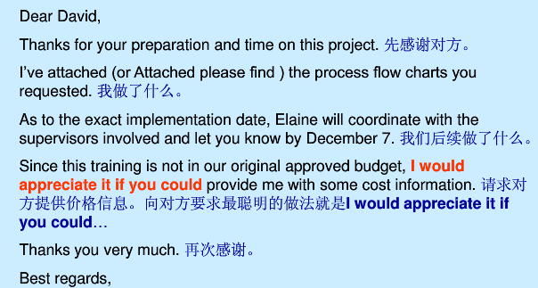

Slide 11
Follow -up
State immediately that the email is a follow-up. Restate your original message and request.

Slide 12
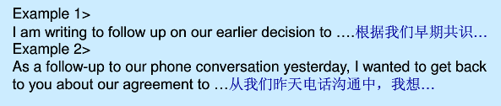
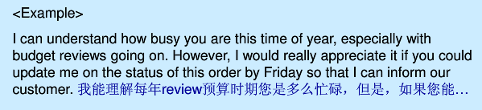
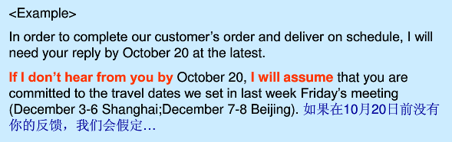

Slide 13

Reminders
State up front the item you wish to remind the reader about and his/her expected action.
repeat all necessary information: time, date, place, purpose, topics of concern, deadlines etc.
Both the subject line and the body should have the word ”reminder”

Slide 14
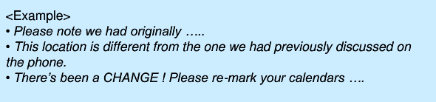
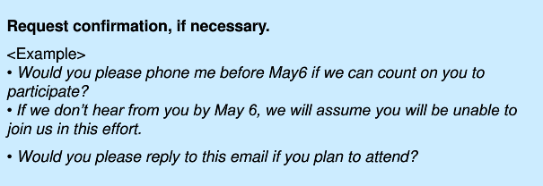

Slide 15
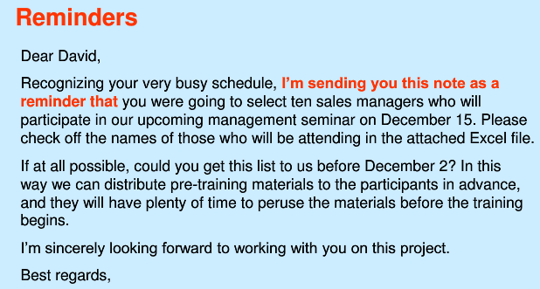

Slide 16
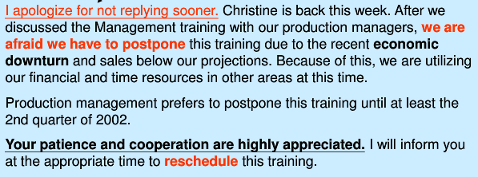
Postponement
Let us look at how Nicole request David to postpone the training.
Dear David,
Best Regards,
Nicole

Slide 17
The Last One:
No Email War!!

