Slide 1
Introduction to Advanced Mathematics 1
Wenjun Ma (马文俊）
School of Computer Science, SCNU
phoenixsam@sina.com

Slide 2
01
Course Information
02
Overview
English of Mathematical Symbols and Formulas
03

Slide 3
Brief Introduction
An basic mathematical course lasted for one year.
Not just things to be memorized, but things to be understood
Practice makes perfect
It is a prerequisite course for probability theory and mathematical statistics, complex variable functions, mathematical physics equation, etc.
No matter you like it or not, you need to master it.
Relevance course(s): exercise class.
12 credits for the whole course.

Slide 4
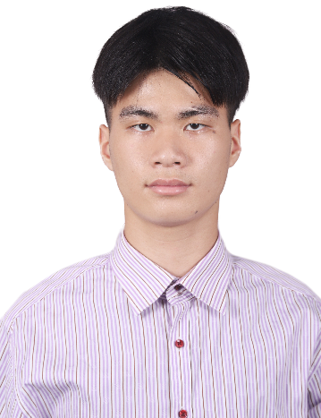
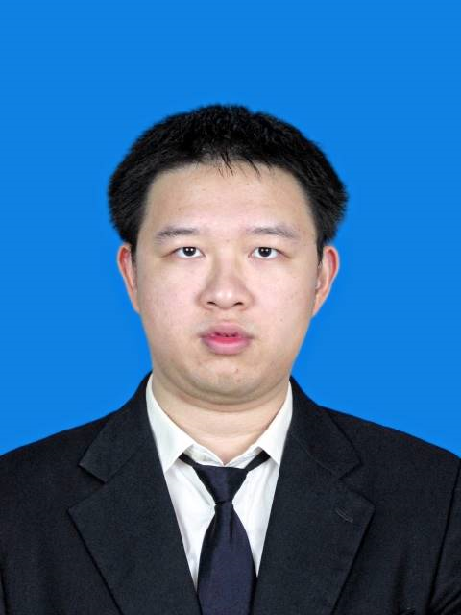
Course Assistant
Name: Pan Li (李攀）
E-mail: lipan@m.scnu.edu.cn
course assistant
1. Checking the homework;
2. Checking the problem in exercise course;
3. Answer the question related to
the homework and exercise.
Name: RuiFeng Zou (邹瑞峰）
E-mail: zruifeng@m.scnu.edu.cn
course assistant
1. Checking the homework;
2. Checking the problem in exercise course;
3. Answer the question related to
the homework and exercise.

Slide 5
Material
Notes (Most Important!)
it can be considered as a textbook (教材）.
prepare lessons before class and review after class based on it.
Question set: use for homework
Slides: contains more details for the content in Notes, only presented on the class, no share except this one.
Reference: Calculus, James Stewart, Cengage Learning (7th Edition, International Metric Version, 2012). Supplementary material for self learning.

Slide 6
Lecture course
Slides and blackboard-writing will be applied explain the key and difficult points of relevant notes.
And homework will be assigned each week to enhance the study effect.
You should finish the homework in time and upload it to MyAberdeen or 砺儒云课堂 before Monday of the following week.

Slide 7
Lecture course assessment
Assessment | Requirements | %
Coursework | Homework submissions | 20
Final Exam | Written test, closed book | 80

Slide 8
Requirement
Written Assignments: One problem sets for homework each week, comprising 20% of the grade.
Final Exam: worth 80% of the final grade. The final exam covers primarily material in Notes, but may also cover material in Slides.
Preparation Readings: You are responsible for completing all assigned reading before the class indicated in the schedule, whether or not the material is covered in lectures.

Slide 9
Excise course
some typical problems of relevant notes will be analysed.
And you should finish some exercise assignments similarly to the typical problems on the class and after class as well.
You should upload exercise assignments to 砺儒云课堂 before Monday of the following week as well.
Finally, some common mistakes of homework and exercise assignments will be explained in the exercise course.

Slide 10
Excise course assessment
Assessment | Requirements | %
Coursework | Homework submissions | 20
Attendance and participation | Attendant course in time | 20
Midterm Exam | Written test, closed book | 60

Slide 11
Homework Submission
Website for homework submission:
MyAberdean
(JC1004(2022-23):Advanced Mathematics I-1) (for AI class)
砺儒云课堂：阿伯丁数据科学与人工智能学院 高等数学（II-1）
https://moodle.scnu.edu.cn/course/view.php?id=12492
（for SE class）

Slide 12
01
Course Information
02
Overview
English of Mathematical Symbols and Formulas
03

Slide 13
Overview of the Course
mainly studies the calculus (微积分）
Calculus is the mathematical study of continuous change.
It has two major branches, differential calculus (微分） and integral calculus （积分）; the former concerns instantaneous rates of change, and the slopes of curves, while integral calculus concerns accumulation of quantities, and areas under or between curves. （distance, speed）

Slide 14
Overview of the Course
The course begins with an introduction to fundamental mathematical concepts; it then develops the basic ideas of the calculus of functions of a single variable and explains some of the ways it is applied.

Slide 15
01
Course Information
02
Overview
English of Mathematical Symbols and Formulas
03

Slide 16
Basic Math Symbols
1+2： one plus two；
+4: positive four；
9x6: nine times six；
15÷3: fifteen is divided by three.

Slide 17
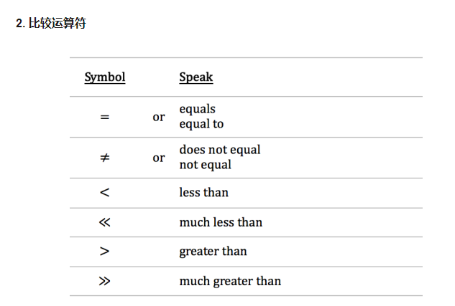
Basic Math Symbols
1+4>3 : one plus four is greater than three;
4+5=9 : four plus five equals nine 或 four plus five is equal to nine.

Slide 18
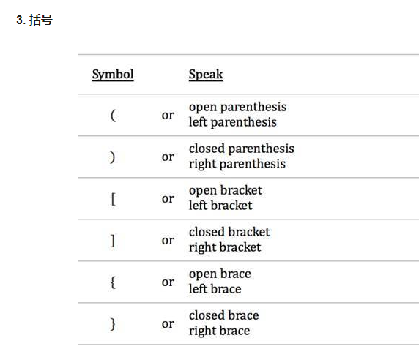
Basic Math Symbols

Slide 19
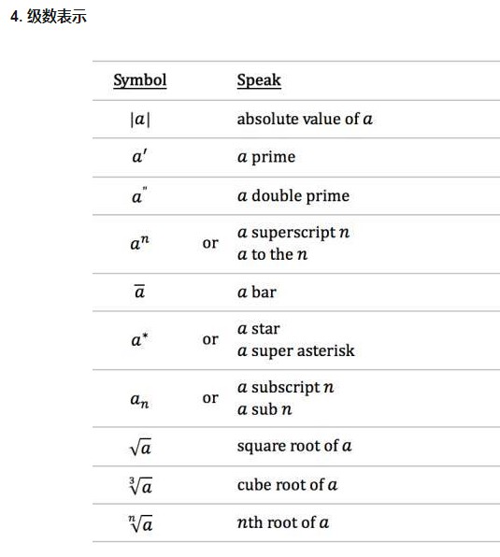
Basic Math Symbols

Slide 20
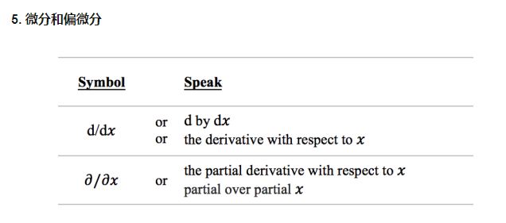
Basic Math Symbols

Slide 21
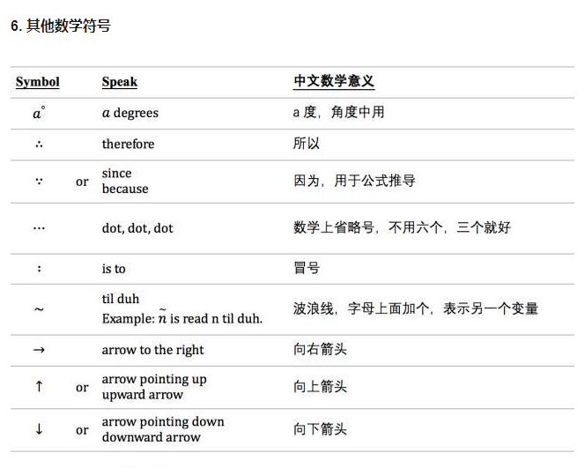
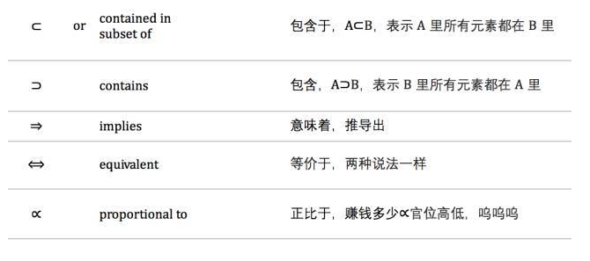
Basic Math Symbols

Slide 22
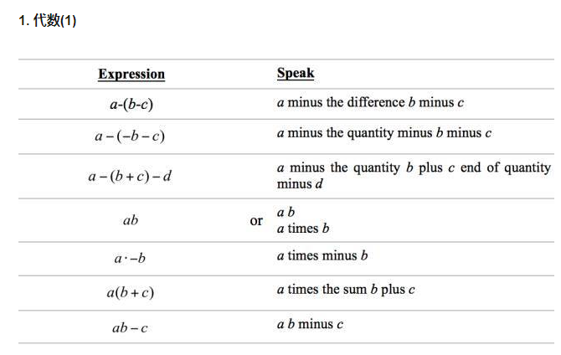
Advanced Math Symbols

Slide 23
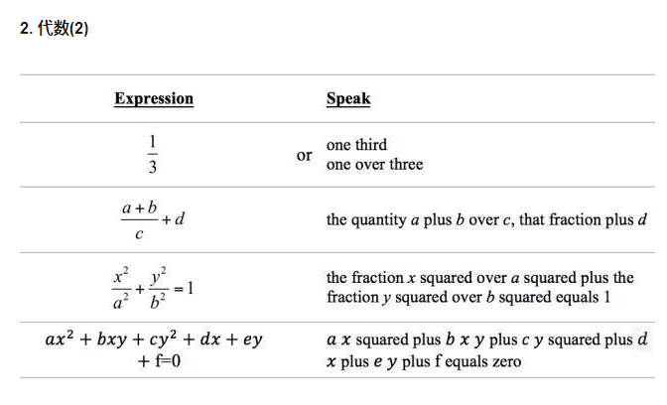
Advanced Math Symbols

Slide 24
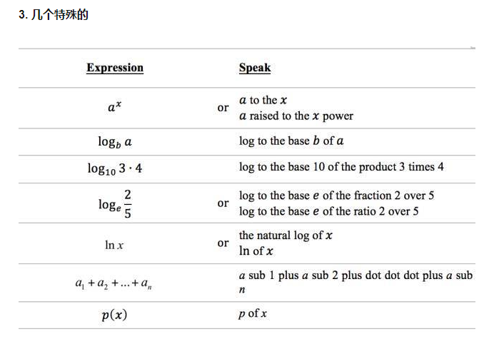
Advanced Math Symbols

Slide 25
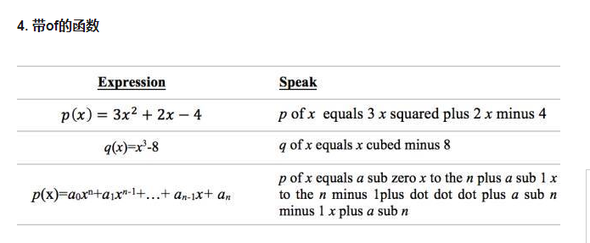
Advanced Math Symbols

Slide 26
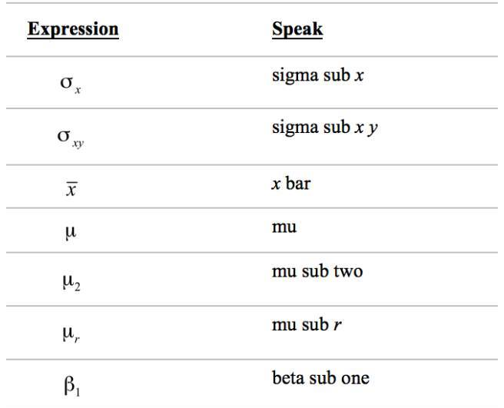
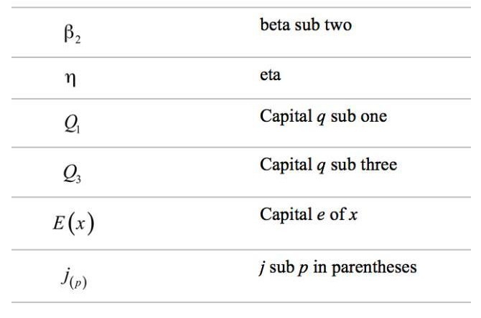
Advanced Math Symbols

Slide 27
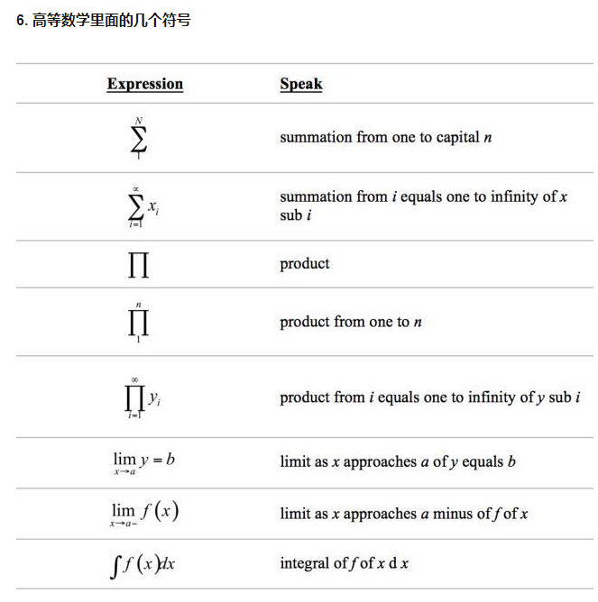
Advanced Math Symbols

