Slide 1
Numerical Differentiation

Slide 2
Numerical Differentiation
Estimate the derivatives (slope, curvature, etc.) of a function by using the function values at only a set of discrete points
Ordinary differential equation (ODE)
Partial differential equation (PDE)
Represent the function by Taylor polynomials or Lagrange interpolation
Evaluate the derivatives of the interpolation polynomial at selected nodal points

Slide 3
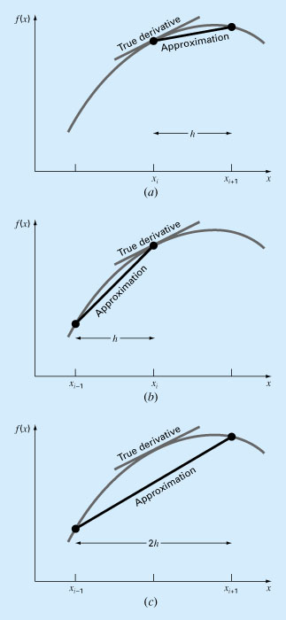
Forward difference
Numerical Differentiation
Backward difference
Centered difference

Slide 4
Forward difference
True derivative
Approximation
h
x
x_{i−1} x_{i} x_{i+1}

Slide 5
Backward difference
True derivative
Approximation
h
x
x_{i−1} x_{i} x_{i+1}

Slide 6
Centered difference
True derivative
Approximation
2h
x
x_{i−1} x_{i} x_{i+1}

Slide 7
First Derivatives
y
x
i-2 i-1 i i+1 i+2
Forward difference
Backward difference
Central difference

Slide 8
Truncation Errors
Uniform grid spacing

Slide 9
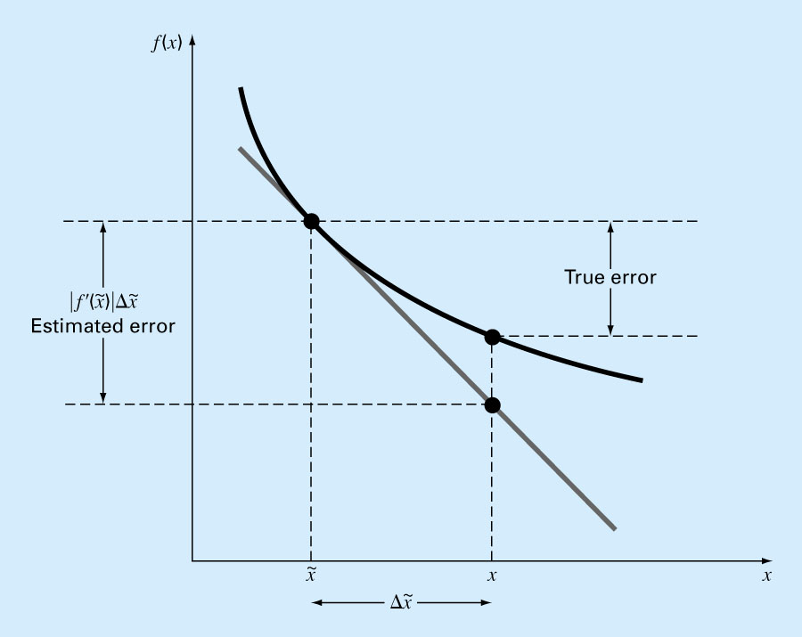
Error Propagation
Error in x leads to error in f(x)

Slide 10
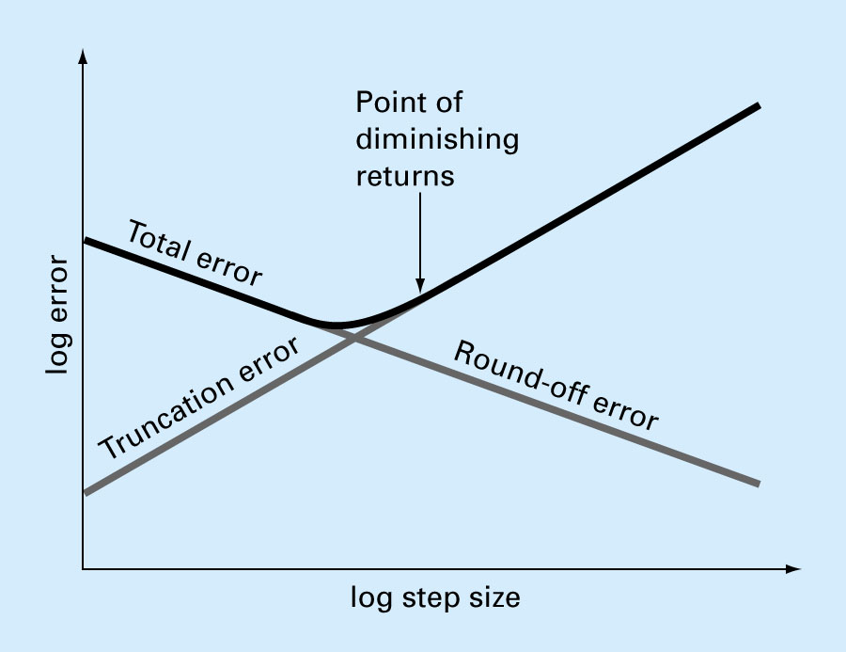
Trade-off between truncation and round-off errors
Total Numerical Error

Slide 11
Example: First Derivatives
Use forward and backward difference approximations to estimate the first derivative of
at x = 0.5 with h = 0.5 and 0.25 (exact sol. = -0.9125)
Forward Difference
Backward Difference

Slide 12
Example: First Derivative
Use central difference approximation to estimate the first derivative of
at x = 0.5 with h = 0.5 and 0.25 (exact sol. = -0.9125)
Central Difference

Slide 13
Second-Derivatives
Taylor-series expansion
Uniform grid spacing
Second-order accurate O(h²)

Slide 14
General Three-Point Formula
Lagrange interpolation polynomial for unequally spaced data

Slide 15
Lagrange Polynomials
Kronecker Delta function

Slide 16
Lagrange Interpolation
1st-order Lagrange polynomial
Second-order Lagrange polynomial

Slide 17
Lagrange Interpolation
Third-order Lagrange polynomial

Slide 18
Lagrange Interpolation
L₀(x)f(x₀)
L₂(x)f(x₂)
x₀
x₁
x₂
L₁(x)f(x₁)

Slide 19
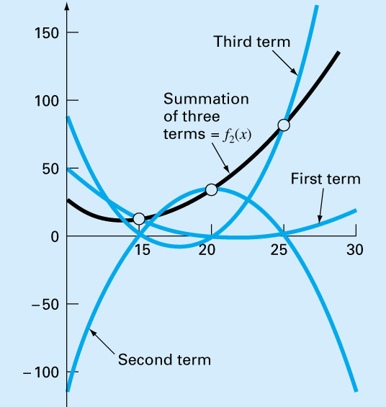
Lagrange Polynomial

Slide 20
General Three-Point Formula
Lagrange interpolation polynomial for unequally spaced data
First derivative

Slide 21
Second Derivative
First Derivative for unequally spaced data
Second Derivative for unequally spaced data

Slide 22
Three-point formula (Uniform Grid)
Forward difference
Centered difference
Backward difference

Slide 23
First Derivatives
Parabolic curve
i-2 i-1 i i+1 i+2
3 -point Forward difference
3 -point Backward difference

Slide 24
Example: First Derivatives
Use forward and backward difference approximations of O(h²) to estimate the first derivative of
at x = 0.5 with h = 0.25 (exact sol. = -0.9125)
Forward Difference
Backward Difference

Slide 25
Higher Derivatives
All second-order accurate O(h²)
More nodal points are needed for higher derivatives
Higher order formula may be derived

Slide 26
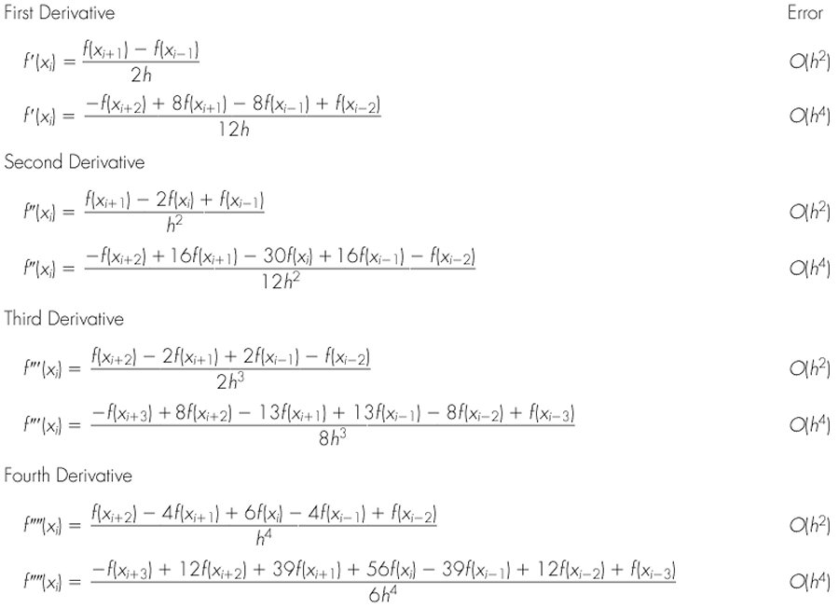
Centered Finite-Divided Differences

Slide 27
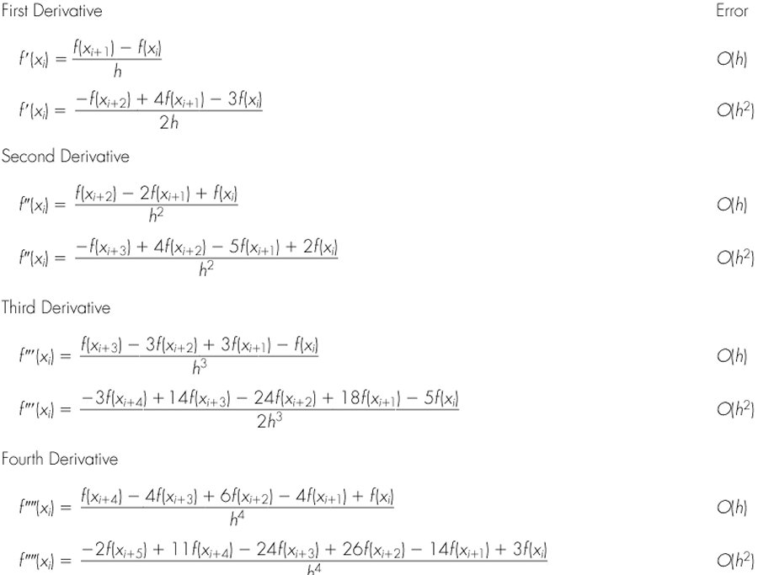
Forward Finite-divided differences

Slide 28
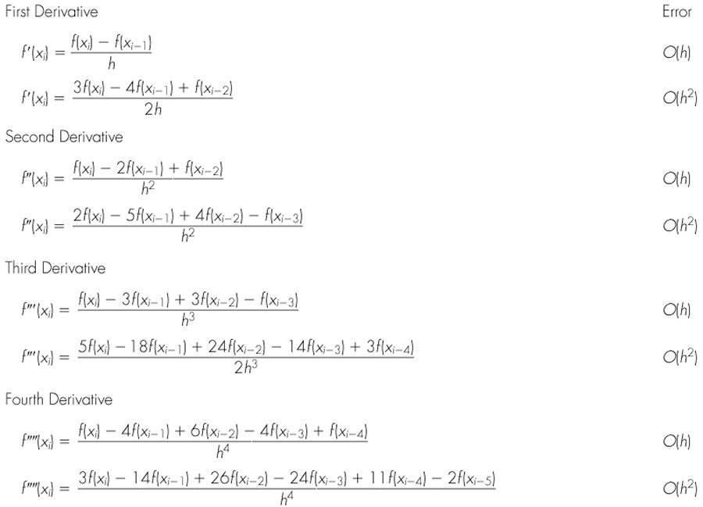
Backward finite-divided differences

Slide 29
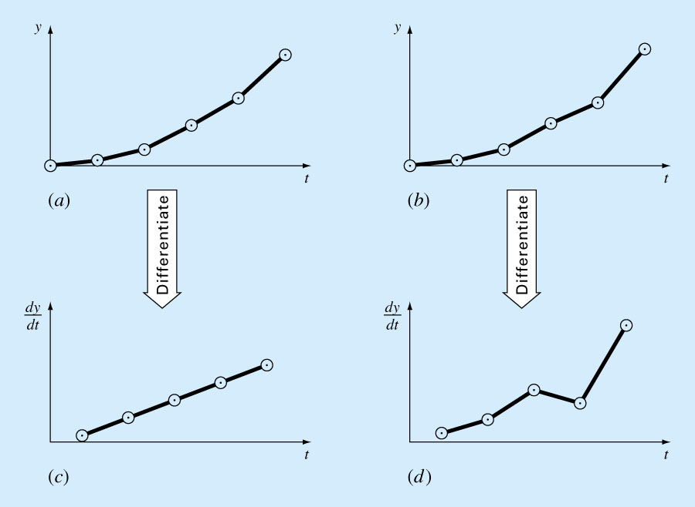
Differentiation of Noisy Data

Slide 30
MATLAB’s Methods
Derivatives are sensitive to the noise
Use least square fit before taking derivatives
p = polyfit(x, y, n) - coefficients of P_{n}(x)
polyval(p, x) - evaluation of P_{n}(x)
polyder(p) - differentiation

