Slide 1
Introduction to Computer Science and Technology
Chapter 15 Communication
--Networking

Slide 2
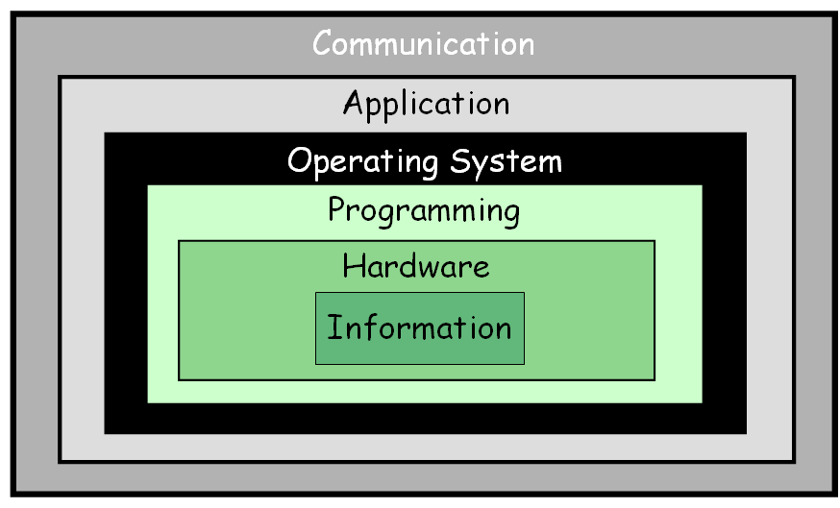
The Communication Layer

Slide 3
Chapter Goals
Describe the core issues related to computer networks
List various types of networks and their characteristics
Explain various topologies of local-area networks
Explain why network technologies are best implemented as open systems
Compare and contrast various technologies for home Internet connections
Explain packet switching
Describe the basic roles of various network protocols
Explain the role of a firewall
Compare and contrast network hostnames and IP addresses
Explain the domain name system
Describe cloud computing and its benefits

Slide 4
Networking
Computer network
A collection of computing devices connected in order to communicate and share resources
Connections between computing devices can be physical using wires or cables or wireless using radio waves or infrared signals
Can you name some of the devices in a computer network?

Slide 5
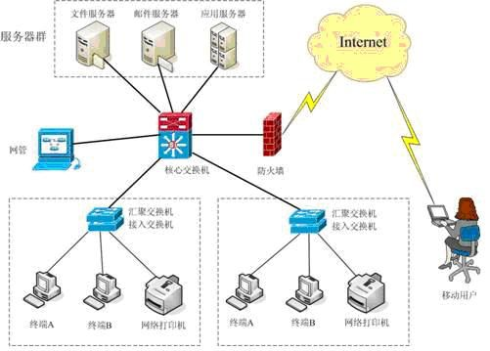
Networking
Node (host)
Any device on a network
Data transfer rate (bandwidth)
The speed with which data is moved from one place to another on a network
Why is bandwidth so key?

Slide 6
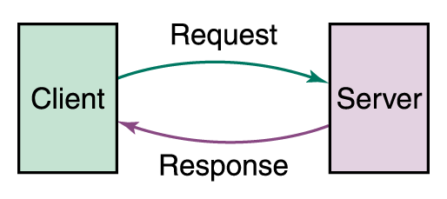
Networking
Computer networks have opened up an entire frontier in the world of computing called the client/server model
Figure 15.1 Client/Server interaction

Slide 7
Networking
Protocol
A set of rules that defines how data is formatted and processed on a network; i.e., rules that allow client/server interaction
File server
A computer that stores and manages files for multiple users on a network
Web server
A computer dedicated to responding to requests (from the browser client) for web pages

Slide 8
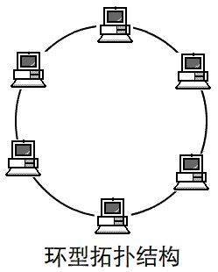
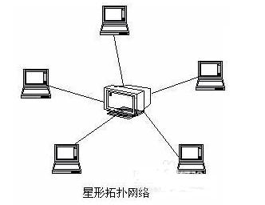
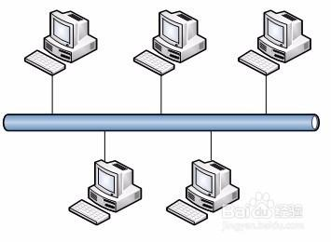
Types of Networks
Local-area network (LAN)
A network that connects a relatively small number of machines in a relatively close geographical area
Ring topology connects all nodes in a closed loop on which messages travel in one direction
Star topology centers around one node to which all others are connected and through which all messages are sent
Bus topology nodes are connected to a single communication line that carries messages in both directions
Ethernet
The industry standard bus technology for local-area networks

Slide 9
Types of Networks
Wide-area network (WAN)
A network that connects local-area networks over a potentially large geographic distance
Metropolitan-area network (MAN)
The communication infrastructures that have been developed in and around large cities
Gateway
One particular set up to handle all communication going between that LAN and other networks

Slide 10
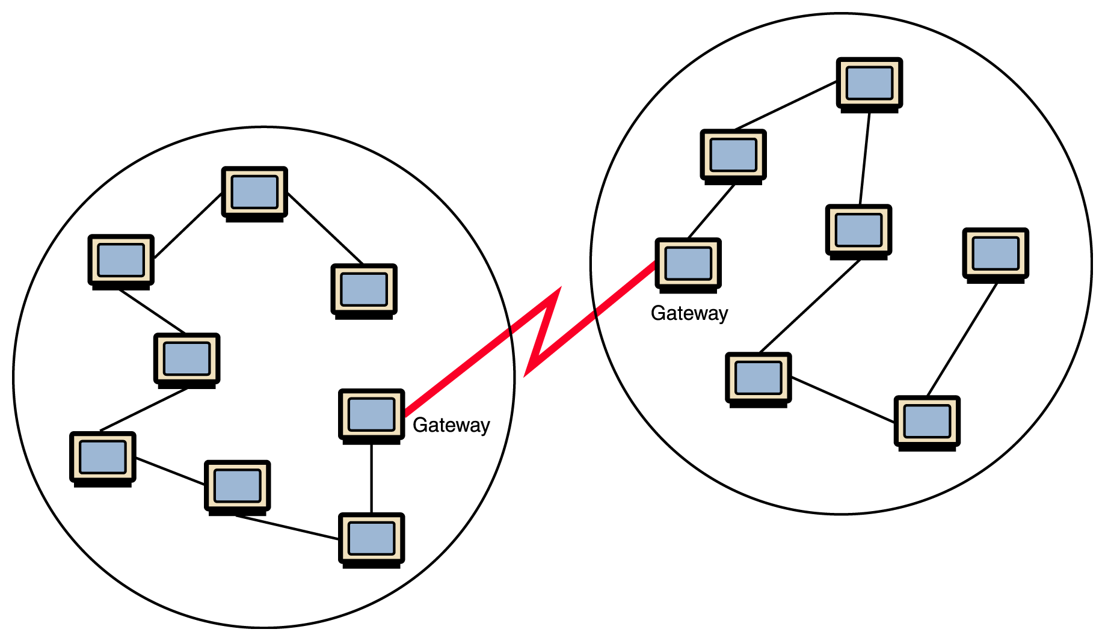
Types of Networks
Figure 15.1 Local-area networks connected across a distance to create a wide-area network

Slide 11
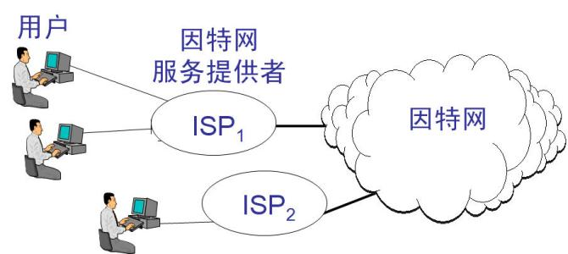
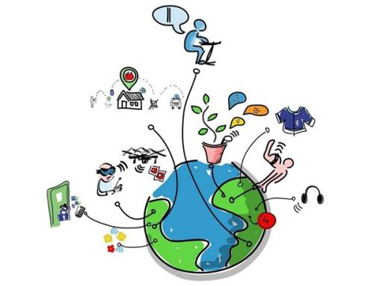
Types of Networks
Internet
A wide area network that spans the planet
So, who owns the Internet?

Slide 12
Internet Connections
Internet backbone
A set of high-speed networks that carry Internet traffic, provided by companies such as AT&T, Verizon, GTE, British Telecom, and IBM
Internet service provider (ISP)
A company that provides other companies or individuals with access to the Internet

Slide 13
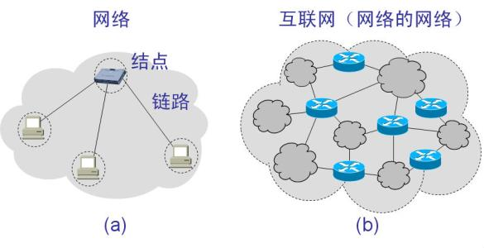
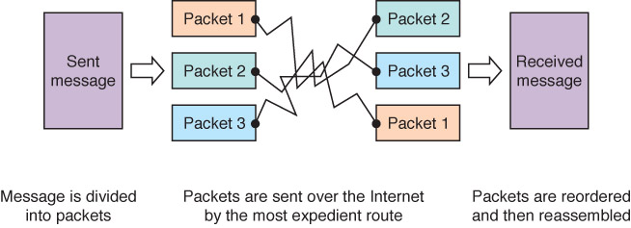
Packet Switching
Packet
A unit of data sent across a network
Router
A network device that directs a packet between networks toward its final destination
Packet switching
Messages are divided into fixed-sized, numbered packets; packets are individually routed to their destination, then reassembled
Figure 15.4 Messages sent by packet switching
Take a message,
break it into three packets,
and
simulate this process

Slide 14
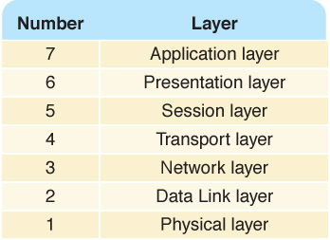
Open Systems
A logical progression...
Open systems
Systems based on a common model of network architecture and a suite of protocols used in its implementation
Open Systems Interconnection Reference Model
A seven-layer logical break down of network interaction to facilitate communication standards
Each layer deals with a particular aspect of network communication
Figure 15.5 The layers of the OSI Reference Model

Slide 15
Network Protocols
Network protocols are layered such that each one relies on the protocols that underlie it
Sometimes referred to as a protocol stack
Figure 15.6 Layering of key network protocols

Slide 16
TCP/IP Protocol
Application: supporting network applications
FTP, SMTP, HTTP
Transport: host-host data transfer
TCP, UDP
Network: routing of datagrams from source to destination
IP, routing protocols
Link: data transfer between neighboring network elements
PPP, Ethernet
Physical: bits “on the wire”
application
transport
network
link
physical

Slide 17
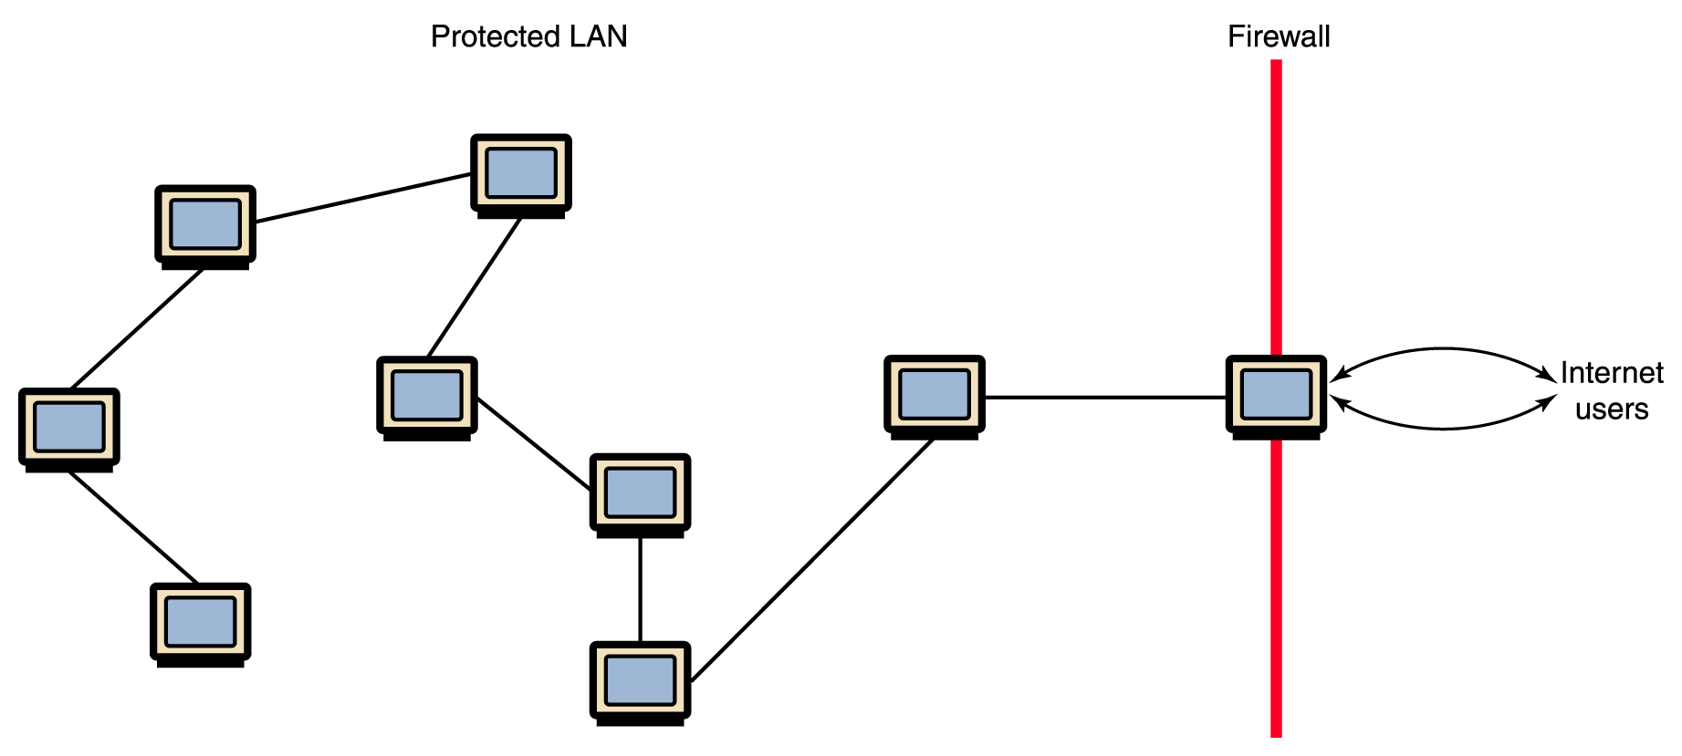
Firewalls
Firewall
A gateway machine and its software that protects a network by filtering the traffic it allows
Have your messages ever been
returned undelivered, blocked by a firewall?

Slide 18
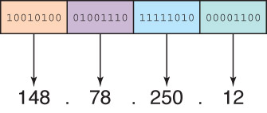
Network Addresses
Hostname
A name made up of words separated by dots that uniquely identifies a computer on the Internet
IP address
An address made up of four one-byte numeric values separated by dots that uniquely identifies a computer on the Internet
Is there a correspondence between the parts of a hostname and an IP address?

Slide 19
Network Addresses
IPv4
The last block was assigned in 2011
IPv6
32 bits organized into 4 groups of 8
FE80:0000:0000:0000:0202:B3FF:FE1E:8329
They work in parallel

Slide 20
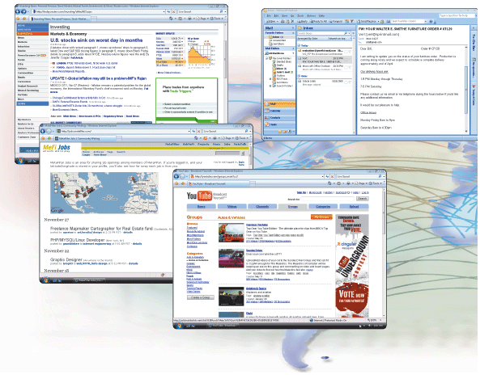
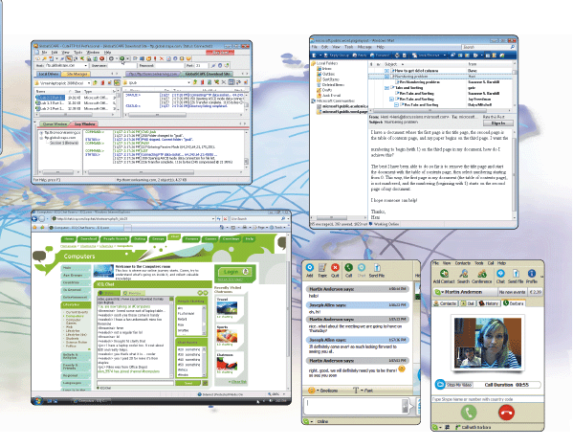
What are some services found on the Internet?

Slide 21
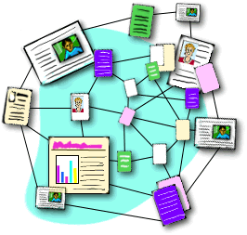
The World Wide Web
The Web
An infrastructure of information combined and the network software used to access it
Web page
A document that contains or references various kinds of data
Links A connection between one web page and another
What are the links used for?

Slide 22
The World Wide Web
Website
A collection of related web pages
Web browser
A software tool that retrieves and displays eb pages
Web server
A computer set up to respond to requests for web pages
Uniform Resource Locator (URL)
A standard way of specifying the location of a Web page
What is the relationship between the Internet and the Web?

Slide 23
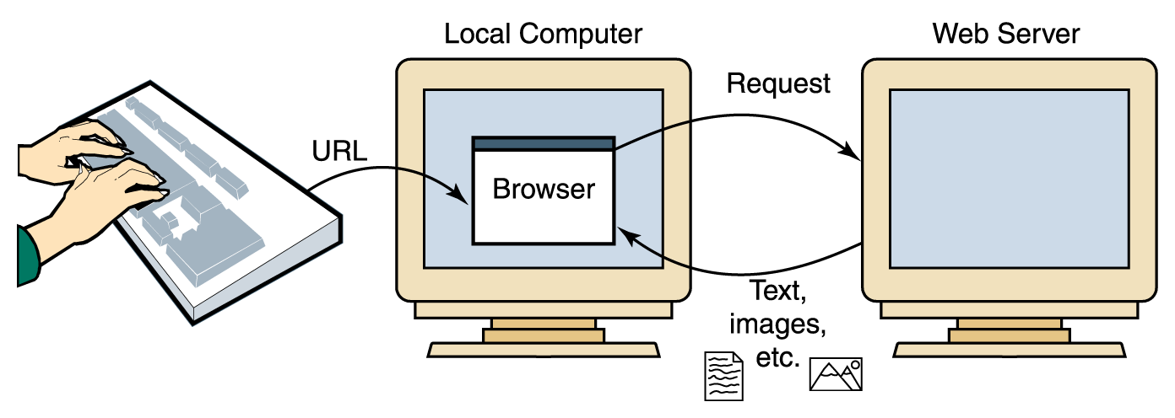
The World Wide Web
Figure 16.1 A browser retrieving a Web page
URL (Uniform Resource Locator, 统一资源定位符): Unique address for a Web page
例：www.scnu.edu.cn/index.html
HTTP (Hyper Text Transfer Protocol)超文本传输协议

Slide 24
Design a Web
HTML (Hyper Text Make-up Languages,超文本标记语言)\HTML5
Java Scrip
JSP(Java服务器页)
XML (Extensible Markup Language,可扩展标记语言)
XSL(eXtensible Stylesheet Language,可扩展样式表语言)

Slide 25
Cloud Computing
Public clouds are accessible by any subscriber
Private clouds are established for a specific group or organization
Community clouds are shared among two or more organizations with the same needs
Hybrid clouds are some combination of the others

Slide 26
The development of Internet Application
Mobile Application and Service
E-commercial and E-government
Internet of things
Cloud Computing
E-marketing
Integrated service
Multimedia
service
Dynamic webpage amd information issue
Information interaction
Static webpage amd information issue
E-mail ，FTP information Intercation
The Internet is not only interconnected technology of computers,but also interconnected system of global unify application.
互联网不仅是计算机互连技术，还是全球统一应用互联体系。

