Slide 1
Chapter 11 File Systems and Directories
p363
Mandatory
1.File types and file extension.
2.The hierarchical tree structure of directories, absolute/ relative path
Extended
1.The definitions of file system;Text files and binary files.
2.The typical operations on files, file Access and file Protection.
3.The definition of directories
4.Disk scheduling Algorithms.

Slide 2
Contents
11.1 File System
11.2 Directories
11.3 Disk Scheduling

Slide 3
11.1 File System
p364
File文件：被命名的数据集合，用于组织辅助存储器的数据信息。
File System文件系统：操作系统为其管理的文件提供的逻辑视图。
Text and Binary Files
Text文本文件：包含字符的文件；
Binary Files二进制文件：包含特定格式数据的文件，要求一个特定的位串解释。
File Types 文件类型
File Type
The kind of information contained in a document
Most files, regardless of format, contain a specific type of information文件中包含的信息的种类;
File extension
Part of a file name that indicates the type
File names are often in two parts:
使用文件扩展名标识

Slide 4
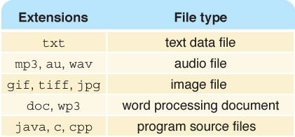
File Types
What kinds of files are the following?
Chapter.doc
Figure1.jpg
Interview.wav
MyFavorite.mp3
Figure 11.1 Some common file
types and their extensions
What's the advantage of using the
appropriate extension?

Slide 5
File Operations 文件操作
p367
Create 创建/Delete 删除
Open 打开/Close 关闭
Read 读取/Write 写入
Reposition the current file pointer in a file 重定位文件中的当前指针
Append 附加
Truncate 删减（删除内容）
Rename 重命名
Copy 复制

Slide 6
File Access and File Protection
p368,369
File Access 文件访问
Sequential file access 顺序访问
Direct file access 直接访问
File Protection 文件保护 (for Multi-user System 多用户系统)
Read
Write/Delete
Execution

Slide 7
File Access
Sequential access
The technique in which data in a file is accessed in a linear fashion; to get the last record, you must read all of the records
Direct access
The technique in which data in a file is conceptually divided into numbered logical records and accessed directly, by specifying logical record numbers

Slide 8
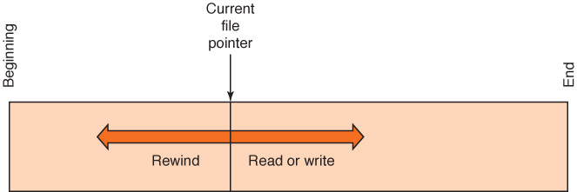
File Access
Figure 11.2 Sequential file access

Slide 9
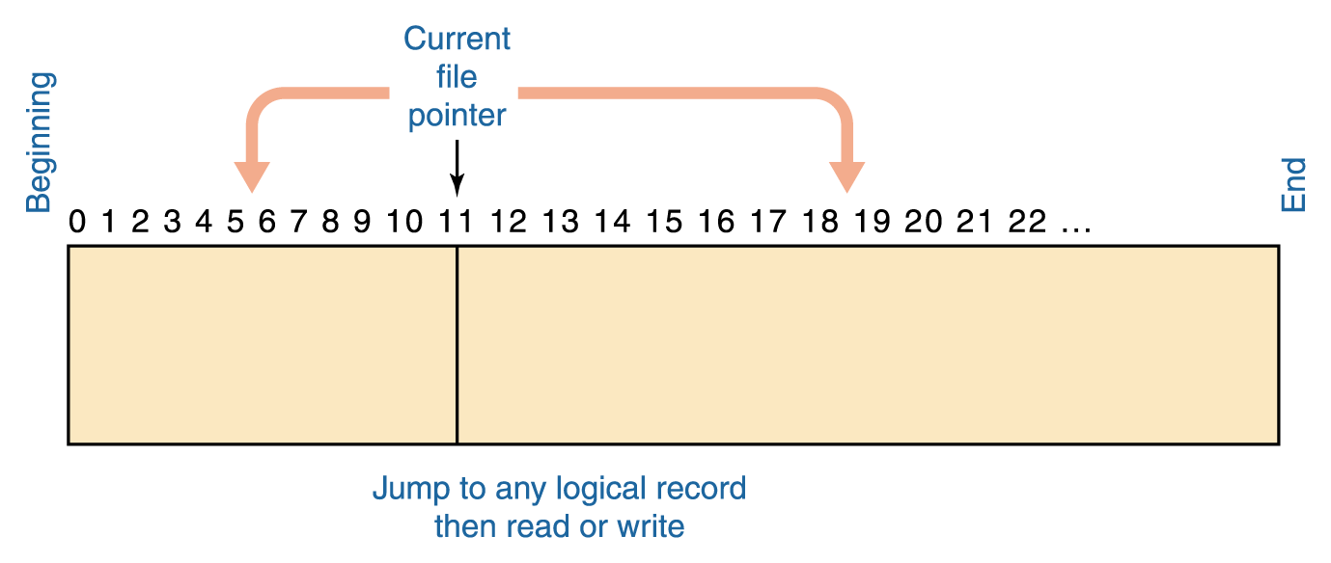
File Access
Figure 11.3 Direct file access

Slide 10
File Access
Which file access do you think is easier to implement: sequential access or direct access?

Slide 11
11.2 Directories
Directory trees 目录树 (p371)
Hierarchical tree structure
Path names: location of a file or directory (p372)
absolute path name 绝对路径
relative path name 相对路径
current working directory
Examples (p372,373)

Slide 12
Directory Trees
Recall that a directory is a named group of files.
A directory can be contained within another directory
Directory
Edition 3
CSI PP Slides
Directory
…
Chapter01.ppt
Chapter17.ppt
Files

Slide 13
Directory Trees
Parent directory
The containing directory
Subdirectory
The directory being contained
Directory tree
A logical view of a file system; a structure showing the nested directory organization of a file system
Root directory
The directory at the highest level

Slide 14
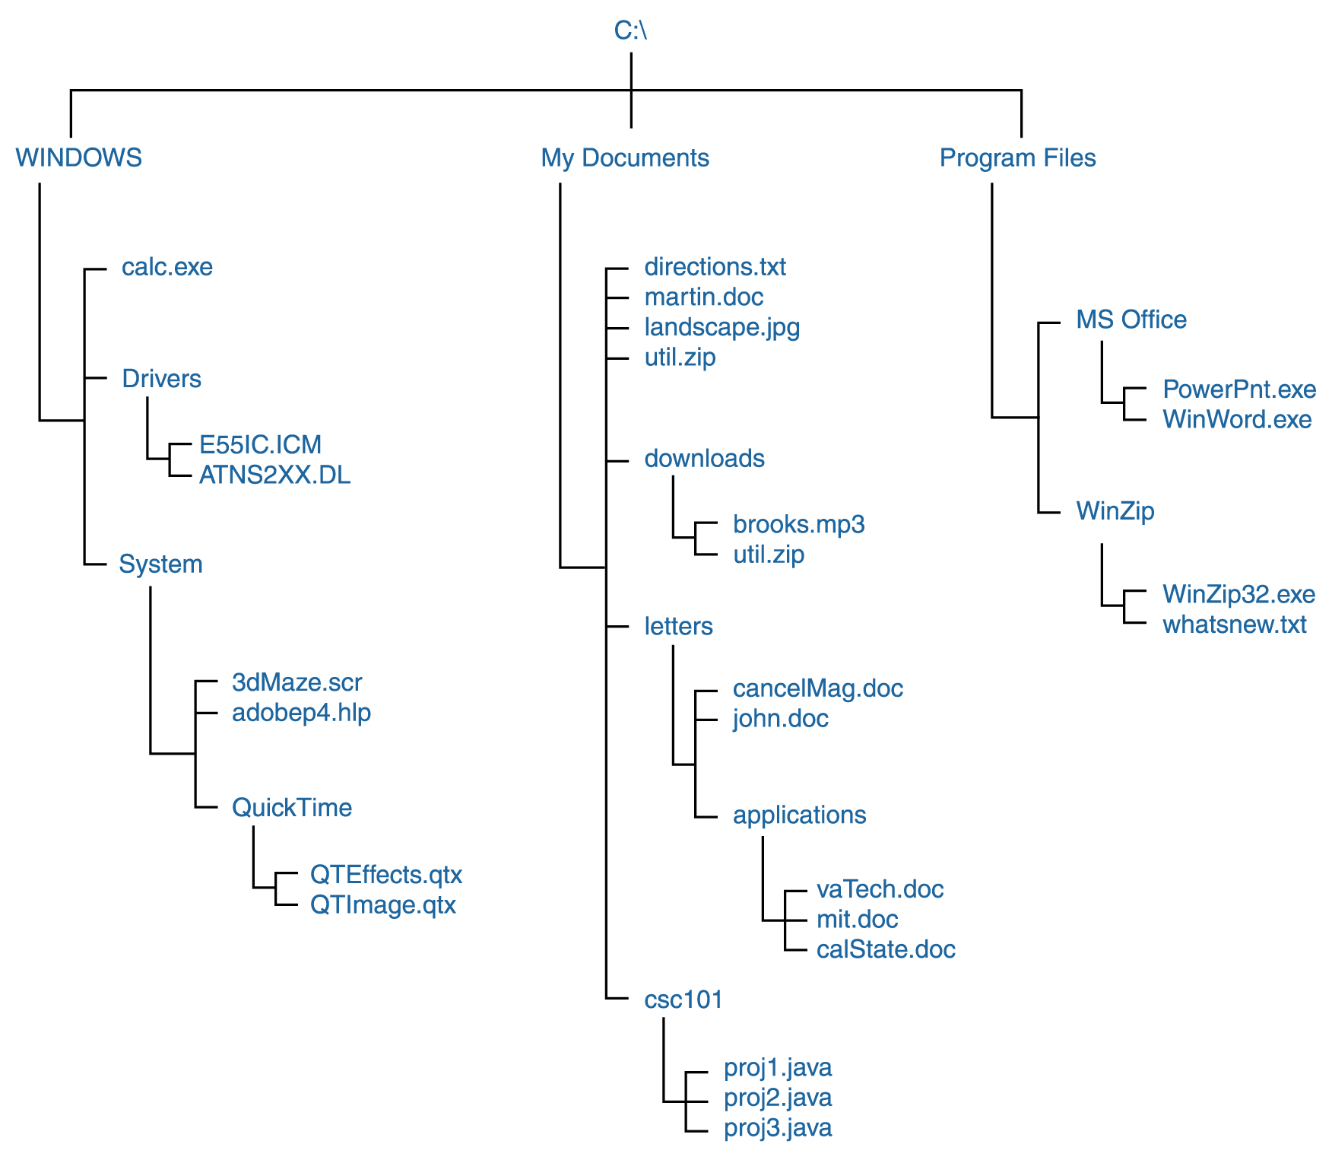
Directory Trees
Figure 11.4 A Windows directory tree

Slide 15
Directory Trees
At any point in time, you can be thought of as working in a particular location (that is, a particular subdirectory)
Working directory
The subdirectory in which you are working

Slide 16
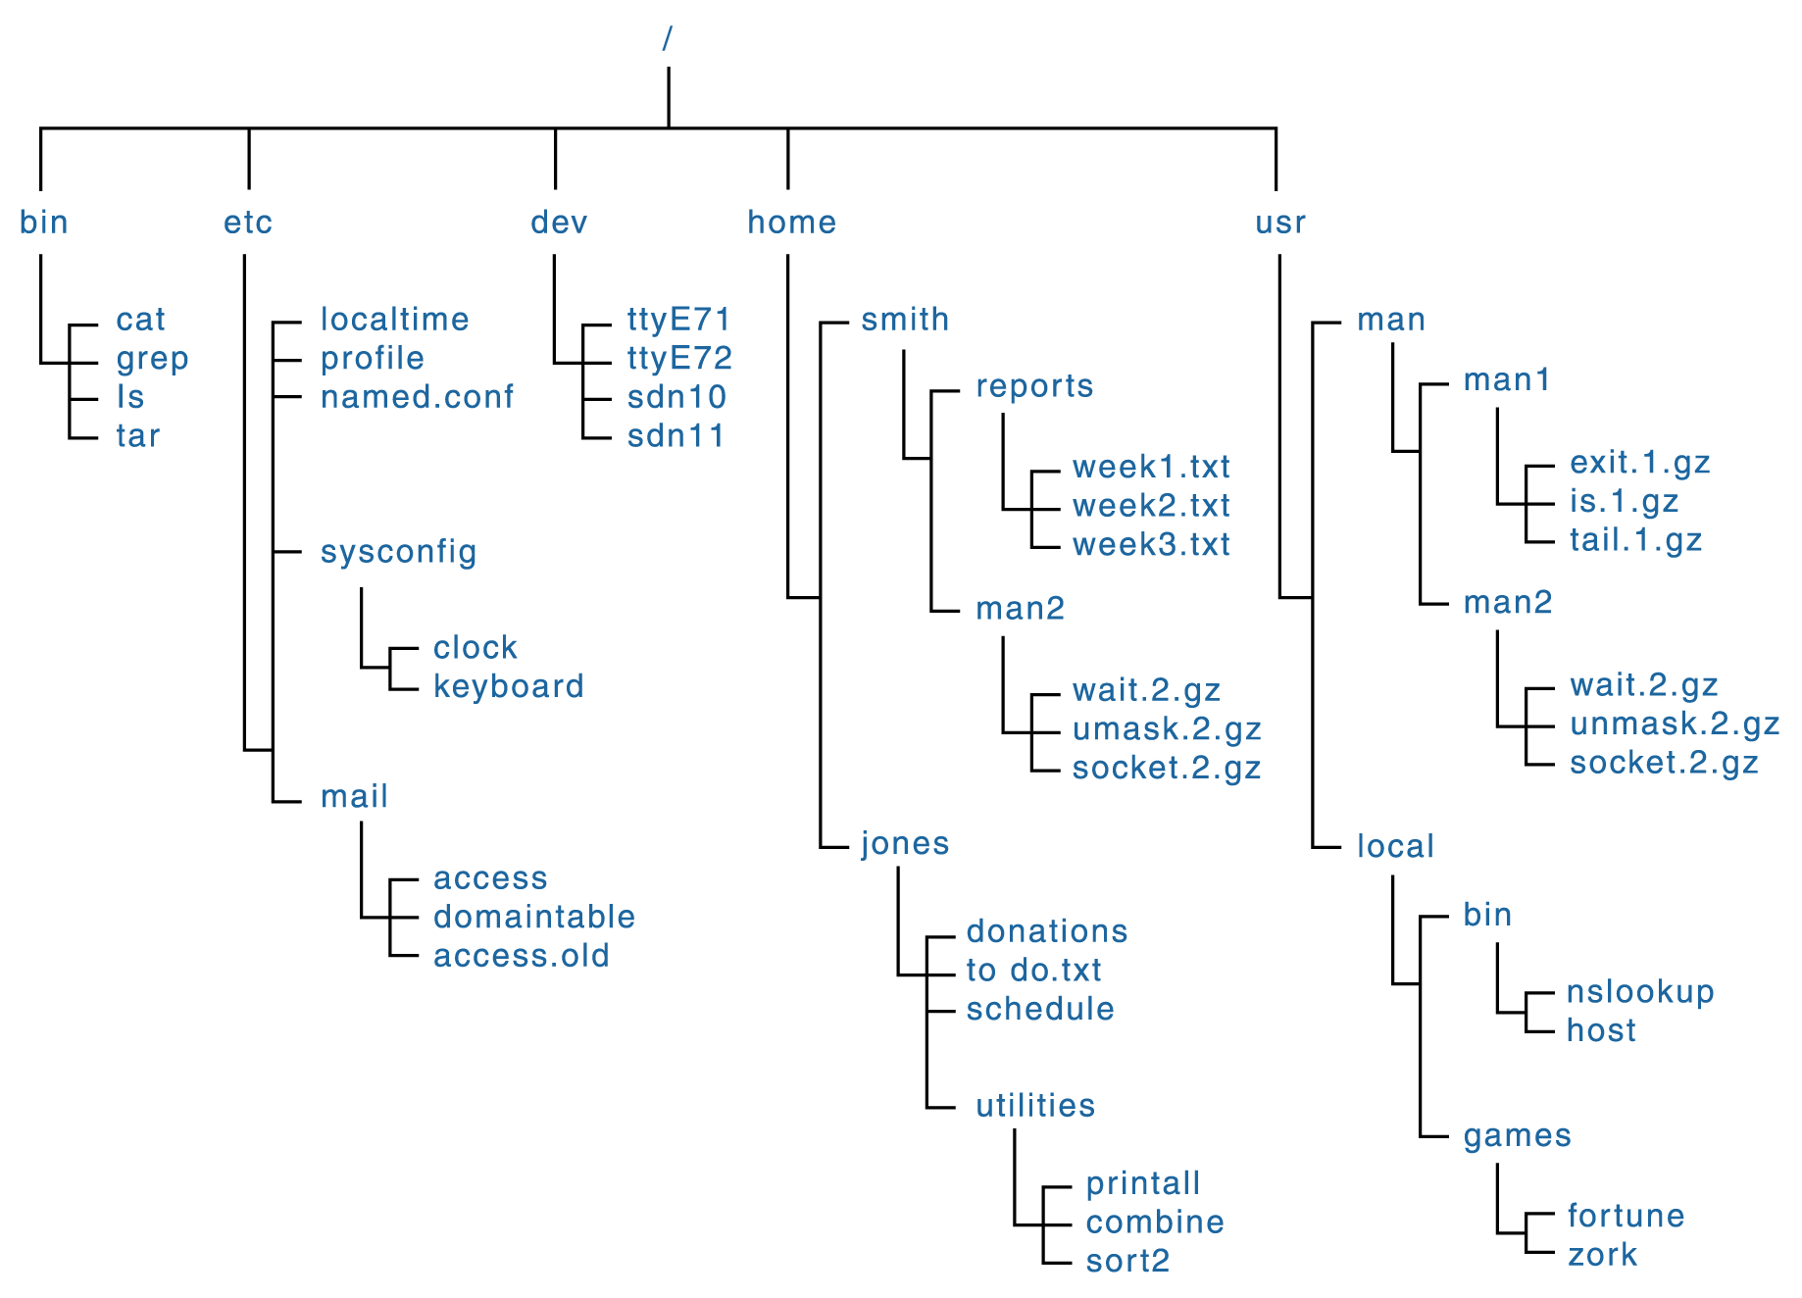
A Unix Directory Tree
Figure 11.5 A UNIX directory tree

Slide 17
Path Names
Path
A text designation of the location of a file or subdirectory in a file system
Absolute path
A path that begins at the root and includes all successive subdirectories
Relative path
A path name that begins at the current working directory

Slide 18
Path Names
Absolute paths
C:\Program Files\MS Office\WinWord.exe
C:\My Documents\letters\applications\vaTech.doc
C:\Windows\System\QuickTime
If current working directory is
C:\My Documents\letters
Relative paths
cancelMag.doc
applications\calState.doc
Distinguish
between
absolute and
relative
paths

Slide 19
11.3 Disk scheduling
p375
Disk scheduling 磁盘调度
The act of deciding which outstanding requests for disk I/O to satisfy first.
Os决定先满足哪个磁盘的I/O请求
Disk scheduling algorithms
First-Come, First-Served (FCFS)
Shortest-Seek-Time-First (SSTF)
最短寻道时间优先
SCAN disk scheduling
SCAN扫描调度

Slide 20
Disk Scheduling
As a computer deals with multiple processes over a period of time, a list of requests to access the disk builds up
Disk scheduling
The technique that the operating system uses to determine which requests to satisfy first

Slide 21
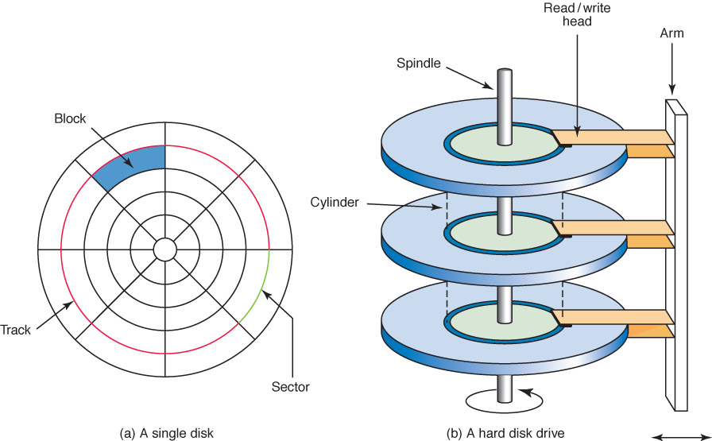
Disk Scheduling
Remember seek time and latency?
Figure 11.5 A magnetic disk drive

Slide 22
Disk Scheduling
First-Come, First-Served (FCFS)
Requests are serviced in the order they arrive, without regard to the current position of the heads
Shortest-seek-time-first (SSTF)
Disk heads are moved the minimum amount possible to satisfy a pending request
Scan
Disk heads continuously move in and out servicing requests as they are encountered
Sound familiar?

Slide 23
Disk Scheduling
Ordered cylinder requests: 49, 91, 22, 61, 7, 62, 33, 35
Read/write heads at Cylinder 26
In what order are they serviced if no more
requests arrive?
FCFS:
SSTF:

Slide 24
Disk Scheduling
SCAN Disk Scheduling works like an elevator
An elevator is designed to visit floors that have people waiting. In general, an elevator moves from one extreme to the other (say, the top of the building to the bottom), servicing requests as appropriate
The SCAN disk-scheduling algorithm works in a similar way, except instead of moving up and down, the read/write heads move in toward the spindle, then out toward the platter edge, then back toward the spindle, and so forth

Slide 25
Disk Scheduling
Ordered cylinder requests: 49, 91, 22, 61, 7, 62, 33, 35
Read/write heads at Cylinder 26 moving toward cylinder 1
In what order are they serviced if no more
requests arrive?
SCAN

Slide 26
Chapter 11 Summary
The chapter explores mainly the organization of files and directories on magnetic disks.
File and file system.
Hierarchical directory tree.
Disk scheduling

